Slide 1


Slide 2
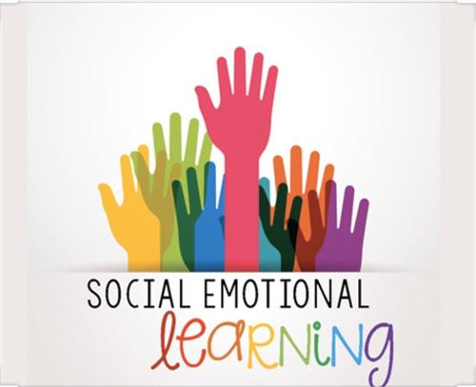

Slide 3
What is Social Emotional Learning?
Social Emotional Learning (SEL) is the process through which children and adults acquire and effectively apply the knowledge, attitudes and skills necessary to understand and manage emotions, set and achieve positive goals, feel and show empathy for others, establish and maintain positive relationships and make responsible decisions.
(Collaborative for Academic, Social, and Emotional Learning (CASEL) )

Slide 4
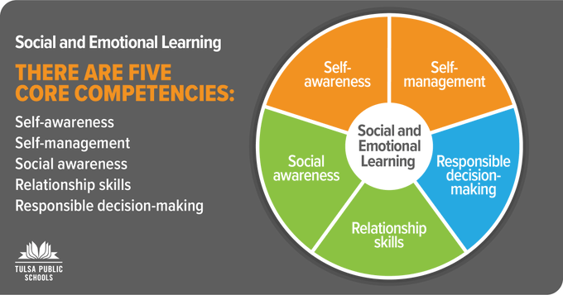

Slide 5
BENEFITS OF SEL
improves group climate;
increases student motivation;
teaches problem-solving skills;
helps students set and meet goals;
teaches study skills and habits;
encourages empathy;
teaches teamwork and collaboration;
improves academic performance;
improves self-regulation skills;

Slide 6
teaches responsible decision-making;
increases personal self-awareness;
encourages perseverance and resilience;
improves confidence;
improves relationship skills;
improves attendance;
creates a feeling of community.

Slide 7

Some ways to incorporate SEL in the classroom

Slide 8
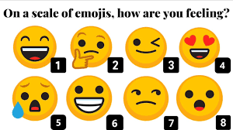
1
Start your class with a personalized greeting and have regular check-ins

Slide 9
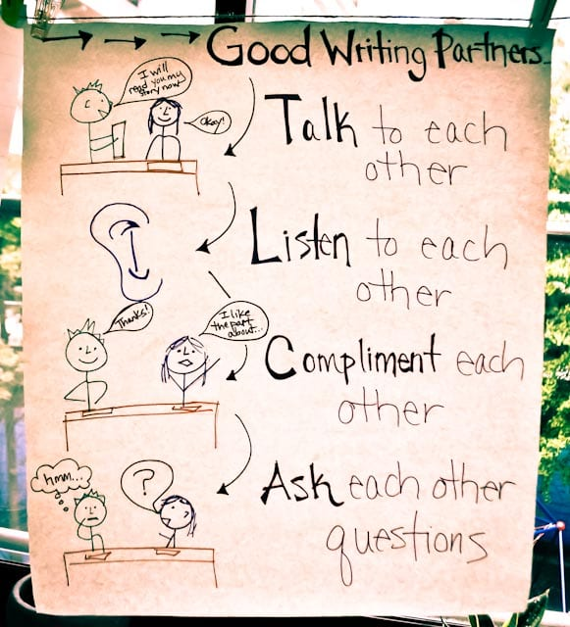
2
Do lots of partner activities

Slide 10

3
Encourage debate

Slide 11

4
Assign groupwork

Slide 12
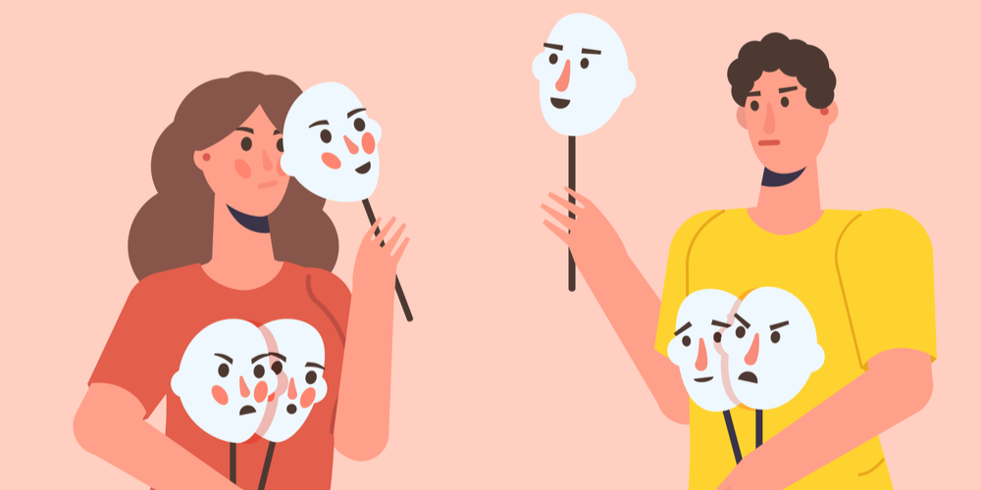
5
Practice lots of role-playing

Slide 13

6
Teach Listening

Slide 14

7
Focus on Positive Self-Talk

Slide 15

8
Teach students to monitor their own progress

Slide 16

9
Recognize each student

Slide 17
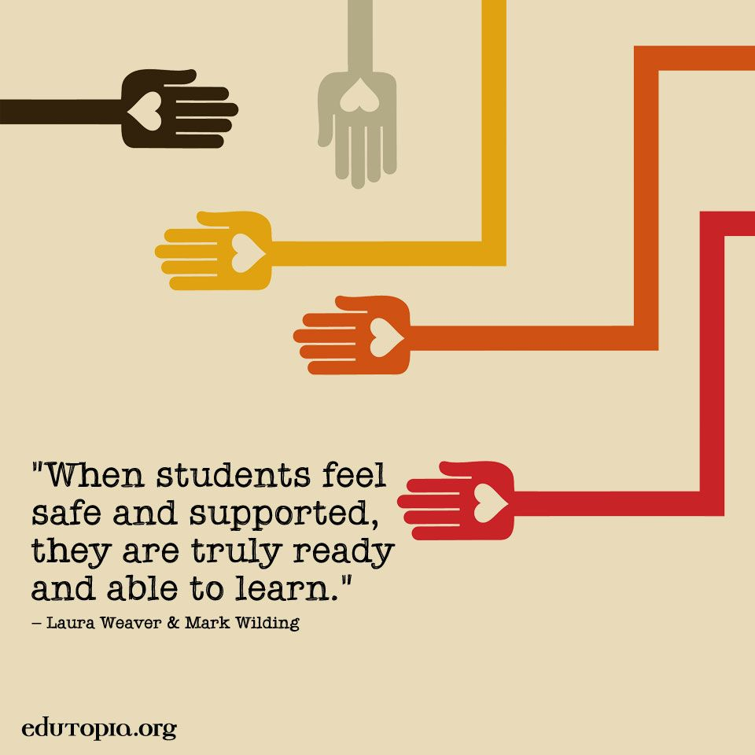

Slide 18

THANK YOU!

