Slide 1
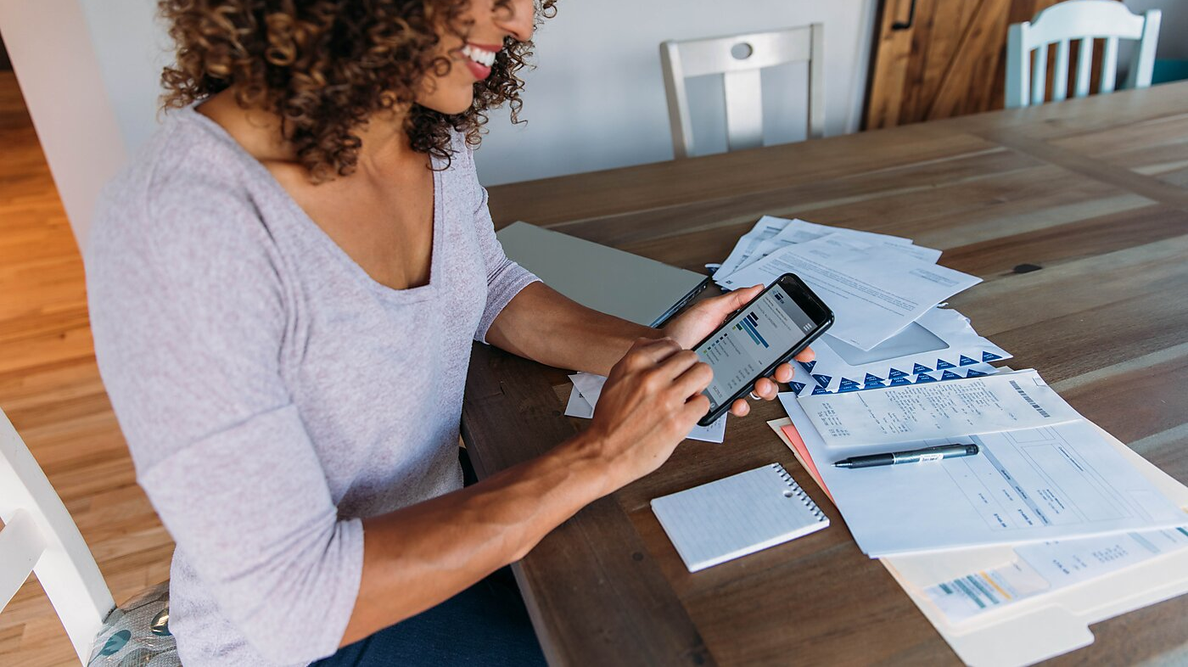
NEW BUSINESS. CHASING PAYMENT.
Created by Iryna Zhukevych
PhD in Pedagogical Sciences
Associate Professor
Це фото; автор: Невідомий автор; ліцензія: CC BY-SA-NC

Slide 2
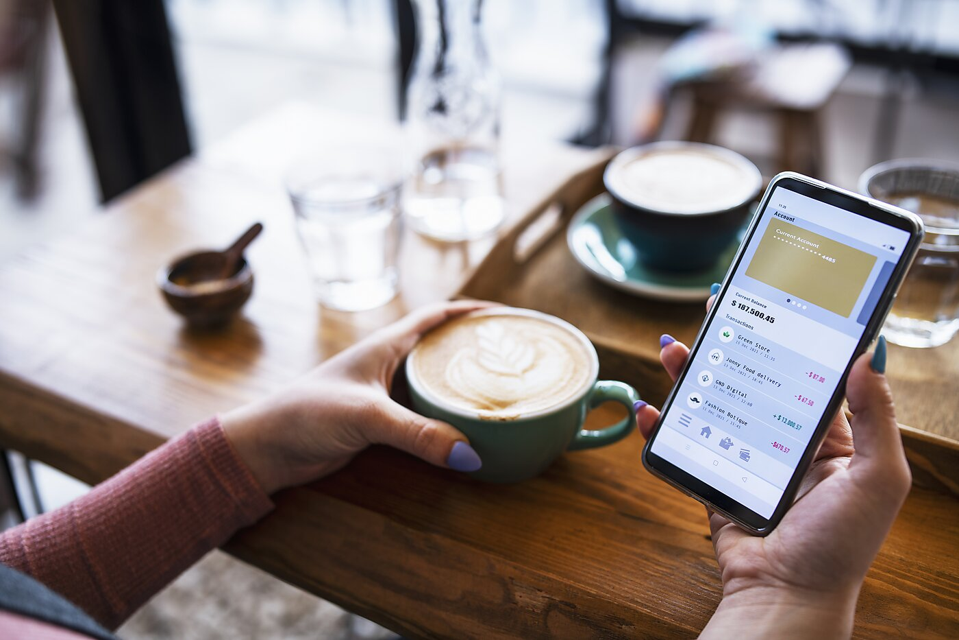
Vocabulary activities
https://quizlet.com/ua/1035726616/chasing-payments-flash-cards/
Це фото; автор: Невідомий автор; ліцензія: CC BY-SA-NC

Slide 3
Fill in the blanks in the following sentences using the most appropriate word from the Quizlet vocabulary.
Despite several polite reminders, the client still has an ______ of €500.
After three months of non-payment, their account is now considered a _______.
We need to ________our records with the bank statements to identify any missing payments.
The contract clearly states the __________, which include payment within 30 days.
If the payment is not received within seven days, we will have no choice but to ______ the matter to our legal department.
The finance team is responsible for sending out a monthly ___________ to all clients.
The repeated failure to pay on time has become a real _______ in our business relationship.
We had to ___________ the late payment fee as a gesture of goodwill.
The international ___________ of funds can sometimes take longer than domestic transfers.
Despite our best efforts to ___________ the debt, the client has gone into liquidation.

Slide 4
Rewrite the following sentences using a different vocabulary item from the list while maintaining the original meaning.
We need to ask the client again about the overdue invoice. (Use: follow up)
The amount owed should have been paid last month. (Use: arrears)
They always give us excuses when we ask for the money. (Use: fobbed off)
We need to get back the money that is owed to us. (Use: recover)
The company decided to cancel the uncollectible debt. (Use: write-off)

Slide 5

Imagine you are a credit controller for a medium-sized company.
Discuss how you would handle the following scenarios, using vocabulary from the list:
Scenario A: A client who is 60 days past their payment due date and hasn't responded to your emails.
Scenario B: A new client is requesting extended payment terms.
Scenario C: There is a €15 discrepancy between your records and the client's reported payment.

Slide 6
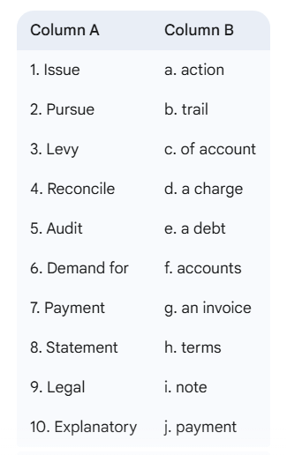
Match the words in Column A with the words in Column B to form common collocations related to chasing payments.

Slide 7
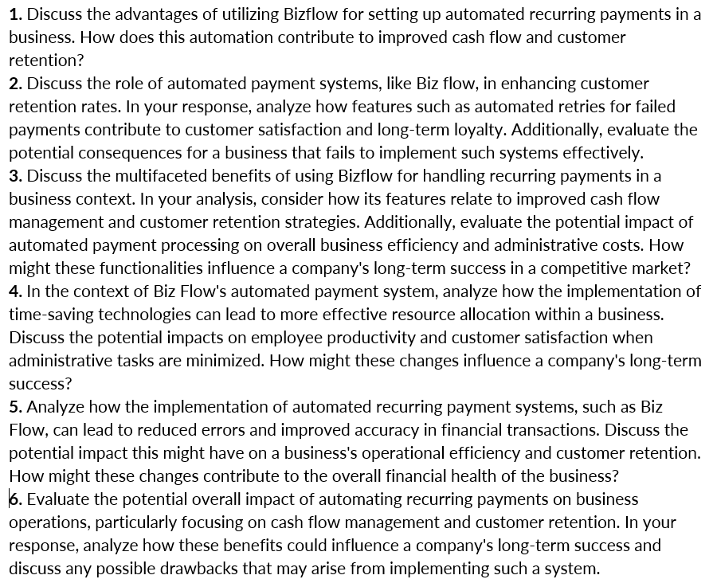
Video
“Tired of Chasing Payments?”
https://www.youtube.com/watch?v=0EkpT3eLd5w

Slide 8

Scenario 1: The Delayed Invoice
You work for a small graphic design company. You completed a website design for a client three months ago, and the invoice for €500 is still unpaid. You've sent two reminder emails but haven't received a response.
Discuss:
What could be the reasons for the delayed payment?
What steps should your company take next to get the payment?
What are the potential risks of being too aggressive or too passive in this situation?
How important is maintaining a good relationship with the client, even when they haven't paid?

Slide 9
Scenario 2: The Disputed Service
You run a freelance translation service. You translated a large document for a new client who is now refusing to pay the full amount. They claim that there were several errors in your translation, although they didn't specify them initially.
Discuss:
How would you handle this situation with the client?
What evidence would you need to support your claim that the translation was accurate?
What are your rights as a freelancer in this situation?
What could you have done differently at the beginning of the project to prevent this issue?

Slide 10

Scenario 3: The Unexpected Financial Difficulty
You manage a small bookstore. One of your regular customers, a local school, placed a large order for books at the beginning of the term. Now, they've contacted you saying they are experiencing unexpected financial difficulties and can only pay half of the agreed amount for now, promising the rest later.
Discuss:
How would you react to this news?
What factors would you consider when deciding how to respond to the school's situation?
What are the potential long-term consequences of offering them a discount or a delayed payment plan?
How can small businesses protect themselves against such situations?

Slide 11

Scenario 4: The International Client
You sell handmade crafts online and recently shipped a large order to a customer in another country. The customer received the goods two weeks ago but hasn't paid yet. You've tried contacting them via email, but they are not responding.
Discuss:
What are the additional challenges of chasing payment from an international client?
What payment methods could have been used to minimize this risk?
What are your options for pursuing the payment from overseas?
How does cultural communication potentially play a role in such situations?

