Slide 1
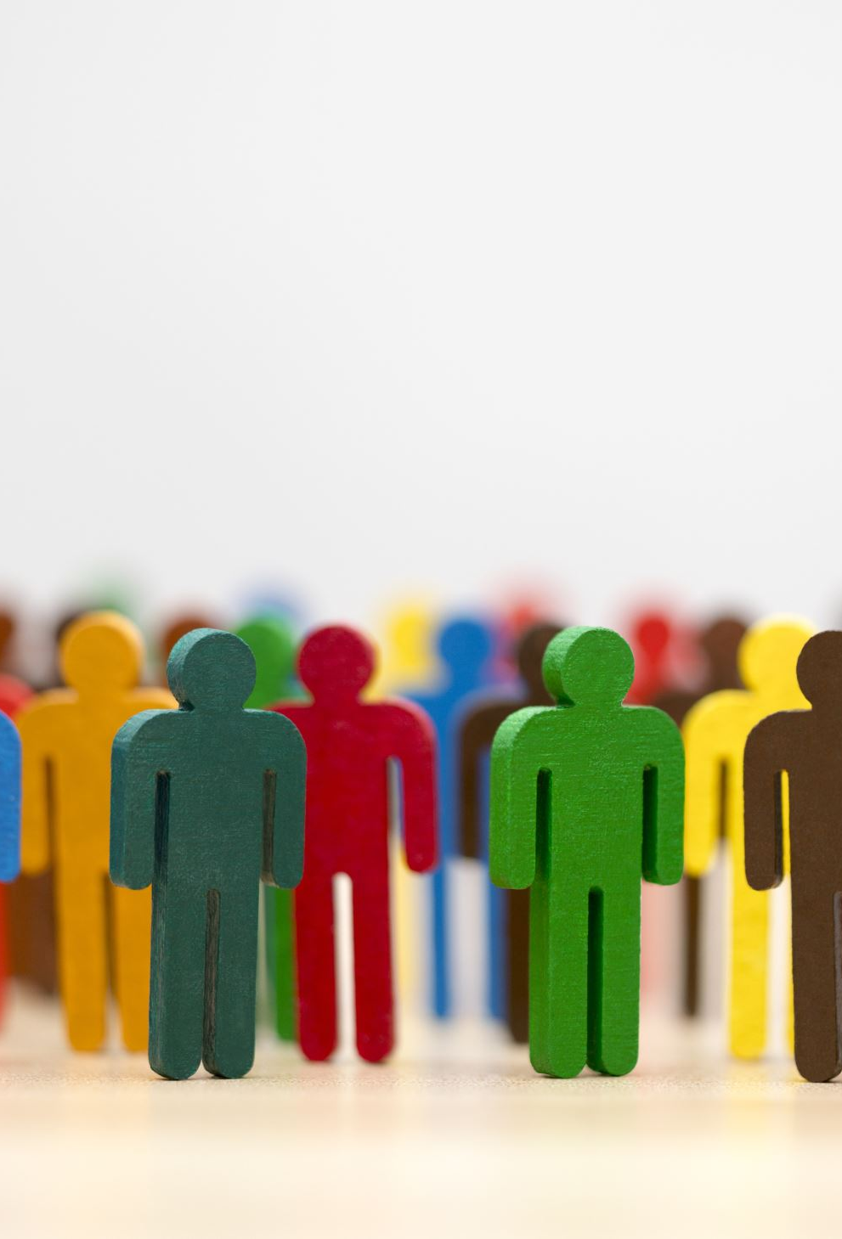
Emotions:
People Watchers
Created by Iryna Zhukevych
PhD in Pedagogical Sciences
Associate Professor

Slide 2
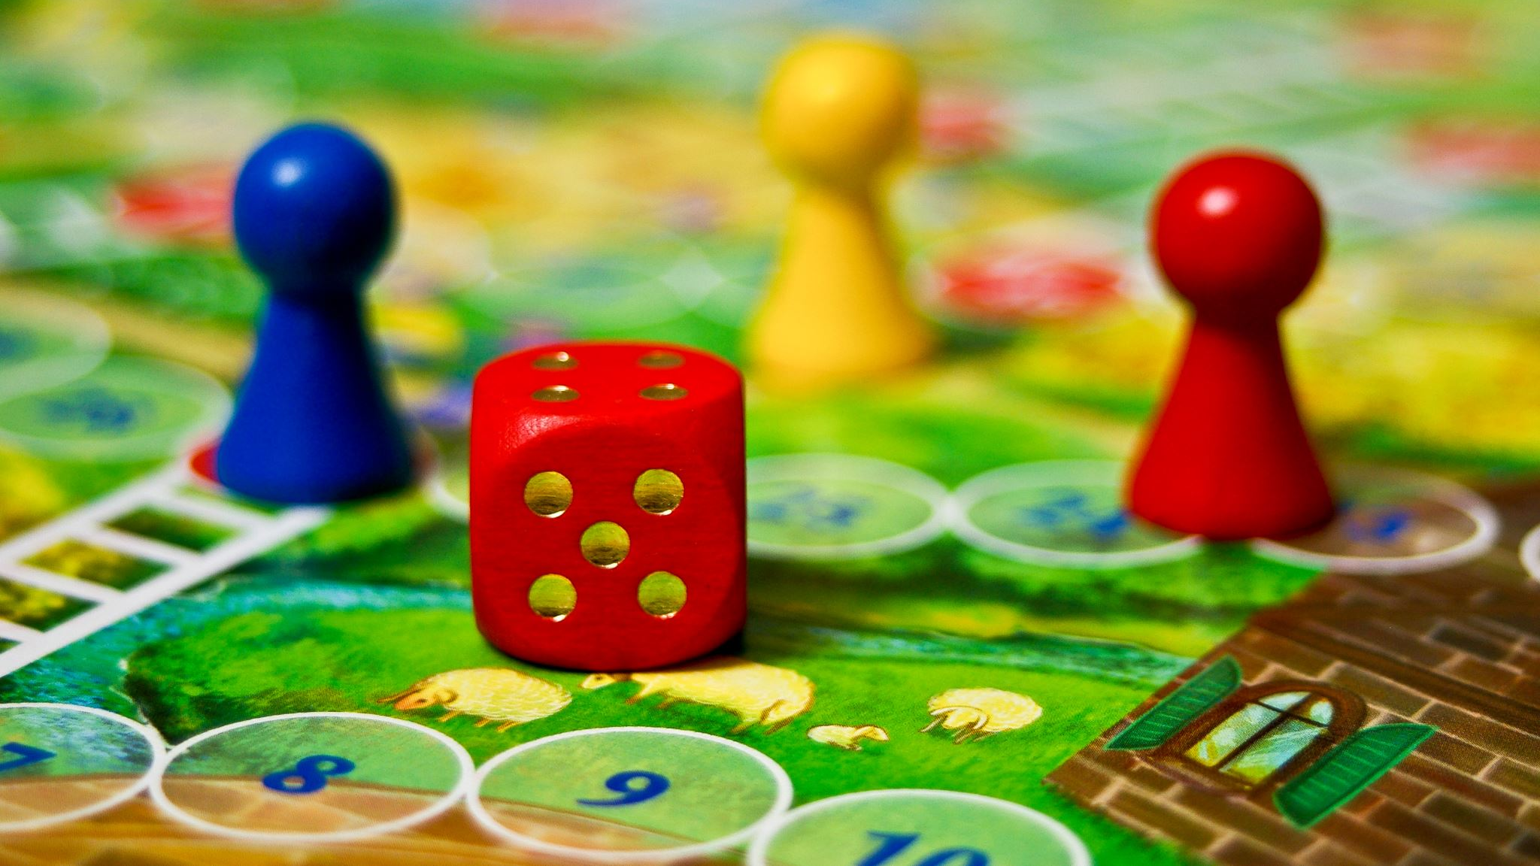
Let’s play a game “Emotions”
https://wordwall.net/resource/78369796/emotions-c1

Slide 3
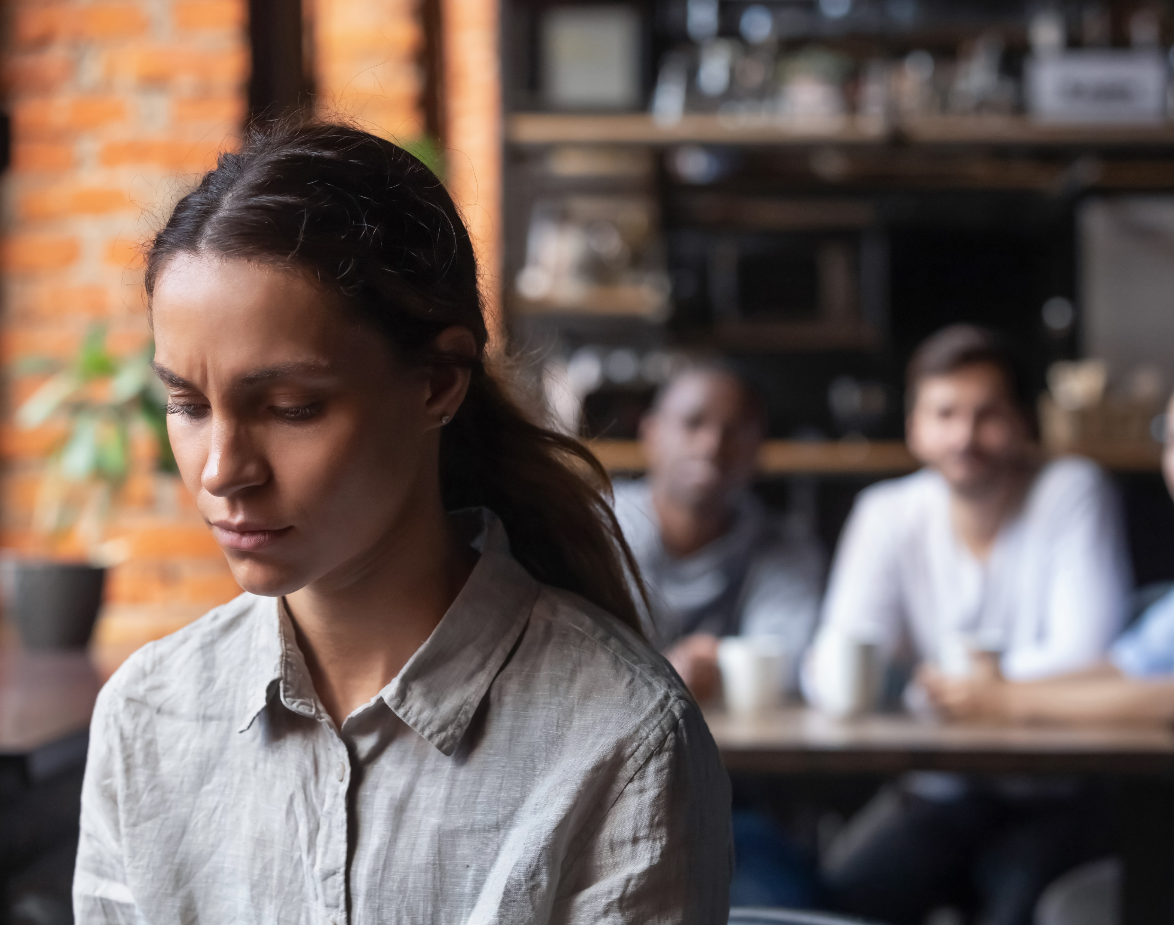
Do you like to observe people, their behavior, emotions and how they express their feelings? Why? / Why not?

Slide 4
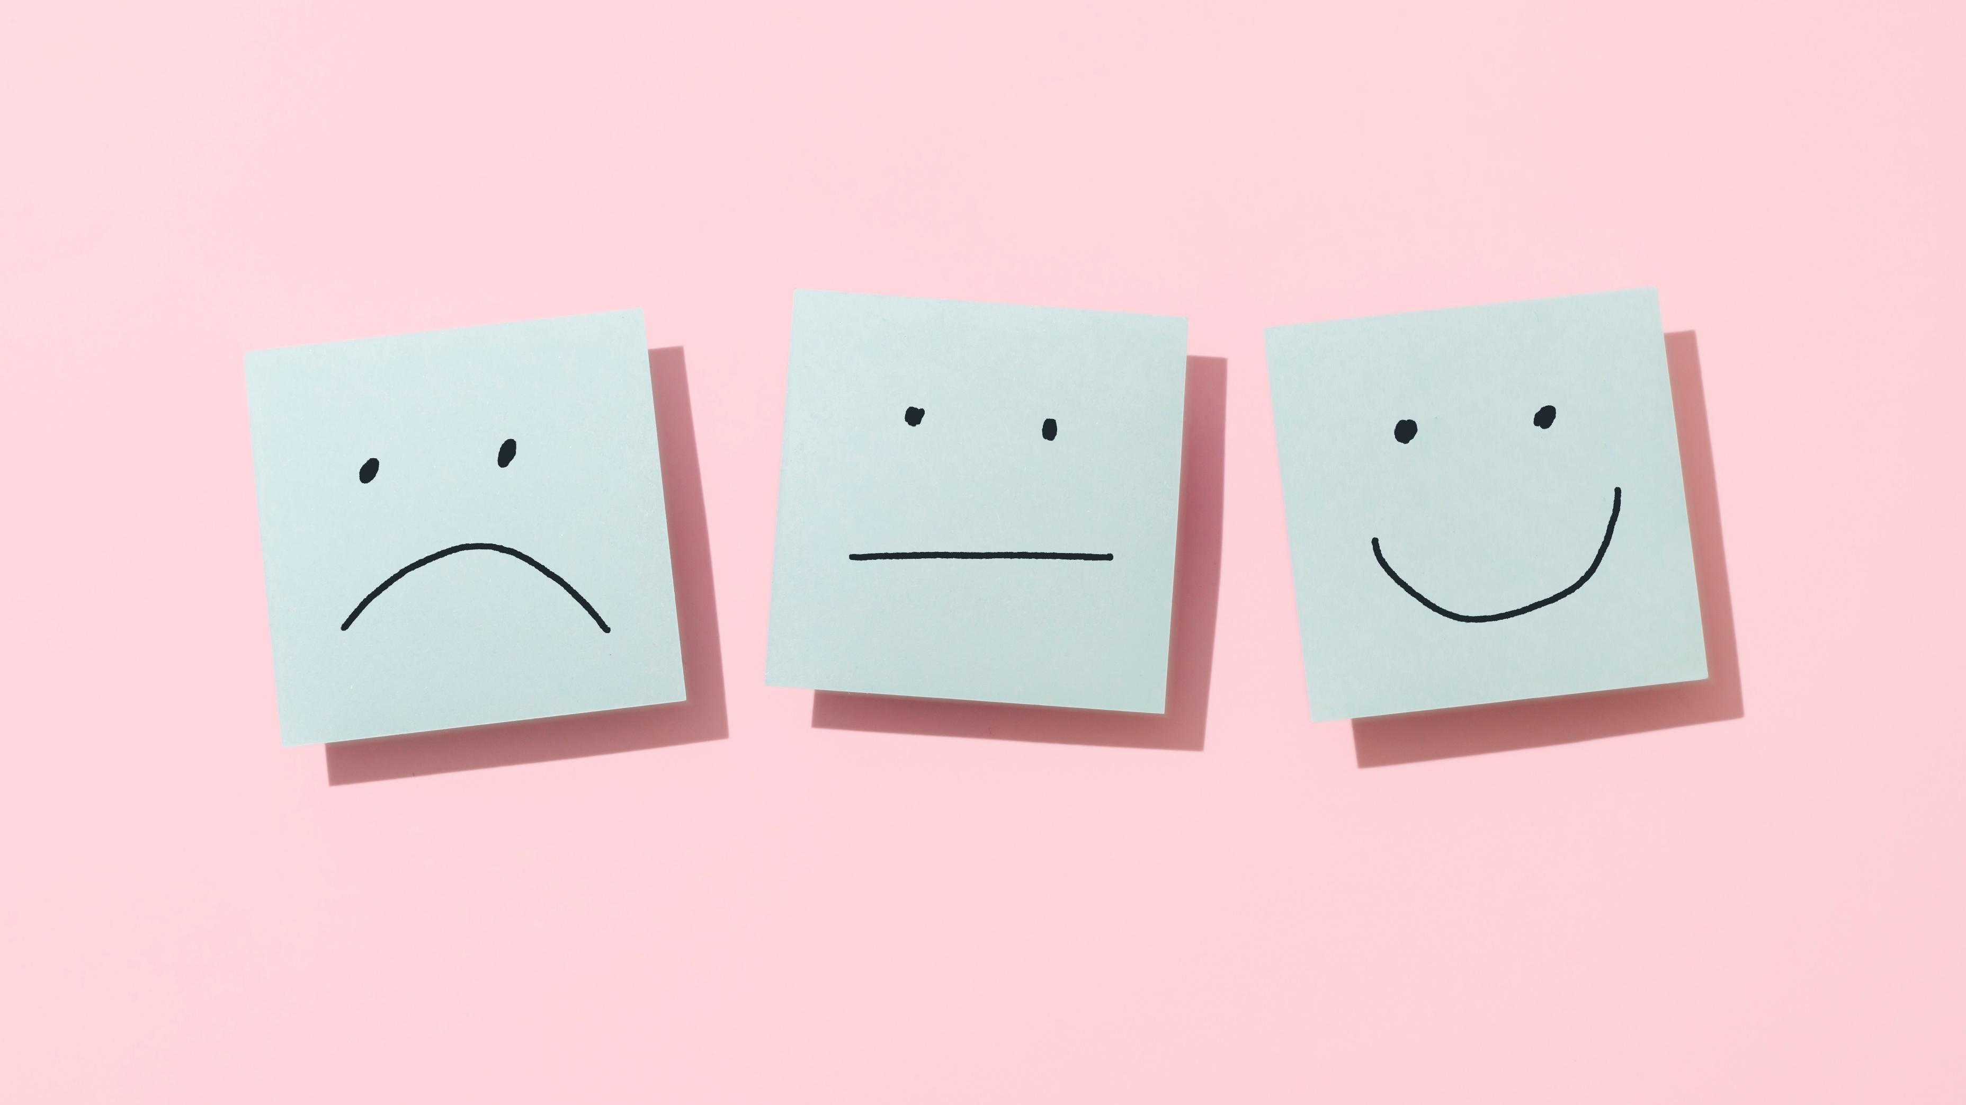
Discuss the importance of respecting and understanding others' emotions, even if they differ from ours.

Slide 5

Describe a character (a person you know well) who experiences different emotions

Slide 6
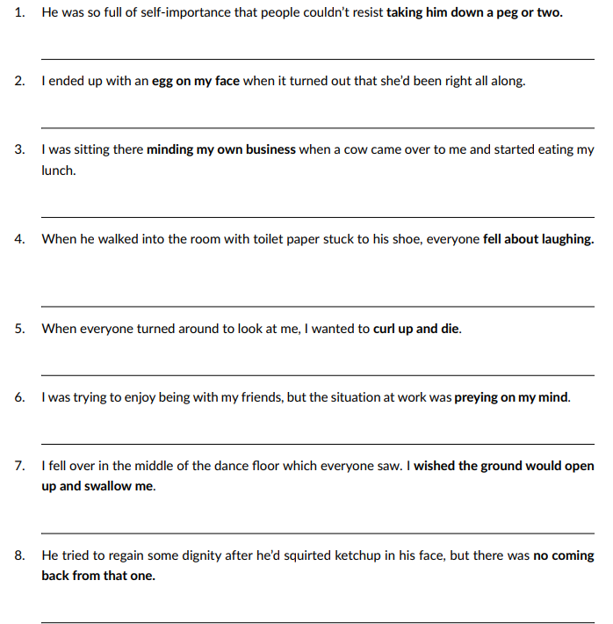
Focus on idioms.
For each of the following sentences, write the meaning of the words in bold.

Slide 7
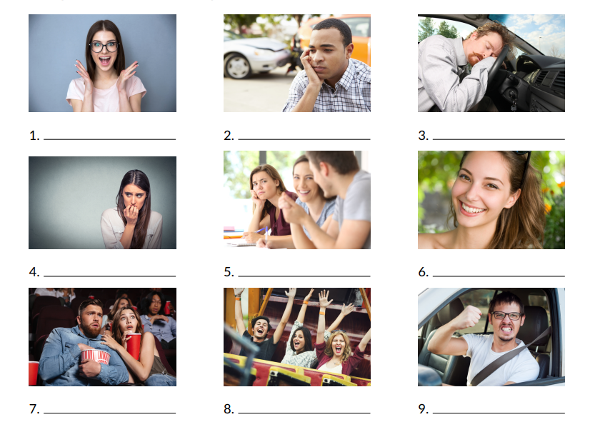
Describe what the people in each picture are feeling.

Slide 8

Watch the video about a girl who feels different emotions https://www.youtube.com/watch?v=nEUzQ7yL9A0&t=7s
After watching the video say how you feel when you find yourself in the situations presented in the video.

Slide 9
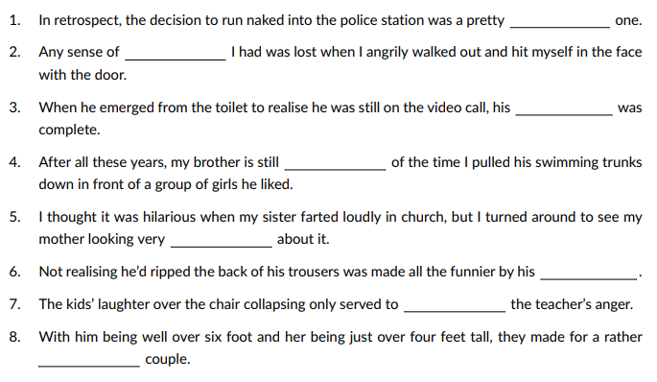
Complete the following sentences with the vocabulary from a game.
You may need to change the form of the word. a) exacerbate (v) b) incongruous (adj.) c) resentful (adj.) d) foolish (adj.) e) po-faced (adj.) f) humiliation (n) g) dignity (n) h) self-importance (n)

Slide 10
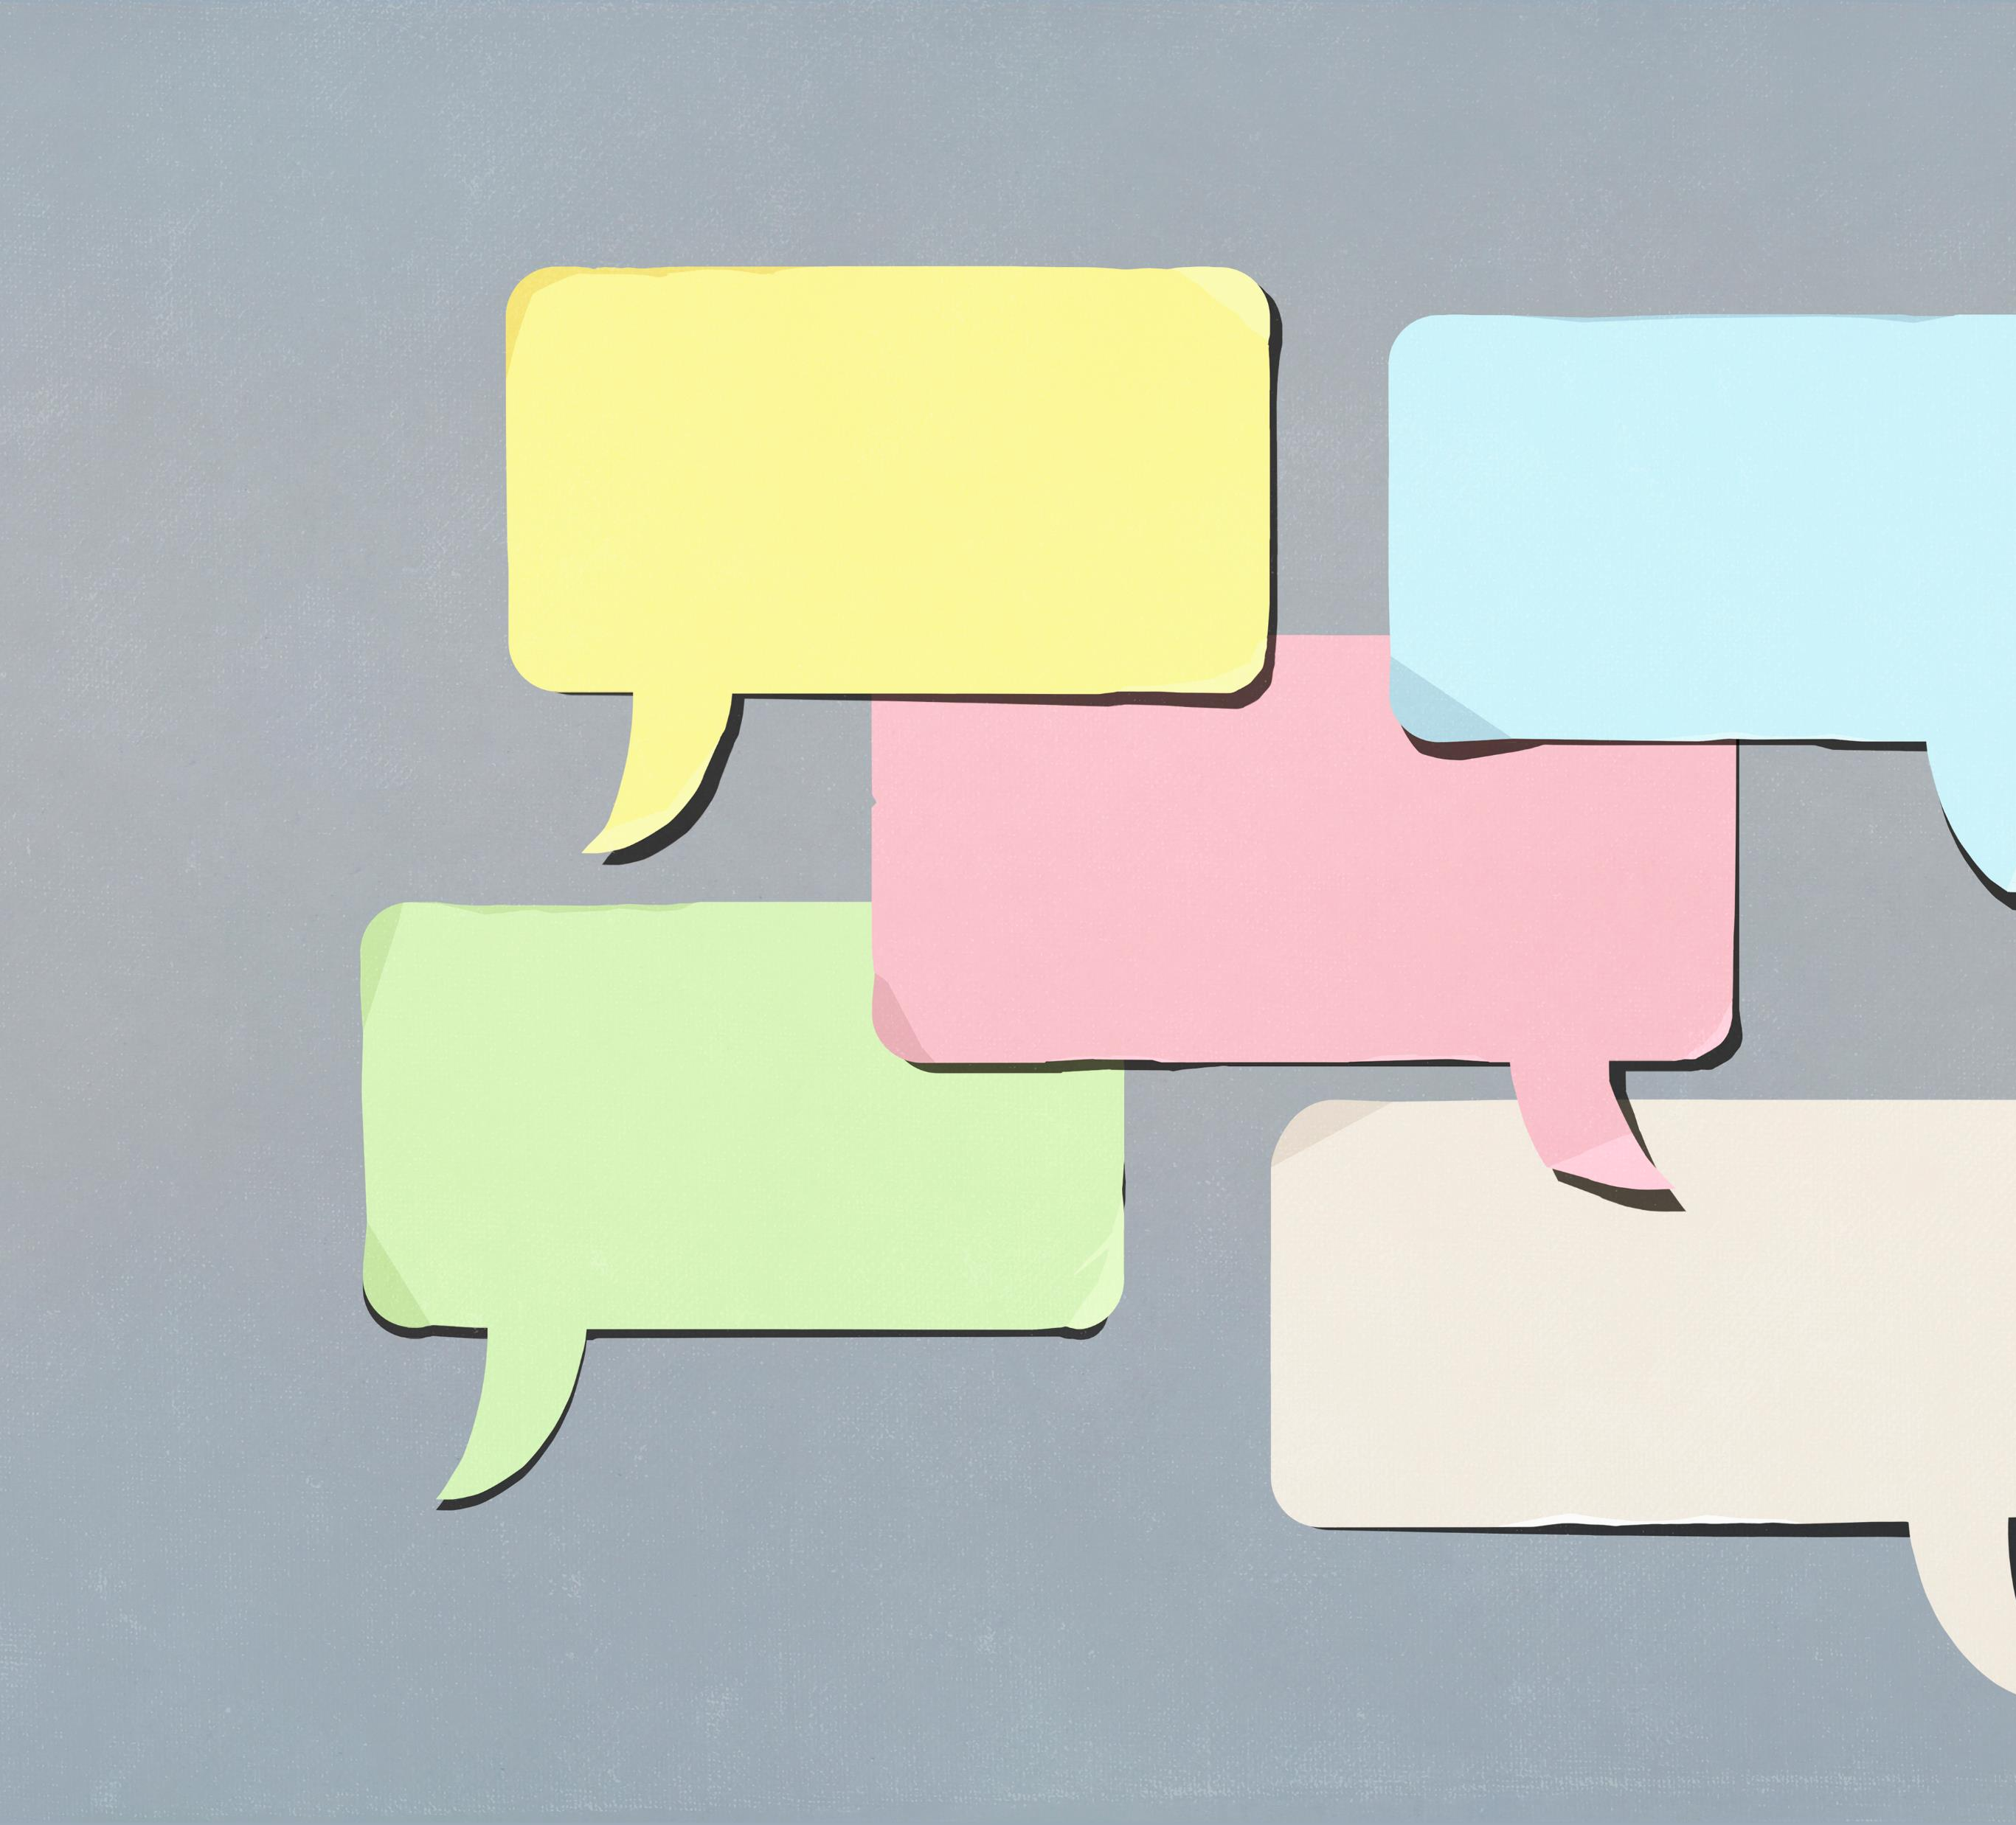
Let’s play a game. Speaking Cards
https://wordwall.net/resource/78388220/embarrassing-situations

