Slide 1

Introduction to Legal Systems: Comparative Analysis of Legal Systems.
Crated by Iryna Zhukevych
PhD in Pedagogical Sciences
Associate Professor
Це фото; автор: Невідомий автор; ліцензія: CC BY-SA

Slide 2

Watch the video and answer the questions below https://www.youtube.com/watch?v=9_M4bNOxsYs
What are the key characteristics of the common law system as described in the video?
How does the role of a judge differ in common law systems compared to civil law systems?
Explain the significance of judicial precedent in the common law system.
Describe the inquisitorial approach of civil law trials and how it contrasts with adversarial trials.
What are the primary sources of law in both common law and civil law systems, according to the video?

Slide 3
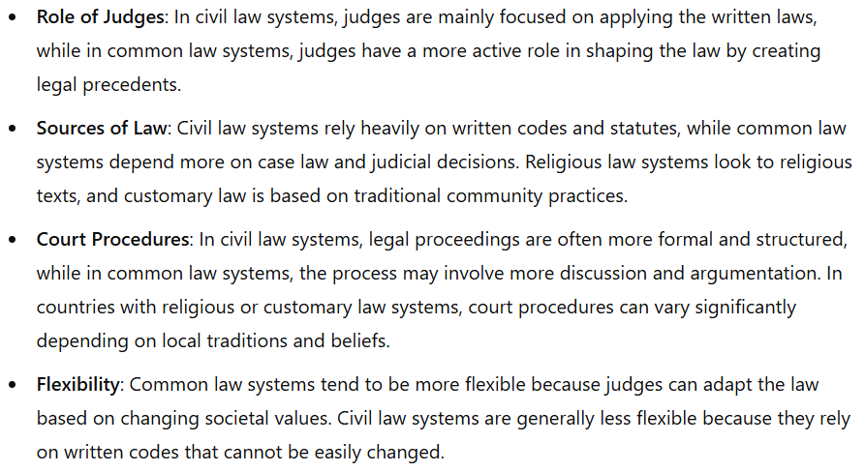
Key Differences in Legal Systems

Slide 4
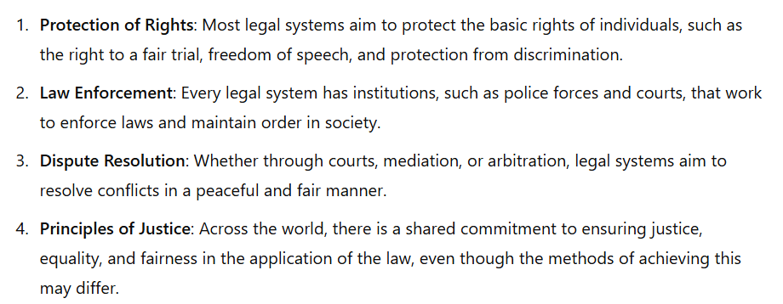
Similarities Across Legal Systems

Slide 5
Watch the video
“What is the difference between Common and Civil Law”? https://www.youtube.com/watch?v=gm5v9Tf0W2U&t=60s

Slide 6
Decide if the sentence is True or False.
1. The quote "the power of the lawyer is in the uncertainty of the law" applies to both common law and civil law systems.
2. In civil law systems, case law is considered the primary source of law.
3. Judges in a common law system have a greater role in shaping the law compared to judges in a civil law system.
4. Civil law is often referred to as code law because it relies on codified statutes.
5. The legal tradition of common law systems has developed primarily through statutory legislation rather than judicial decisions.
6. In civil law systems, judges act mainly as investigators who apply existing laws rather than create them.
7. Lawyers in common law systems do not have to convince a jury as part of their role in court.
8. The doctrine of stare decisis is a key feature of the common law tradition.
9. Common law systems prevent anyone from preparing legal documents unless they are fully licensed lawyers.
10. The origins of civil law can be traced back to the legal reforms of Emperor Justinian.

Slide 7

Let’s compare legal systems in different countries and highlight the similarities and differences. Include information on:
The type of legal system the country uses (Civil Law, Common Law, Religious Law, or Customary Law)
How judges make decisions
The sources of law
The role of legal institutions (courts, police, etc.)
The protection of individual rights

Slide 8

Country: Germany
(Civil Law System)
Legal System: Civil law, based on the Bürgerliches Gesetzbuch (BGB) code.
Judges: Apply the written law and have limited discretion to interpret it.
Sources of Law: Codified laws and statutes.
Role of Legal Institutions: Courts are responsible for interpreting the law strictly according to written codes. Police enforce laws.
Protection of Rights: The Constitution (Basic Law) guarantees fundamental rights like freedom of speech and privacy.

Slide 9

Country: United Kingdom (Common Law System)
Legal System: Common law, where judicial precedents play a large role.
Judges: Judges interpret past case law to make decisions and may create new precedents.
Sources of Law: Case law, statutes, and legal principles from previous rulings.
Role of Legal Institutions: Courts interpret the law, and police ensure its enforcement.
Protection of Rights: Human rights are protected through the Human Rights Act (based on the European Convention on Human Rights).

Slide 10

Country: Saudi Arabia (Religious Law System)
Legal System: Religious law, specifically Sharia Law.
Judges: Judges interpret Islamic religious texts, such as the Quran and Hadith, to make rulings.
Sources of Law: Quran, Hadith, and Islamic legal principles.
Role of Legal Institutions: Religious scholars play a large role in shaping legal interpretations. Courts enforce these religious rulings.
Protection of Rights: While rights are guaranteed in the Quran, the interpretation can vary, and some rights (such as women's rights) may be more restricted compared to other legal systems.

