Slide 1

Financial Institutions
Created by Iryna Zhukevych
PhD in Pedagogical Sciences
Associate Professor
Це фото; автор: Невідомий автор; ліцензія: CC BY-ND

Slide 2

Financial Institutions | The Different Types and How they Work
https://www.youtube.com/watch?v=3Ejk-F4t7L8

Slide 3
Fill in the blank with the correct words.
Commercial banks
Raise capital
Insurance
Banks
Capital
____ are financial institutions that accept deposits from the public and create credit.
Investment banks specialize in helping companies ____ by issuing stocks and bonds.
____ institutions offer services like insurance and pension funds.
Credit unions are member-owned financial cooperatives that provide services similar to ____.
____ markets facilitate the issuance and trading of financial instruments like stocks and bonds.

Slide 4
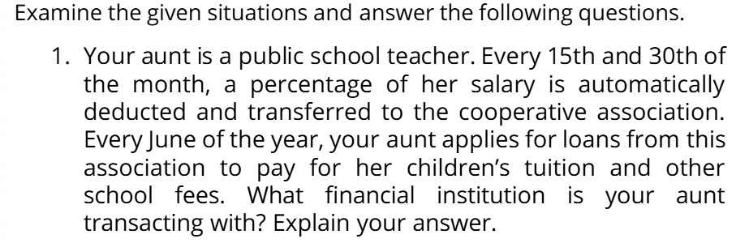

Slide 5
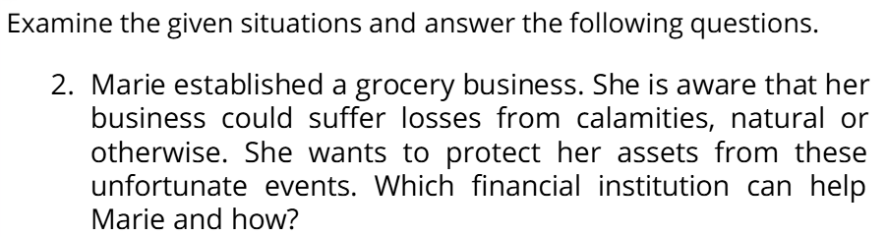

Slide 6
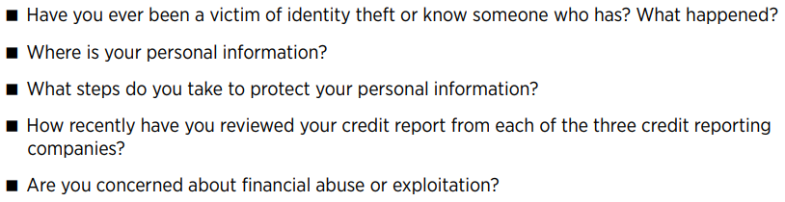

Slide 7

Practice vocabulary and listening skills
https://theenglishflows.com/lesson-plans/insurance/pre-class-activities/

Slide 8
Questions
Question 1.
In our community, financial institutions like banks and credit unions play a crucial role in managing personal and business finances, offering services such as loans, savings accounts, and investment opportunities. Considering the significance of these institutions in promoting economic growth and stability, how would you assess the impact of financial institutions on individual financial literacy and economic decision-making in your local context?

Slide 9
Question 2. Discuss the role of financial institutions in the local economy, focusing on how they facilitate access to credit for small businesses while incorporating principles from economics and social studies to explain the broader impact on community development.

Slide 10
Question 3. Imagine you are planning to open a small food truck business in your local community. To get started, you will need to secure funding for your venture. Consider the roles of different financial institutions, such as banks, credit unions, and community development financial institutions (CDFIs). Which type of financial institution would be the most suitable for your startup, taking into account aspects like interest rates, loan terms, and the support they provide for local businesses?
(A) Online Loan Providers
(B) Peer-to-Peer Lending Platforms
(C) Traditional Banks
(D) Venture Capital Firms
(E) Community Development Financial Institutions (CDFIs)

