Slide 1
SPECIALIZED CORPORA COMPILING IN RESPONSE TO EDUCATIONAL REQUIREMENTS OF MODERN STUDENTS
Prepared by: Hanna Kolosova and Olha Narodovska

Slide 2
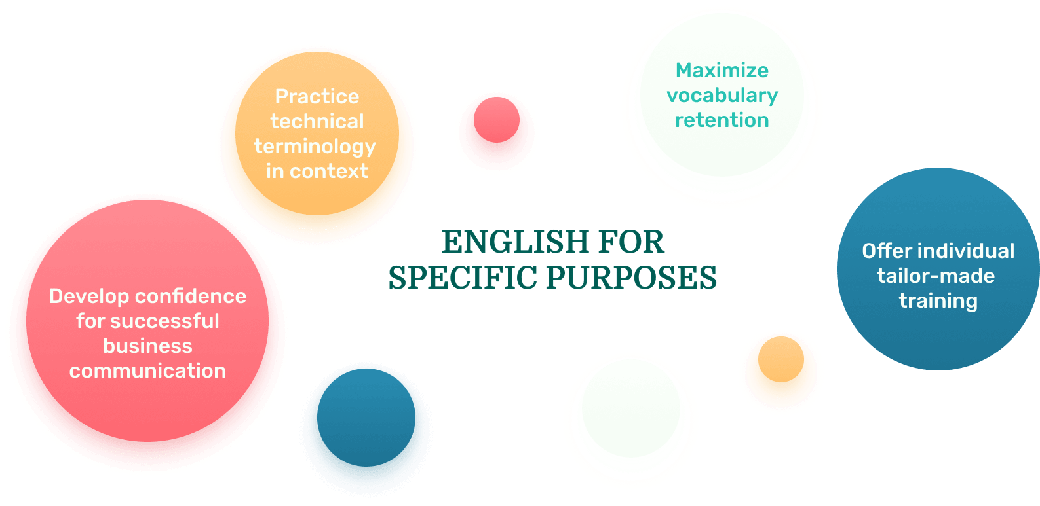
English for Specific Purposes

Slide 3
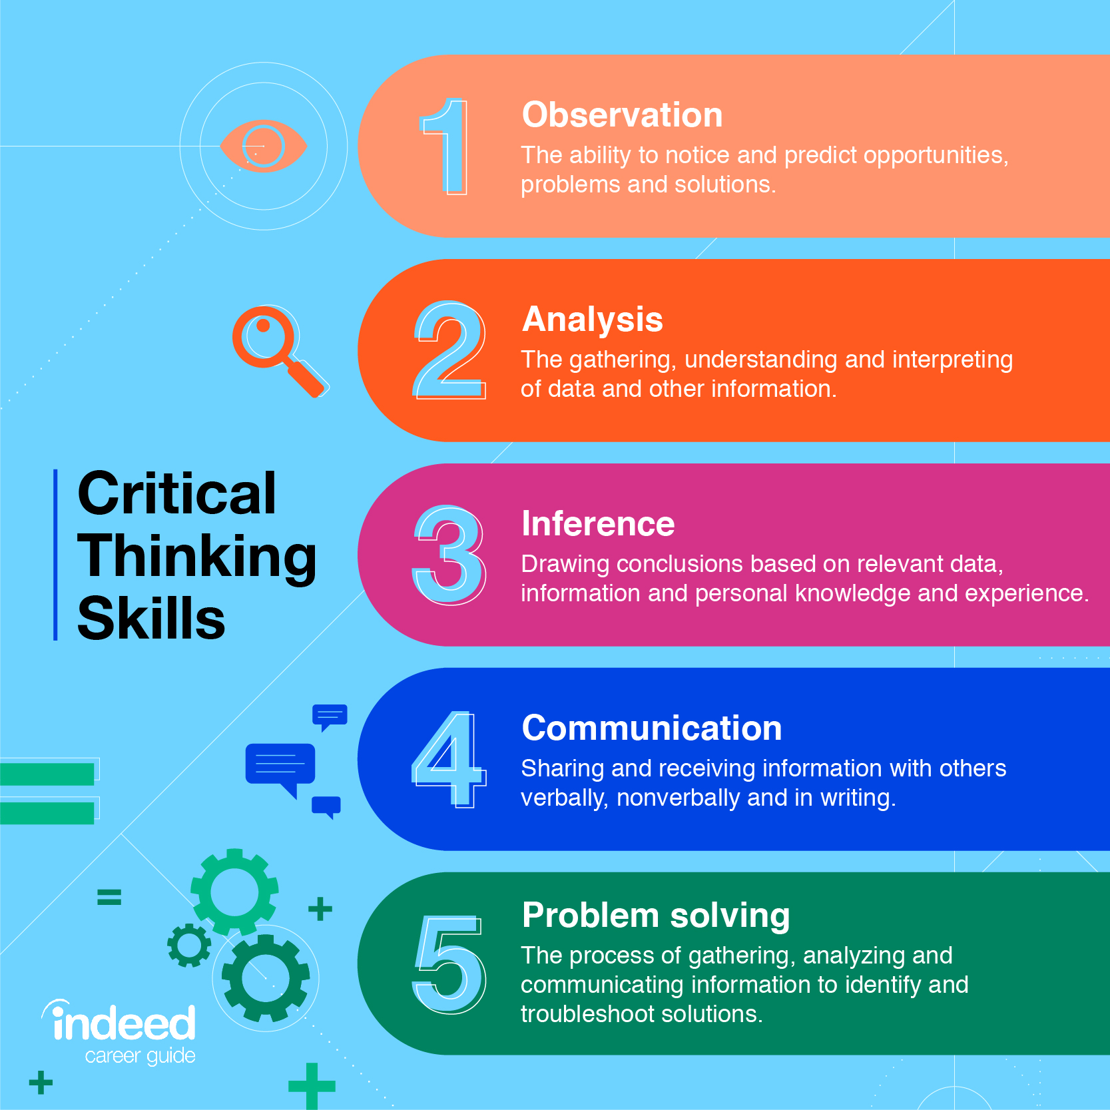
Additional benefits of student’s development

Slide 4
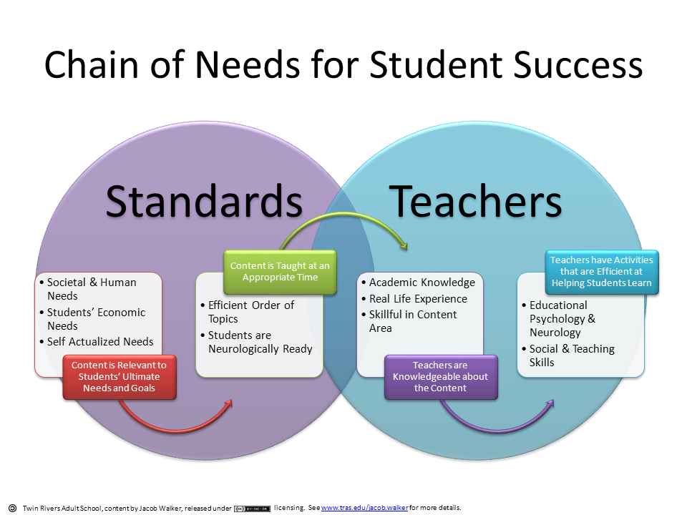

Slide 5
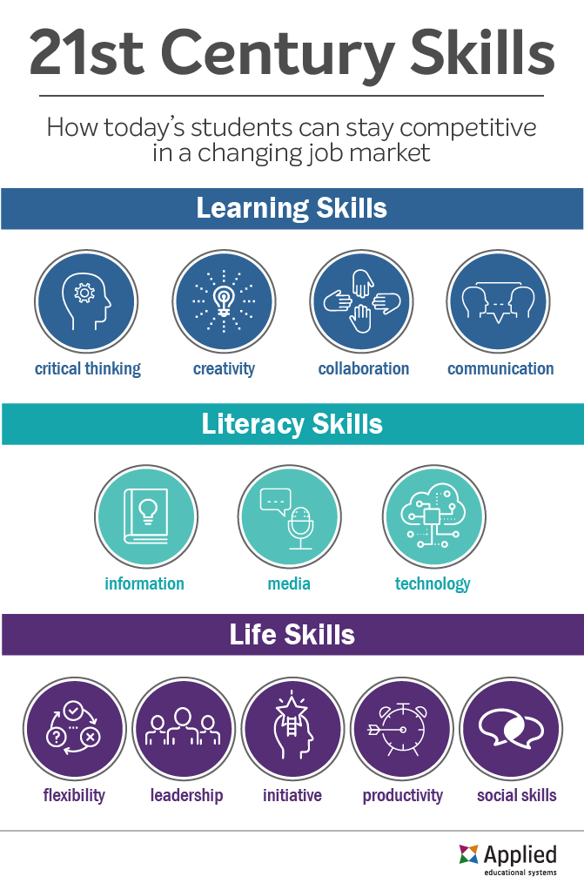
Any modern student is expected to:

Slide 6
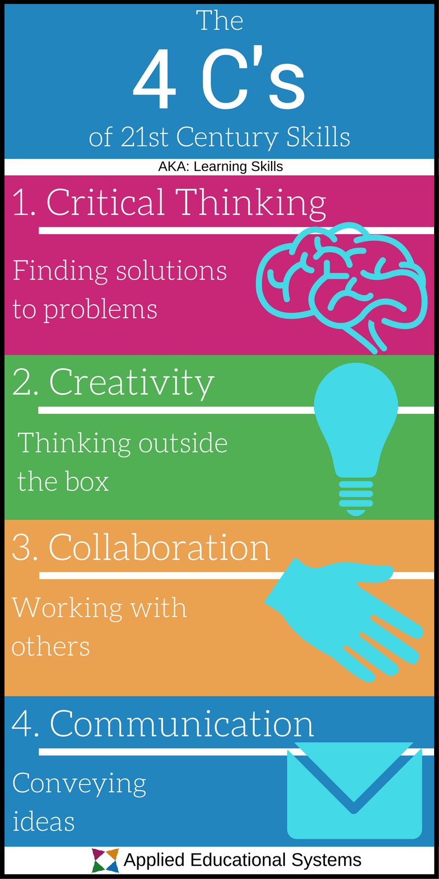
A psychological portrait of
a 21st-century student
They like to control, but they don't want to be tied to
a regular schedule
They like to have a choice
They are ready to cooperate
They are inclusive
They use digital technologies
They think differently
They are more likely to take risks
They value free time

Slide 7
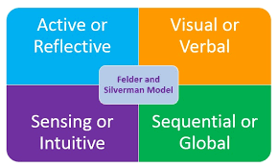
Students perception types

Slide 8
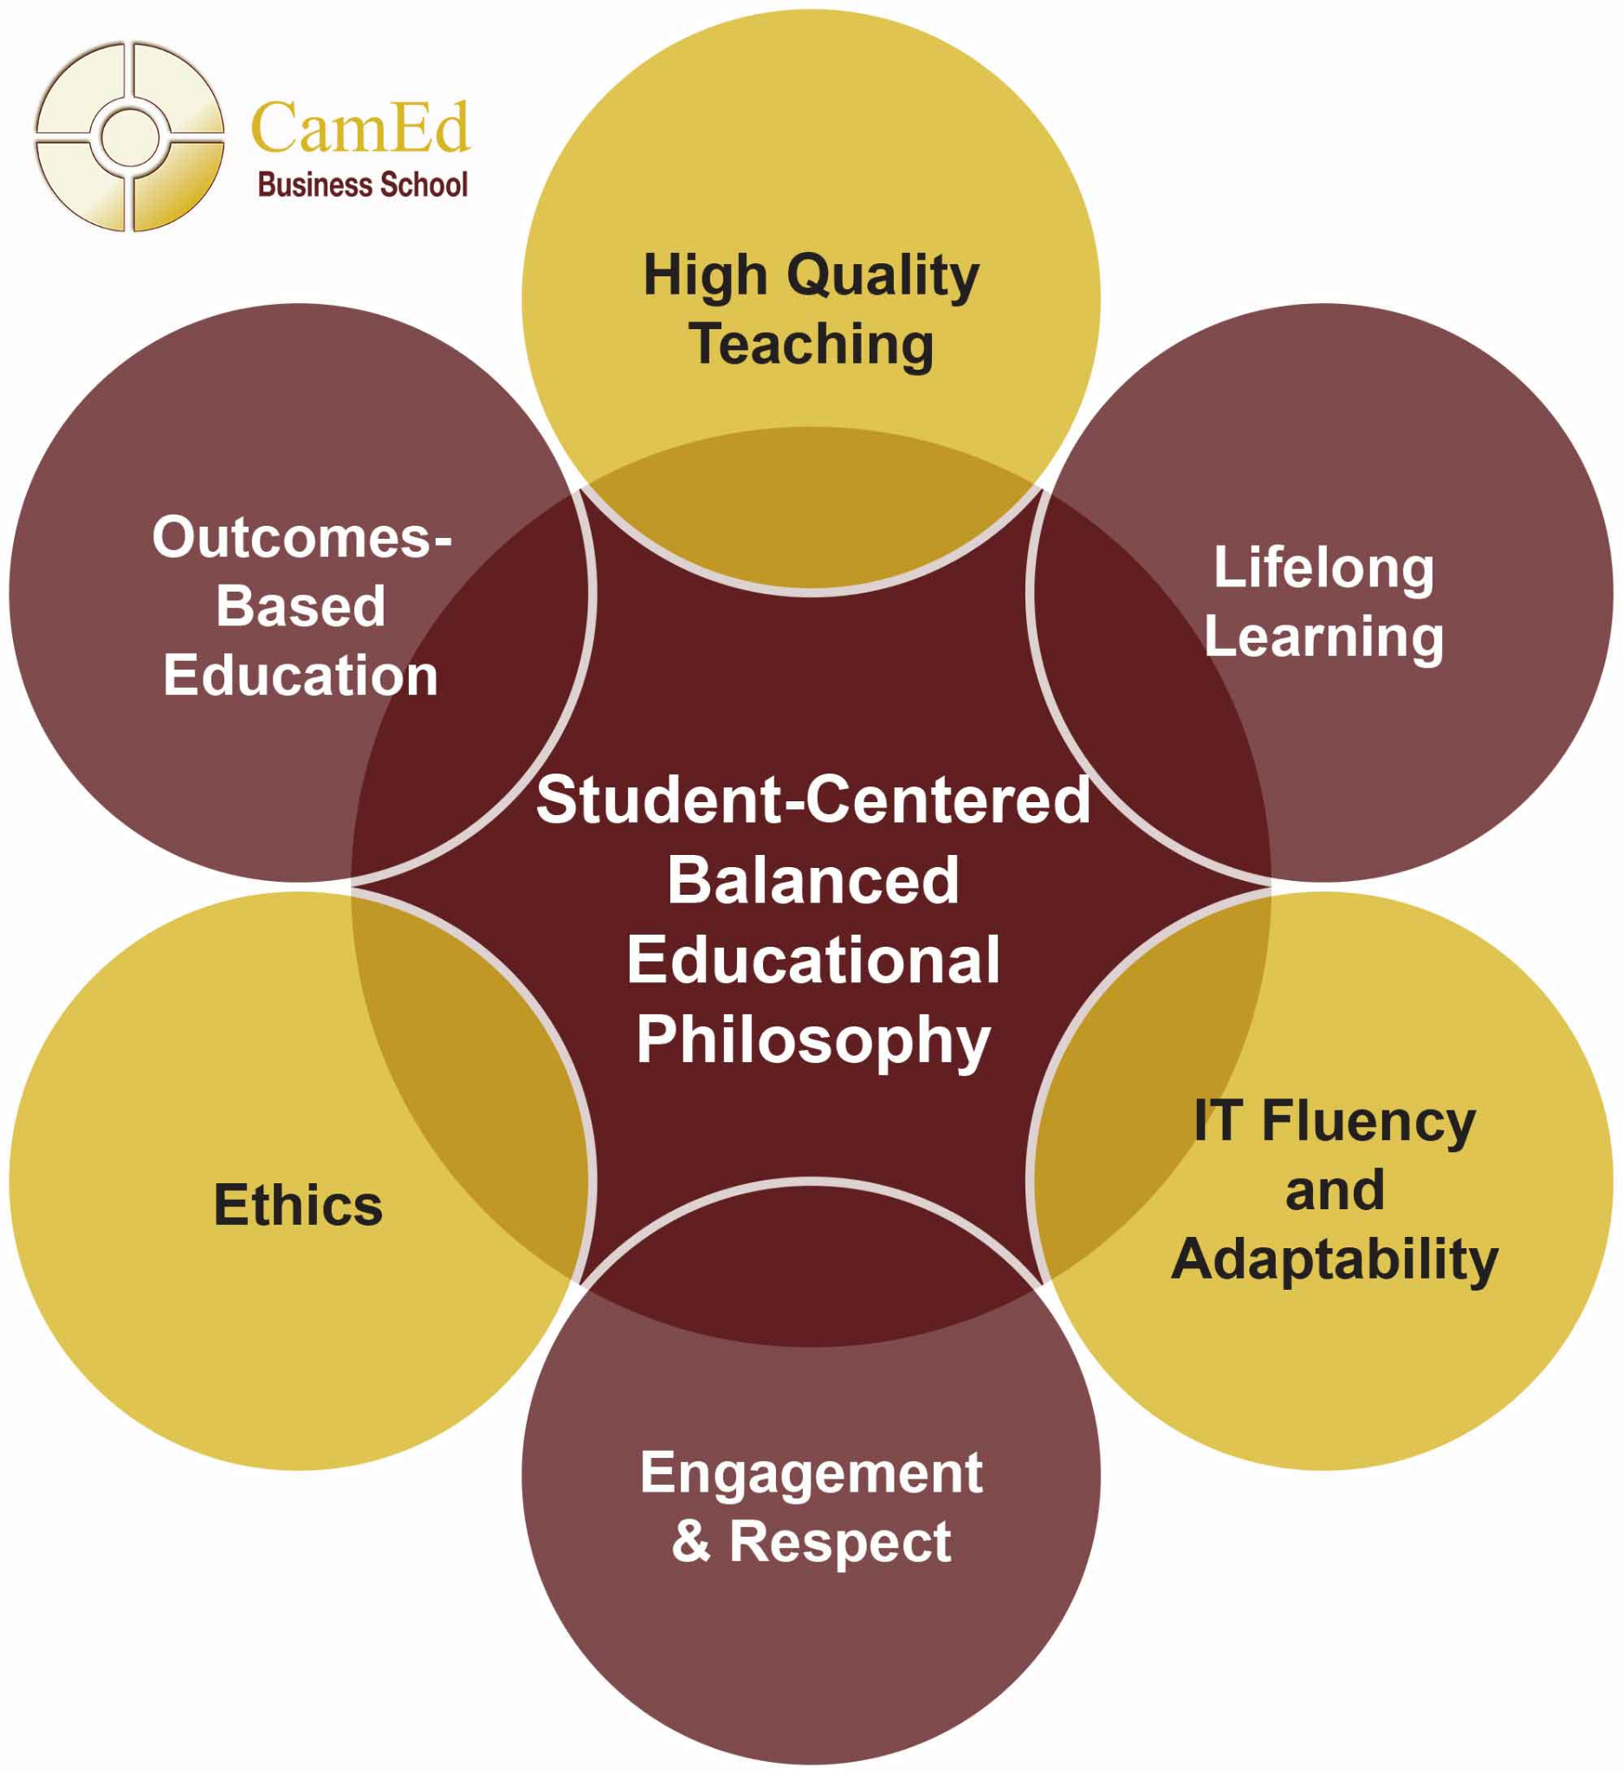
The difficulties to change the approach

Slide 9
REFERENCES
1. Bovill, C., Cook-Sather, A., & Felten P. (2011). Students as co-creators of teaching approaches, course design and curricula: For academic developers. International Journal for Academic Development, 16, 133–145.
2. Jensen, A. A., & Kjær-Rasmussen, L. K. (2017). Re-thinking curriculum for the 21st-century learners: Examining the Advantages and Disadvantages of Adding Co-Creative Aspects to Problem-Based Learning. Co-Creation in Higher Education, 6, 1–14.
3. Iversen, A. M., Pedersen, A. S., Krogh, & Jensen, A. A. (2015). Learning, leading, and letting go of control: Learner-led approaches in education. Sage Open, 5.
4. Ramsden, P. (2003). Learning to teach in higher education. Routledge.
5. Silverman, L. K. (2009). Visual-spatial learners. Encyclopedia of giftedness, talent and creativity. Thousand Oaks, CA: Sage Publications.
6. Steel, J. L., Meredith, K. S., Temple, C., & Walter, S. (2007). What is Critical Thinking. Guidebook I. Prague: Kritické myšlení, o.s.

