Slide 1

TECHNICAL PROBLEMS AND FIXES

Slide 2
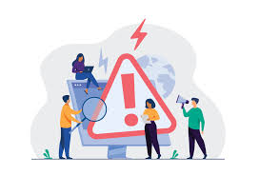
Questions for discusion
Have you ever faced a technical problem? What was it, and how did you solve it?
What is the most frustrating technical issue you have encountered?

Slide 3

Key Terms
Troubleshooting: The process of identifying and resolving a problem.
Glitch: A minor malfunction or error in a system.
Debugging: The process of identifying and removing errors from software or hardware.
System Crash: When a computer or device stops working unexpectedly.
Connectivity Issues: Problems with internet or network connections.

Slide 4

Advantages and Disadvantages of Addressing Technical Problems
Advantages:
Increases efficiency by resolving issues quickly.
Reduces downtime and maintains productivity.
Builds problem-solving skills and technical knowledge.
Disadvantages:
Some issues may require specialized expertise or tools.
Troubleshooting can be time-consuming.
Misdiagnosing a problem can lead to further complications.

Slide 5

Speaking Questions
What technical problems do you encounter most often?
Do you prefer fixing technical issues yourself or seeking professional help? Why?
How do you usually feel when a technical problem disrupts your work or routine?

Slide 6
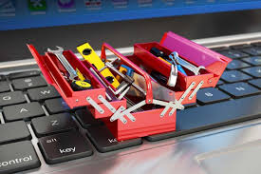
Discussion Topics
Why is it important to understand the basics of troubleshooting in today's technology-driven world?
What are some common mistakes people make when trying to fix technical problems?
How can companies improve their technical support services to help customers more effectively?

Slide 7
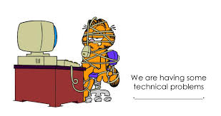
Problem Identification (Group Work)
Imagine someone has one of the problems: a slow computer, an unresponsive application, or a network error).
Identify the problem and suggest a step-by-step solution

Slide 8

Conclusion
Recap: Understanding technical problems and their solutions requires recognizing common issues, using appropriate terminology, and applying logical troubleshooting steps.
Takeaway: Being proactive and methodical in addressing technical problems can save time and improve efficiency.
Homework: Research a common technical problem (e.g., "Why won’t my phone charge?") and prepare a short presentation explaining the issue and its solution.

