Slide 1
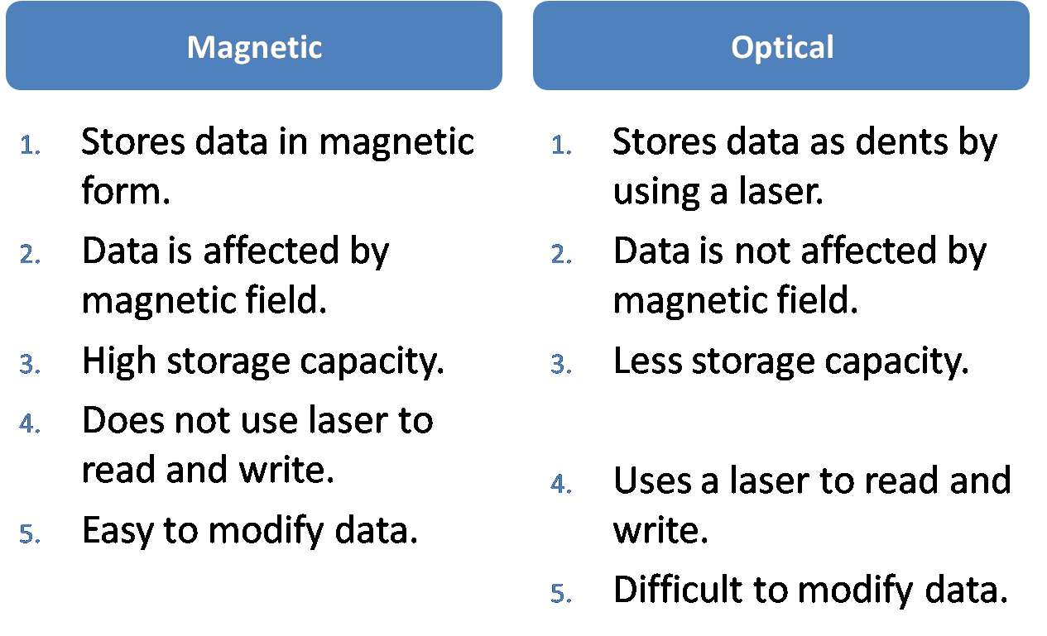
History, technology and applications of magnetic and optical storage

Slide 2
Introduction to Magnetic and Optical Storage
Magnetic Storage
Optical Storage
Utilizes magnetism for data storage on disks and tapes.
A key component in computer systems for efficient data storage.
Offers high capacity and durability in storing data.
Uses laser light to read and write data on spinning discs.
Popular for its high capacity and durability in storing data.
Ensures data integrity and longevity.

Slide 3

Optical storage: History
Key Milestones in Optical Storage
Optical drives introduced in the 1980s as a high-capacity and durable storage solution.
First optical disc format was the compact disc (CD), offering 700 MB of data storage or 80 minutes of audio.
Evolution to higher-capacity formats like DVD and Blu-ray, revolutionizing video and data storage capabilities.

Slide 4
Optical storage: Technology
Optical discs have a layered structure, including a label, polycarbonate layer, reflective layer, and protective layer.
During the writing process, a laser diode burns pits into the polycarbonate layer, representing 0s.
For reading data, a lower intensity laser is used to differentiate between lands and pits, reconstructing the original data.
Recordable discs allow for data rewriting by modifying the recording layer's properties.

Slide 5
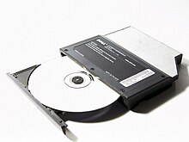

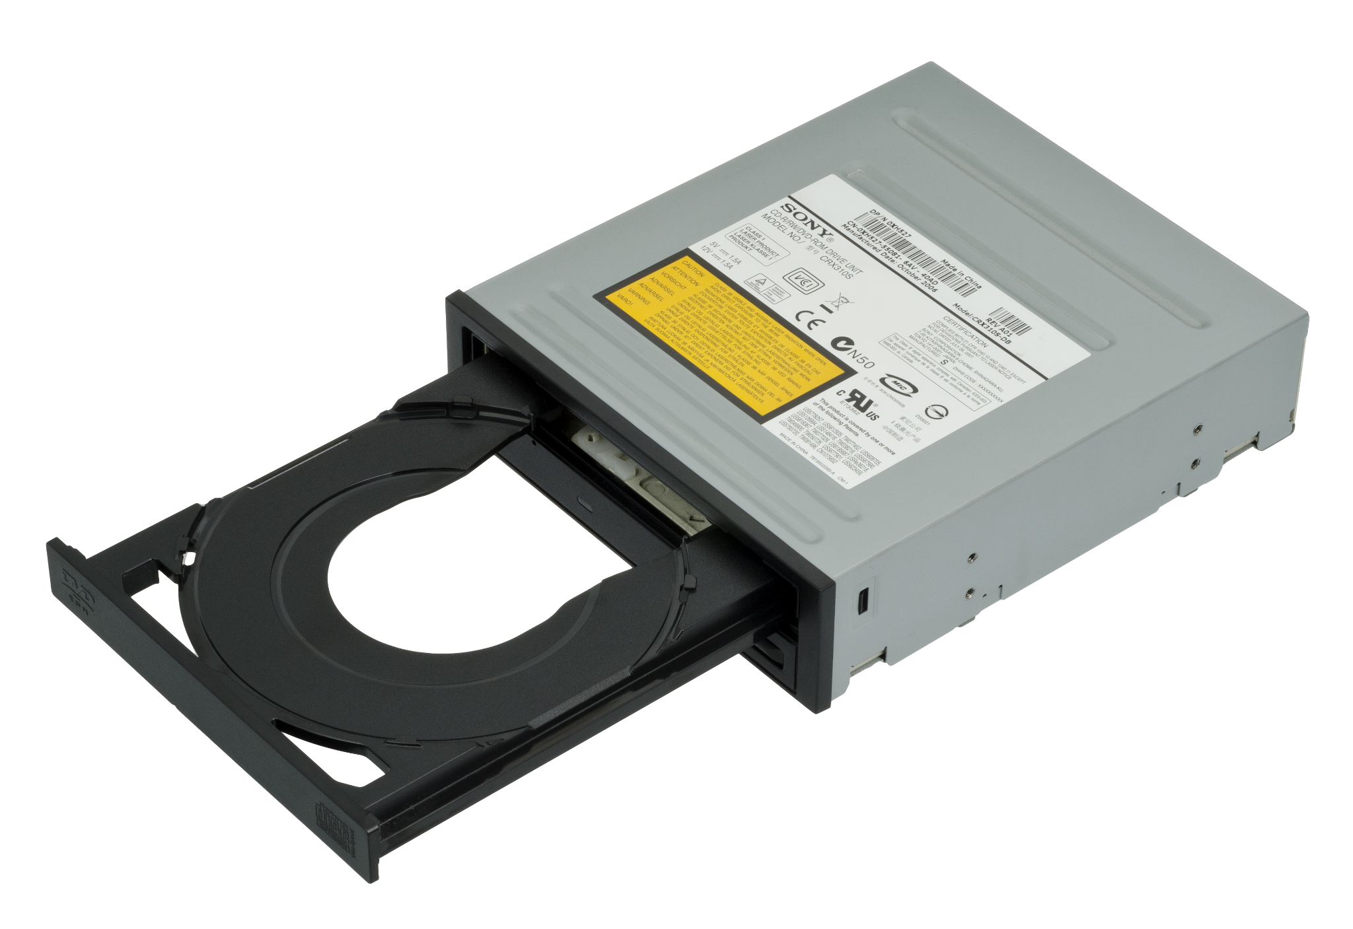
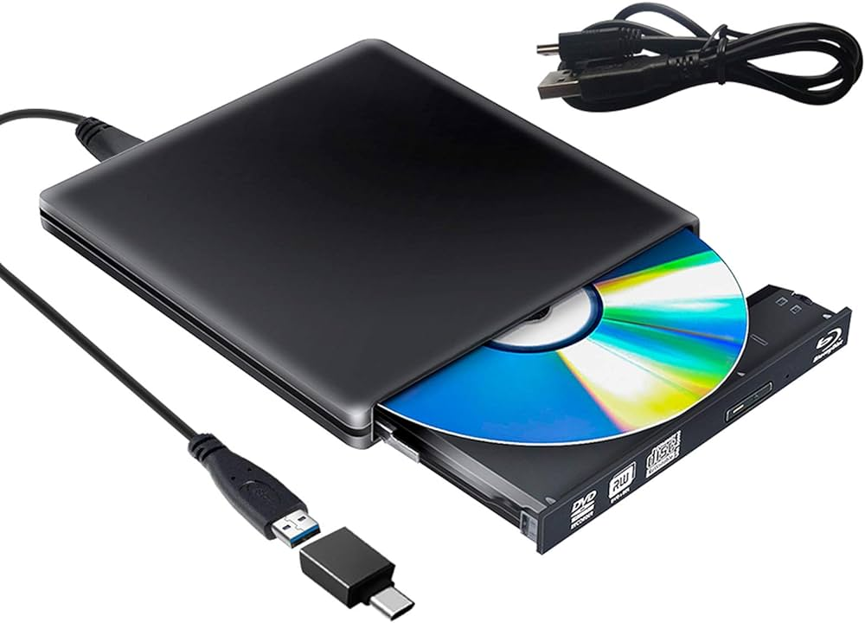
Optical storage: Devices
Optical Disc Storage
CD-ROM
DVD-ROM
Blu-ray Disc ROM
A CD-ROM (Compact Disc Read-Only Memory) is a pre-pressed optical compact disc that contains data. It is commonly used for software and multimedia storage.
A DVD-ROM (Digital Versatile Disc Read-Only Memory) is a high-capacity opticl disc used for data and video storage, offering greater storage than CD-ROMs.
A Blu-ray Disc ROM is an optical disc storage medium designed to supersede the DVD format, offering increased storage capacity and HD optical storage.

Slide 6
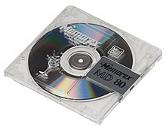
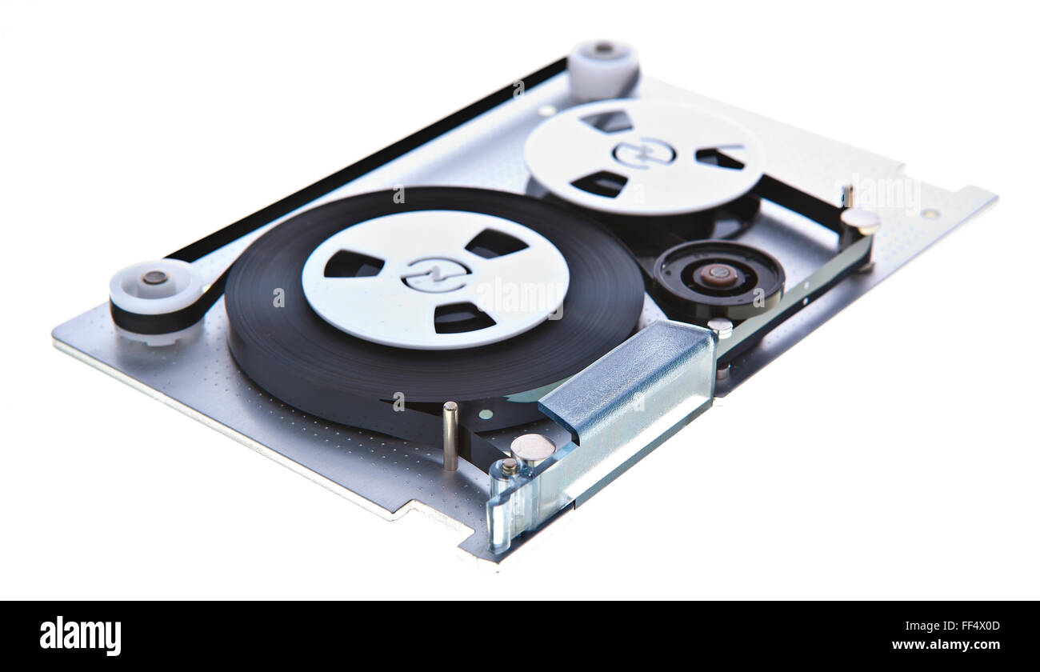
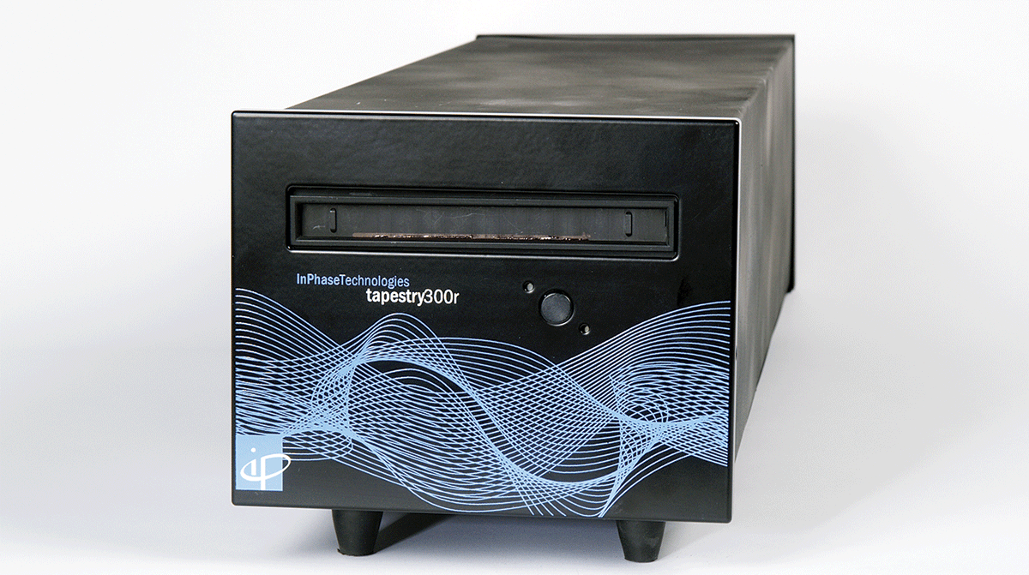
Optical storage: Devices
Non-Disc Optical Storage Devices
Magneto-optical Drives
Optical Tape
Holographic Storage
Combining magnetic and optical technologies, magneto-optical drives use rewritable discs for high data reliability.
Utilizing lasers on thin, flexible tapes, optical tape storage offers high capacity and cost efficiency, ideal for enterprise data backups.
An innovative technology using lasers to store 3D data, offering high densities. Holographic storage has the potential to revolutionize optical storage.

Slide 7
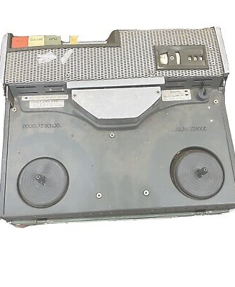
Magnetic storage: History
Key Milestones in Magnetic Storage History
In 1888, Oberlin Smith publicized the concept of wire recording for audio.
The first magnetic recorder was invented by Valdemar Poulsen in 1898, utilizing a wire wrapped around a drum.
Fritz Pfleumer developed the first magnetic tape recorder in 1928, revolutionizing audio storage.
During World War II, German engineers created the Magnetophon, an audio tape recording machine.
In the late 1940s, U.S. and British researchers adopted the Magnetophon's design to make high-quality magnetic tape recorders.

Slide 8
Magnetic storage: Technology
Magnetic storage is essential in computer architecture for persistent data storage.
It works by manipulating magnetic properties in the storage medium.
Non-volatility is a key feature, retaining data without power.
Magnetic storage devices offer high capacities and fast read/write speeds.

Slide 9
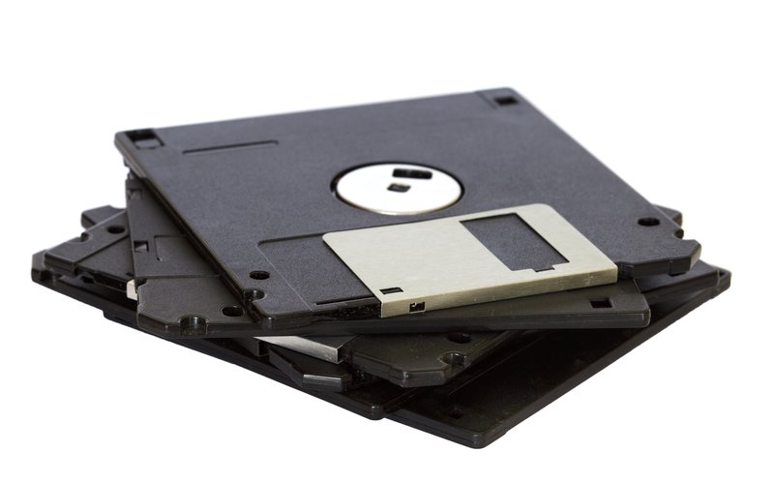
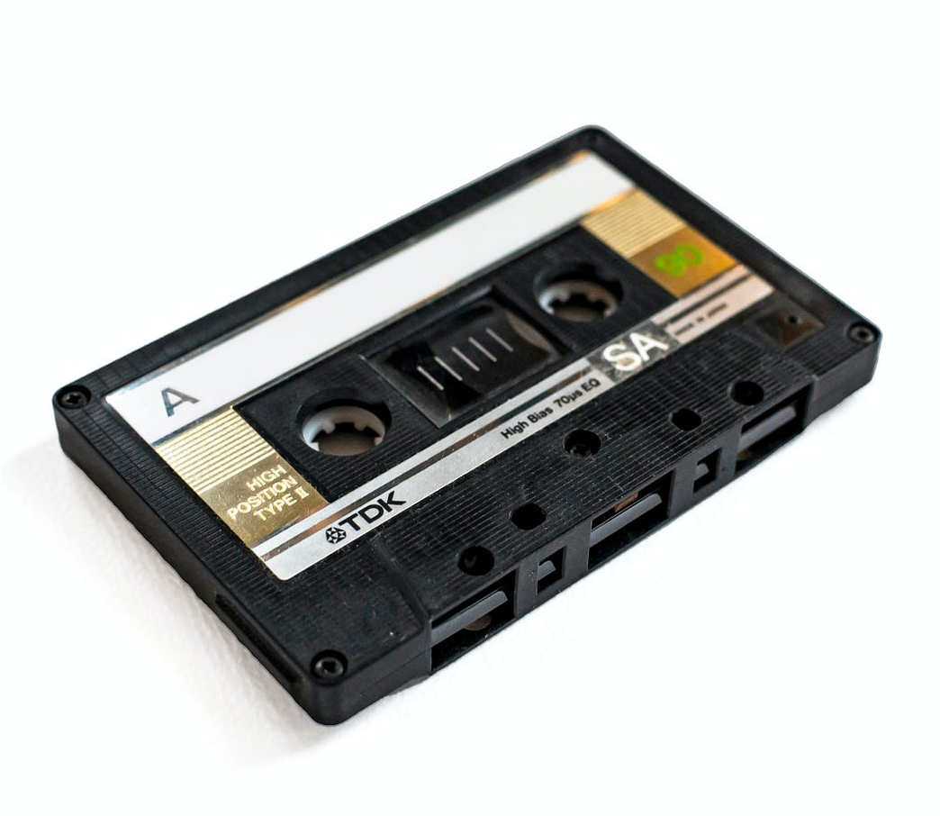

Magnetic storage: Devices
Floppy Disks
Magnetic Tapes
Hard Disk Drives
A thin, flexible magnetic storage medium housed in a protective casing, used for transferring data between computers and backing up files.
Commonly used for backup and archiving, providing high storage capacities at a relatively low cost.
The most common magnetic storage devices, ranging from gigabytes to terabytes, composed of multiple platters to store data.

Slide 10
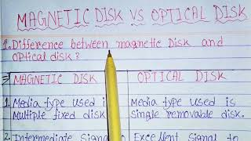
Thank you for attention!

