Slide 1

Negotiations
Created by Iryna Zhukevych
PhD in Pedagogical Sciences
Associate Professor

Slide 2
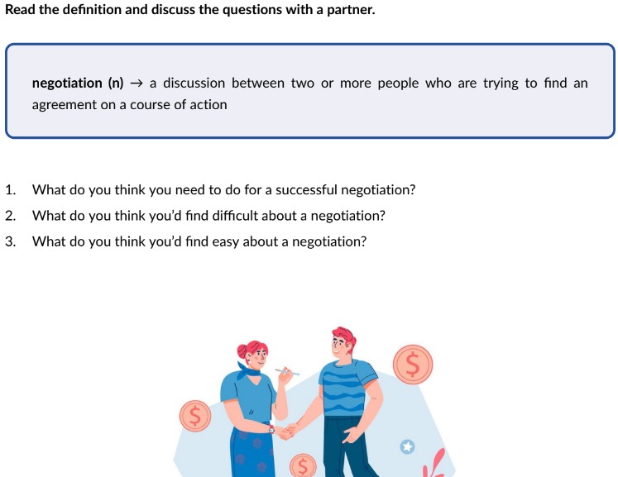


Slide 3

Negotiation.
Practice listening
Look at the notes about negotiations. Some information is missing. You will hear part of a talk given by a business executive. For each question (1 - 7) fill in the numbered space using one or two words.
You will hear the talk twice.
https://www.linguahouse.com/esl-lesson-plans/business-english/negotiations/audioplayer/negotiations_bemp3

Slide 4
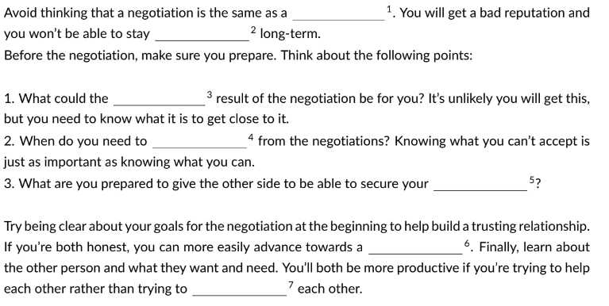

Slide 5

Game. Complete the sentences.
https://wordwall.net/resource/79276344

Slide 6

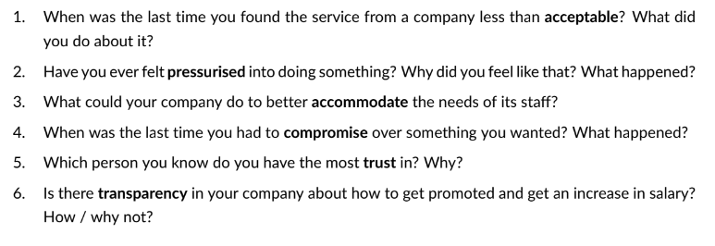
Discuss the questions.

Slide 7

Role plays
https://www.usingenglish.com/files/pdf/business-english-giving-reasons-in-negotiations.pdf

Slide 8

A FEW GOLDEN RULES TO SUCCESSFUL NEGOTIATIONS
https://www.englishclub.com/business-english/negotiations-process.php

Slide 9

Look at the photos and discuss the questions below.
What type of negotiation do you think each one shows?
Which stage of the negotiation are they at?
What do their body language and facial expressions say?
Do you think the negotiations had a favourable outcome?

Slide 10

Watch the video of a negotiation.
What techniques could you see?
https://m.youtube.com/watch?v=r-GFmH0EK9Y

