Slide 1
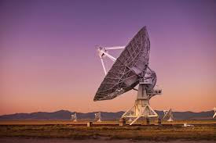
ANTENNAS

Slide 2
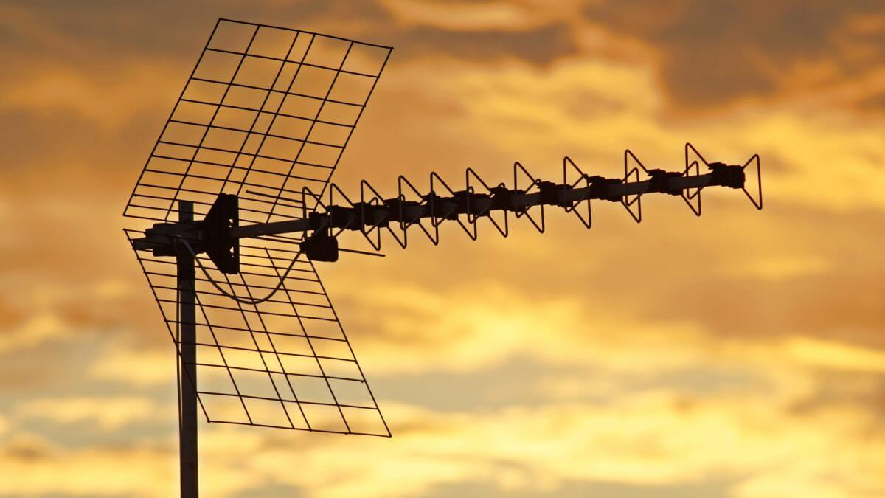
QUESTIONS FOR DISCUSSION
Have you ever noticed antennas on buildings, cars, or other devices?
What do you think antennas are used for?
Why might antennas be important for things like television, radio, or cell phones?

Slide 3
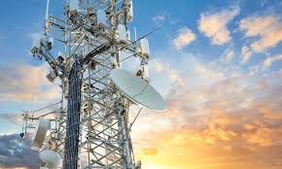
BRIEF EXPLANATION
What is an Antenna?
An antenna is a device used to send or receive signals, such as radio, television, or cell phone signals. Antennas work by turning electrical signals into radio waves that travel through the air, allowing communication over long distances.
Where Are Antennas Used?
Antennas are used in many devices we use every day, such as radios, televisions, mobile phones, and even Wi-Fi routers.

Slide 4
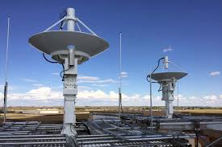
KEY TERMS
Antenna: A device that sends or receives radio waves to allow communication.
Signal: Information sent in the form of radio waves, such as TV channels or phone calls.
Transmission: The process of sending signals from one place to another.
Frequency: The number of times a signal wave repeats in a specific time; it affects how signals travel.
Receiver: A device that picks up signals sent by an antenna, like a radio or a mobile phone.

Slide 5
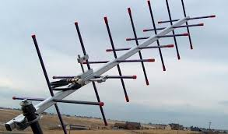
KEY POINTS
How Antennas Work:
Antennas take electrical signals and turn them into radio waves, which travel through the air. These waves carry information, like sounds or pictures, that can be received by other antennas.
Types of Antennas:
Dipole Antenna: A basic type used in radios and TVs.
Yagi Antenna: Used to pick up strong signals from a specific direction, often for TV.
Parabolic Antenna (Dish): A large, bowl-shaped antenna used for satellite signals.
Cellular Antenna: Used in mobile phones to send and receive calls and data.
Importance of Antennas:
Antennas are essential for communication over long distances and are found in nearly every communication device.
They help us stay connected, whether by watching TV, listening to the radio, or using the internet on our phones.

Slide 6
QUESTIONS
Why do you think antennas are important in our daily lives?
Discuss how antennas make it possible to communicate and access information.
What would happen if antennas stopped working?
Think about how daily life might change without access to TV, radio, or mobile phones.
What types of devices can you think of that use antennas?
List common devices like radios, Wi-Fi routers, and cell phones, and discuss their purpose.
How do you think antennas might improve in the future?
Talk about how technology might make antennas faster, smaller, or more powerful.
Do you think all homes need antennas? Why or why not?
Discuss how antennas bring convenience and communication into homes and businesses.

Slide 7
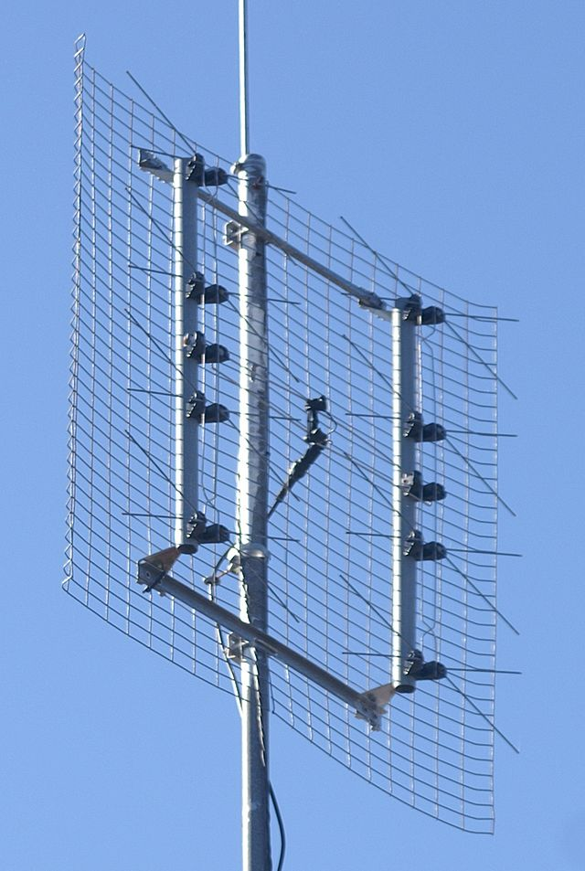
Practice and Application
Activity: Explain a Device That Uses an Antenna
Pick a device that uses an antenna (e.g., cell phone, TV, or radio).
Write a few sentences about how that device uses its antenna to work.
Share their examples with the class.

Slide 8
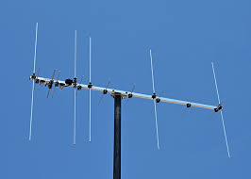
Conclusion and Recap
Antennas are devices that help us send and receive signals over long distances.
Different types of antennas are used for specific purposes, from watching TV to making phone calls.
Antennas are a key part of everyday communication technology, making life more convenient.

