Slide 1
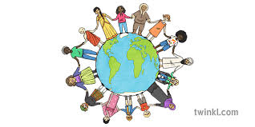
COMMUNITIES

Slide 2

QUESTIONS
What does the word "community" mean to you?
Can you think of some examples of communities? (e.g., neighborhood, school, online groups)
Why are communities important to people?
What do you think is the role of people within a community?
How do communities support their members in times of need?

Slide 3
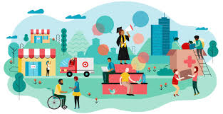
BRIEF EXPLANATION
What is a Community?
A community is a group of people who live in the same area or share common interests, goals, or values. They support each other and interact in various ways to help make life better for everyone.
Types of Communities:
Local Communities: People living in the same neighborhood or town.
Interest-Based Communities: Groups of people with shared hobbies or professions, such as sports teams or online groups.
Cultural Communities: Groups formed by people from the same cultural or ethnic background.
Global Communities: People connected by shared global concerns, such as climate change or human rights.

Slide 4
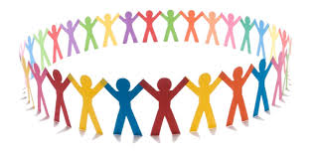
KEY TERMS
Community: A group of people who live in the same place or share a common interest or goal.
Support: Helping others by providing assistance or care.
Solidarity: A sense of unity and mutual support within a community.
Diversity: Having people from different backgrounds, cultures, or beliefs within a community.
Collaboration: Working together as a group to achieve a common goal.

Slide 5
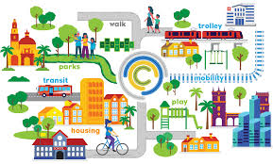
Detailed Explanation of Communities
Why Are Communities Important?
Communities provide support and a sense of belonging. They help individuals feel connected and provide opportunities for cooperation and collaboration to solve problems or achieve goals.
The Roles Within a Community:
Every person in a community plays a role. These roles can range from leaders who guide and organize, to volunteers who help others, to everyday members who contribute in small ways. Each person’s contribution helps strengthen the community.
Challenges Communities Face:
Communities sometimes face issues like conflict, lack of resources, or isolation. It’s important for community members to work together to find solutions.

Slide 6
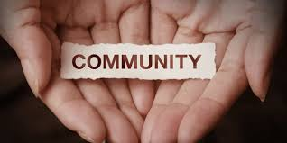
Speaking Tasks
Task 1: Describe Your Community
Think about their own community. What is it like? Who are the people in it? What are the main things that bring people together? Ask them to speak for 1-2 minutes describing their community.
Task 2: Discuss the Importance of Community Support
Share a time when their community helped them or when they helped someone in their community. Discuss how support from others can make a big difference.
Task 3: Compare Different Types of Communities
Compare a local community with an online community. What are the similarities and differences? Which type of community is easier to be part of, and why?
Task 4: The Role of Diversity in a Community
Discuss how having a diverse community can help people learn from each other. What are some benefits of living in a community with different cultures and backgrounds?
Task 5: Create a Community
Have students imagine they are starting a new community. What values or goals would they want the community to have? What roles would people play in that community?

Slide 7
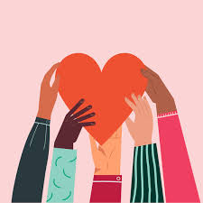
Additional Discussion Questions
What are some ways people can give back to their community?
How can someone become more involved in their community?
Do you think a community can help people achieve their goals? How?
What might happen if people didn’t have any communities?
How do you feel when you are part of a community?

Slide 8

Conclusion and Recap
A community is a group of people who share something in common, such as a place, an interest, or a goal.
Support, collaboration, and diversity are key aspects of a strong community.
Communities face challenges, but working together helps solve problems and improve life for everyone.

