Slide 1

Investing Strategies
Created by Iryna Zhukevych
PhD in Pedagogical Sciences
Associate Professor

Slide 2
Reading + Test
https://lingua.com/businessenglish/reading/investing/

Slide 3
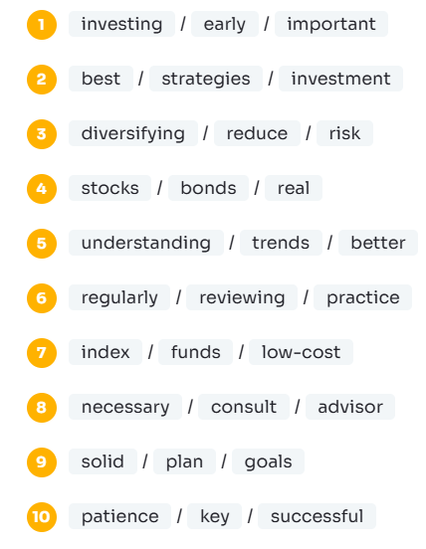
Make sentences from these words!

Slide 4
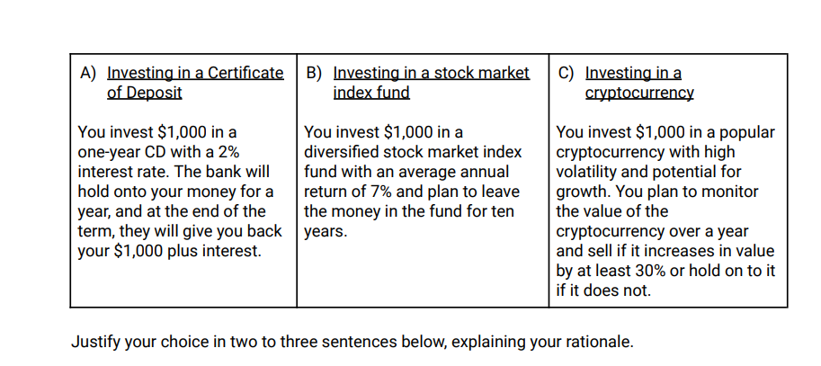
Watch the video https://www.prageru.com/video/investing
You have saved enough money for a healthy emergency fund and now have an extra $1,000 that you’d like to invest. Read the three investment scenarios below and consider the risks and potential rewards. Which scenario below is the most responsible investment, considering the video you just watched?

Slide 5
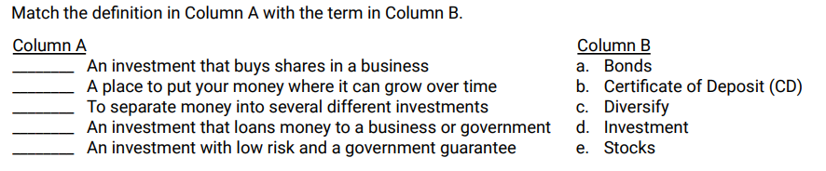

Slide 6
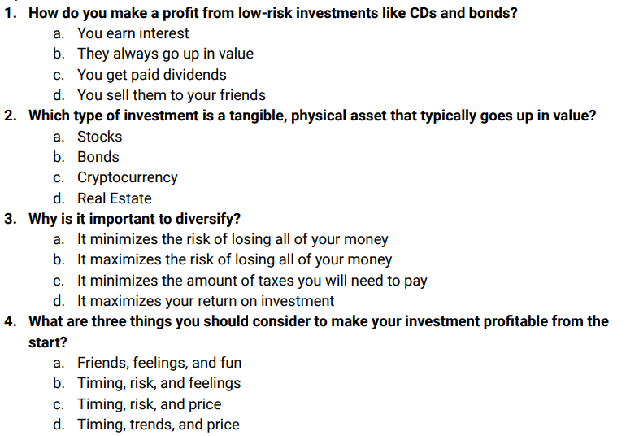
Multiple Choice

Slide 7

Match the following investment strategies with their primary characteristics:
A. Growth Investing
B. Value Investing
C. Income Investing
D. Socially Responsible Investing
1. Focuses on companies with potential for above-average earnings growth
2. Seeks to invest in undervalued companies with strong fundamentals
3. Prioritizes investments that generate regular income through dividends
4. Considers environmental and social impact alongside financial returns

Slide 8

Arrange the following steps of fundamental investment analysis in the correct sequential order:
1. Analyze financial statements
2. Evaluate industry trends
3. Assess company management
4. Determine intrinsic value
5. Make investment decision

Slide 9

Breakout rooms.
Explain the key differences between active and passive investment strategies and provide two specific advantages of each approach.

Slide 10
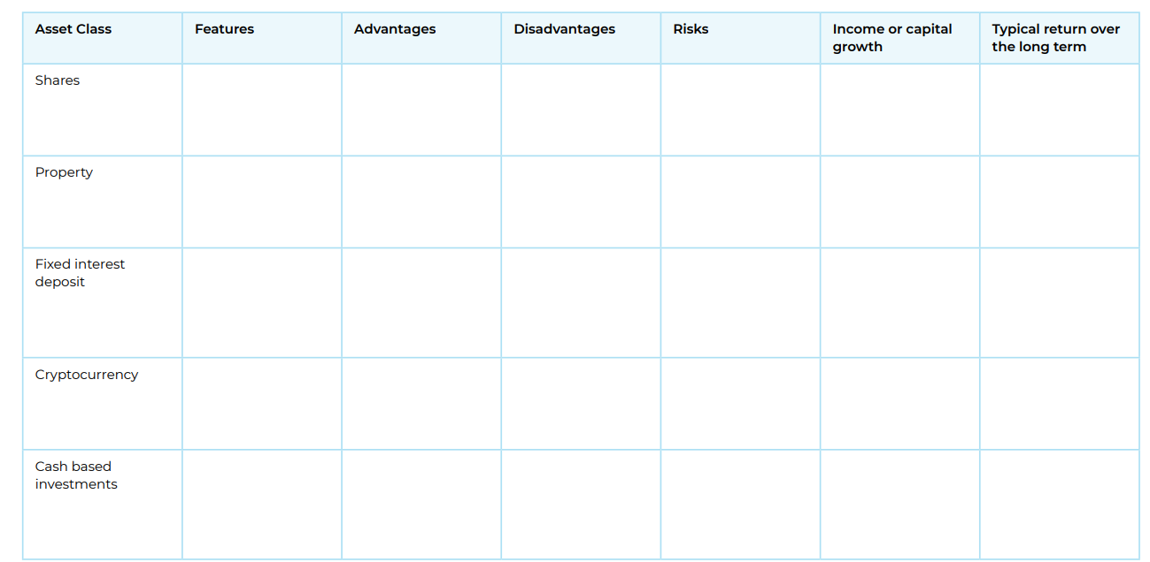
Investment Features (Break into small teams).
Research several investment types to complete this table.
Use the suggested investments or choose your own.

Slide 11

Speaking Cards
https://wordwall.net/resource/89486457
Це фото; автор: Невідомий автор; ліцензія: CC BY-SA-NC

Slide 12
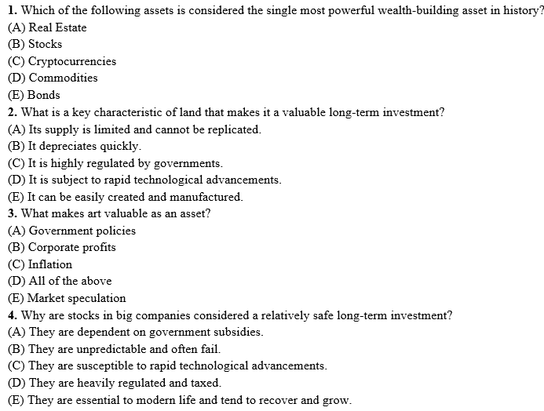
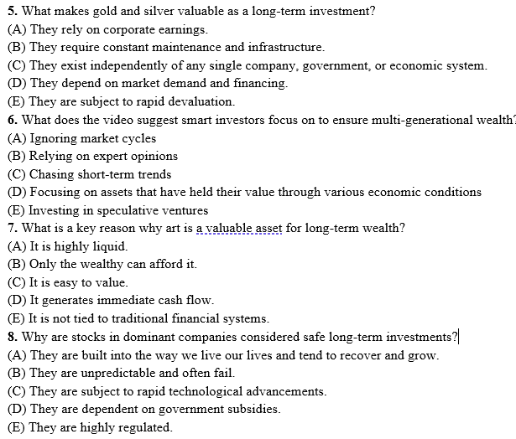
Watch the video and answer the questions below. https://www.youtube.com/watch?v=BvhYfdFg2M4

