Slide 1

Video Conferences
Created by Iryna Zhukevych
PhD in Pedagogical Sciences
Associate Professor
Це фото; автор: Невідомий автор; ліцензія: CC BY-SA-NC

Slide 2
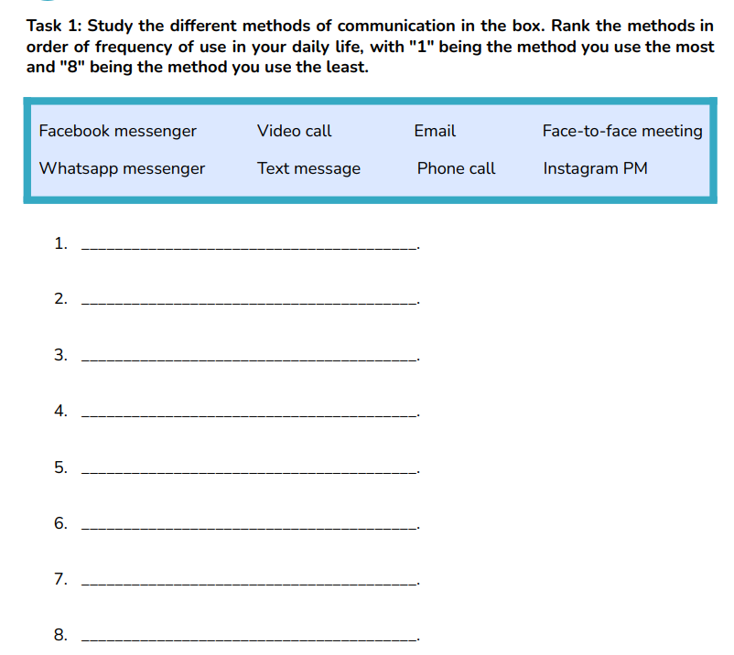

Slide 3
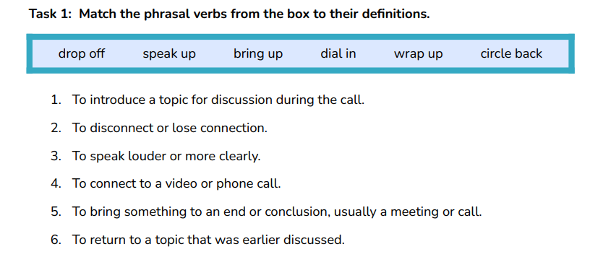

Slide 4
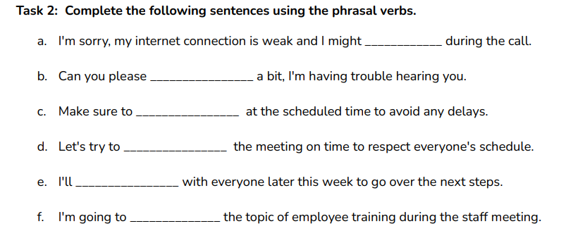

Slide 5
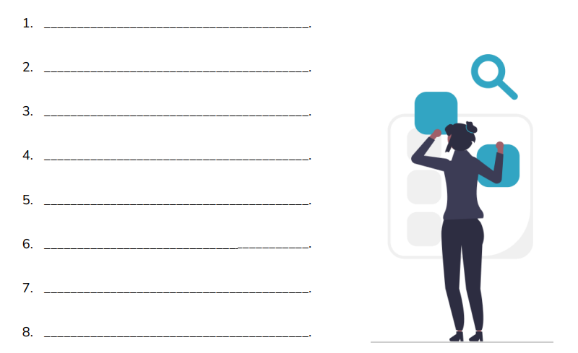
Watch the video. How many problems can you identify? List them below.
https://www.youtube.com/watch?v=JMOOG7rWTPg

Slide 6
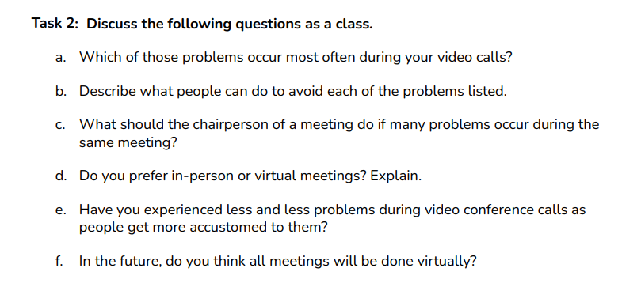

Slide 7
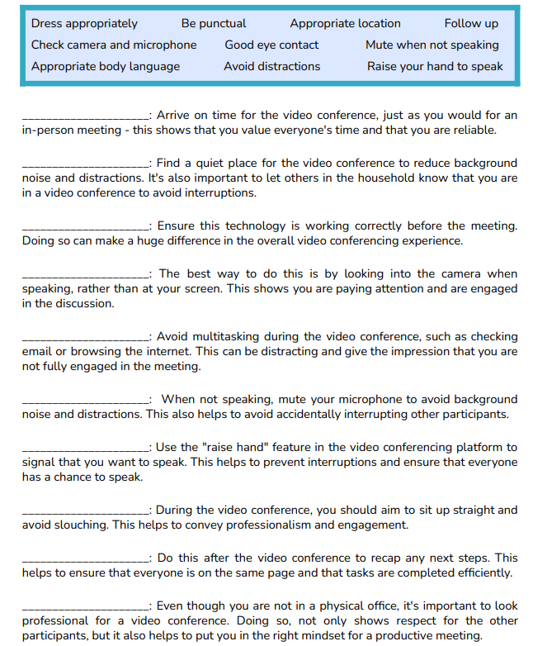
VIDEO CONFERENCING ETIQUETTE

Slide 8
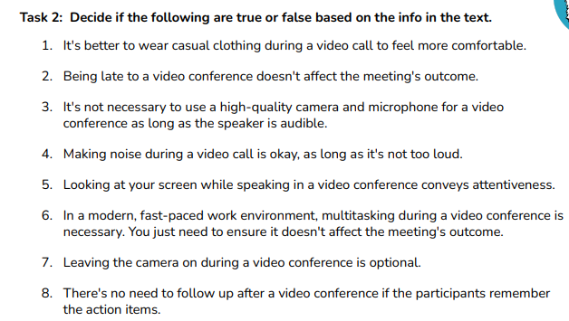

Slide 9
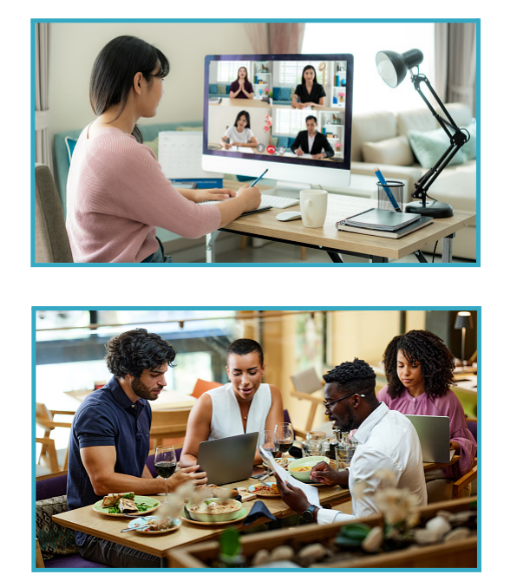
Describe the benefits and challenges of each scenario pictured regarding: a. Team morale and chemistry. b. Communication. c. Productivity. d. Gaining recognition.

Slide 10
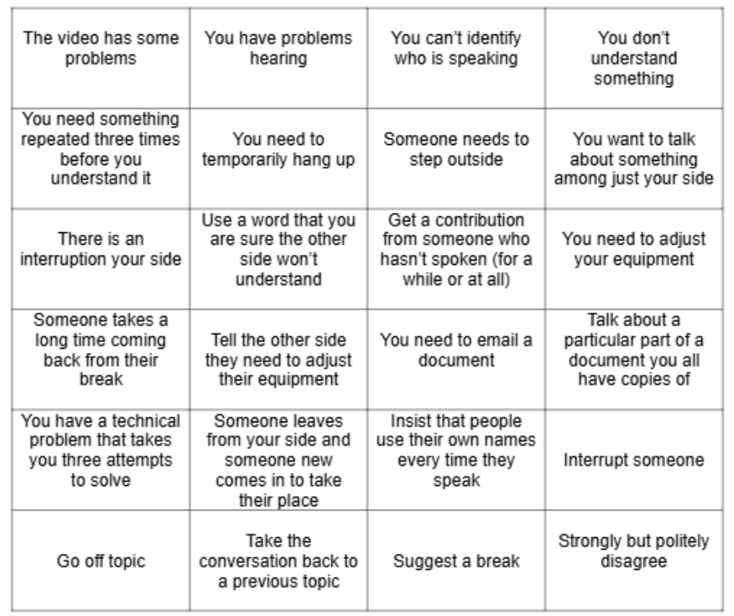
Imagine you are all participants in an important online meeting. During the meeting, several technical and communication issues occur. Look at the squares in the picture. Each square represents a problem or action that might happen during the meeting. Try to solve them.

Slide 11
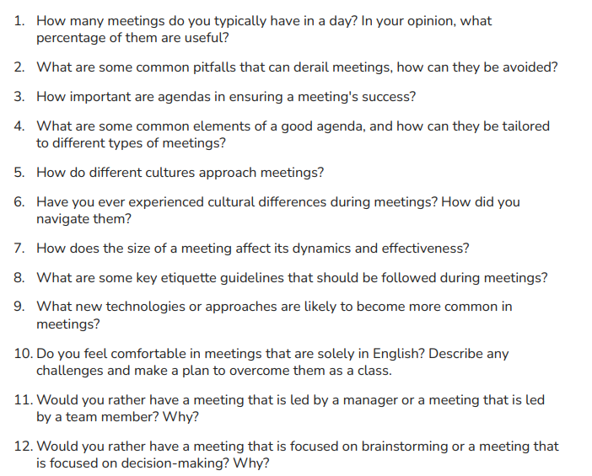
GENERAL MEETING DISCUSSION QUESTIONS

Slide 12
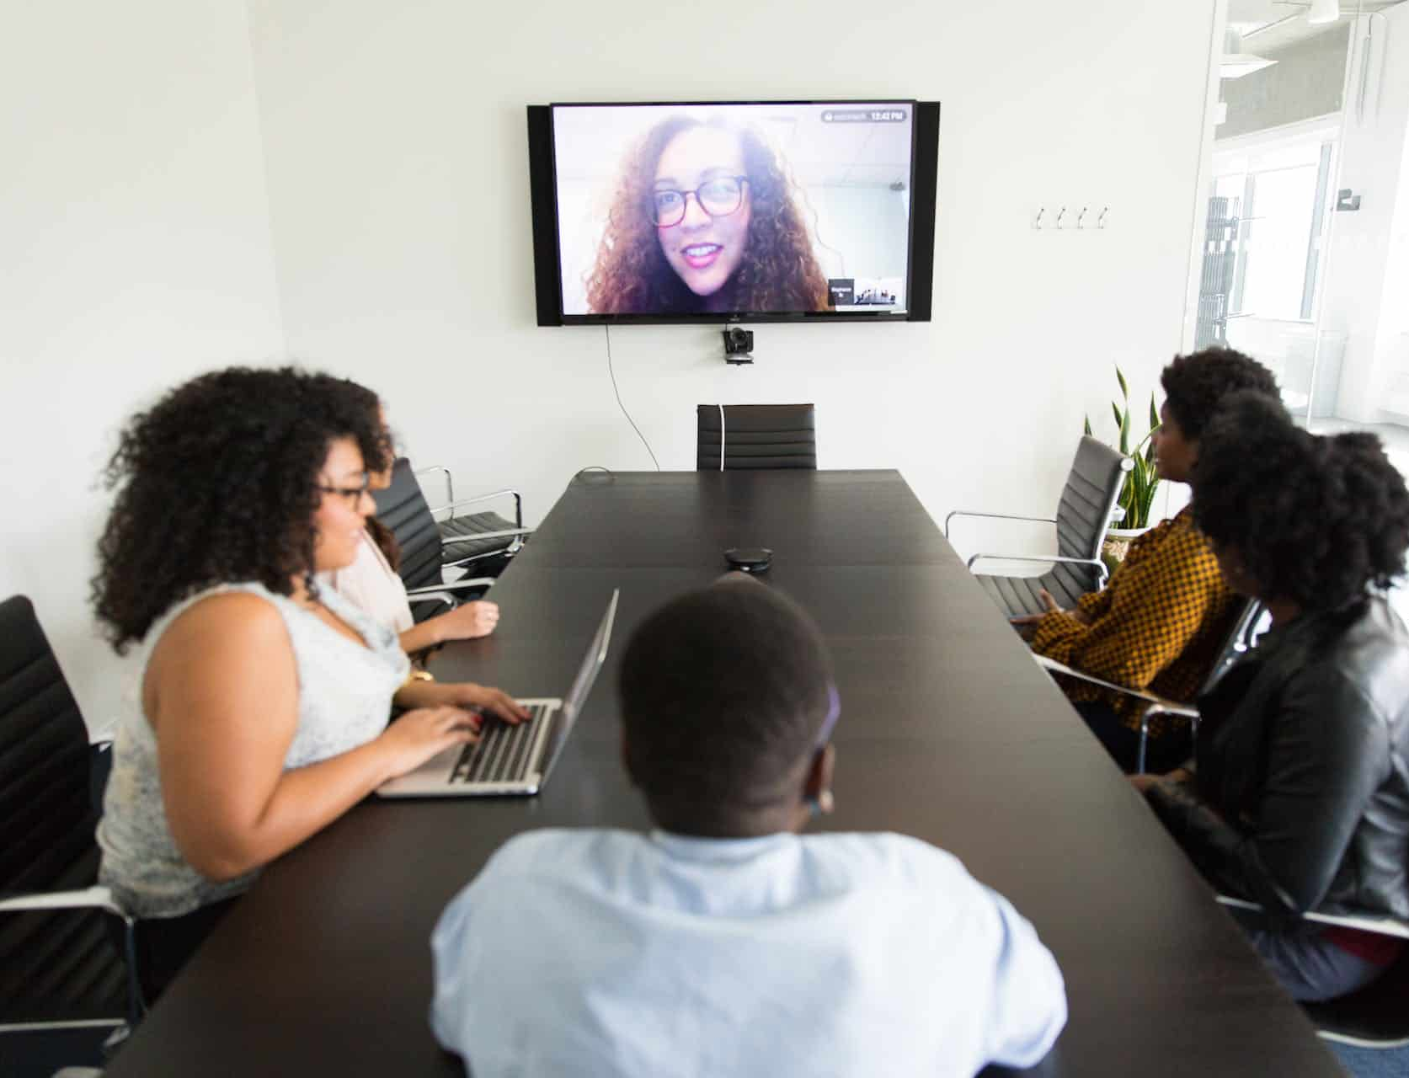
Videoconferences and Presenting Online
https://www.businessenglishpod.com/category/video-conference-english/page/2/
Це фото; автор: Невідомий автор; ліцензія: CC BY

