Slide 1
How to teach grammar with fun
Hanna Kolosova
Ph.D., Associate Professor,
Department of English language for Humanities, FL,
Igor Sikorsky Kyiv Polytechnic Institute

Slide 2
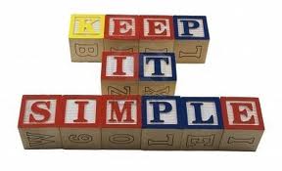
!!! KEEP IT SIMPLE !!!
One problem that teachers often encounter is that of trying to do too much, too quickly. Here is an example:
T: Let's learn the verb "to have" today. - OK - So, the verb "to have" can be used in the following ways: He has a car, He's got a car, He had a bath this morning, He has lived here for a long time, If I had had the opportunity, I would have bought the house. Etc.
Obviously, you are focusing on one point: The verb "to have". Unfortunately, you are covering just about every usage of have which then also brings into play the present simple, have for possession, past simple, present perfect, "have" as an auxiliary verb etc. Overwhelming to say the least!

Slide 3
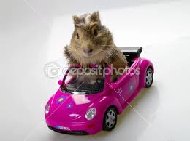
FOCUS ON SPECIFIC POINT
The best way to approach teaching is to choose JUST ONE USE OR FUNCTION, AND FOCUS ON THAT SPECIFIC POINT. Using our example from above:
T: Let's learn the use "have got" for possession. He has got a car is the same as saying He has a car... etc.
Instead of working "vertically" i.e. uses of "have", you are working "horizontally" i.e. the various uses of "have" to express possession. This will help keep things simple (they are actually pretty difficult already) for your learner and give them tools on which to build.

Slide 4

use easy vocabulary
You need to become aware of the type of vocabulary and structures you are using. Here is an example:
T: OK Tom. Let's hit the books. Have you got through your homework for today?
At this point, the student is probably thinking WHAT! Slowing down speech patterns and eliminating idioms and phrasal verbs can go a long way to helping students learn more effectively. Maybe the lesson should begin like this:
T: OK Tom. Let's begin. Have you finished your homework for today?

Slide 5

FOCUS ON FUNCTION
Perhaps the best ways of giving a lesson shape is to focus on a certain function and take that function as the clue for the grammar that is taught during the lesson.

Slide 6
This is what I do every day
I get up at 7 o'clock.
I take a shower.
I have my breakfast.
I drive to work.
I cook dinner in the evening.
I watch TV with my husband.
I go to bed at 11 o’clock.

Slide 7
This is what my twin sister Rachel does every day
She gets up at 7 o'clock.
She takes a shower.
She has her breakfast.
She drives to work.
She cooks dinner in the evening.
She watches TV with her husband.
She goes to bed at 11 o’clock.

Slide 8
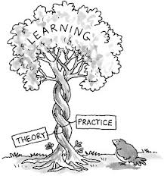
3 PS
NEVER FORGET ABOUT THE GOLDEN RULE OF TEACHING GRAMMAR – 3 PS: PRESENTATION, PRACTICE AND PRODUCTION.

Slide 9
Сlass structure when teaching grammar skills
☺ Begin with an exercise, game, listening, etc. that introduces the grammar concept.
☺ Ask students questions that will help them identify the grammar concept to be discussed.
☺ Follow with another exercise that more specifically focuses on the grammar concept, but takes an inductive approach. This could be a reading exercise with questions and responses in the structure that is being taught.
☺ Check responses, ask students to explain the grammar concept that has been introduced.
☺ At this point introduce teaching explanations as a way of clearing up misunderstandings.
☺ Provide an exercise which focuses on the correct construction of the grammar point. This could be an exercise such as a fill the gap, cloze or tense conjugation activity.
☺ Ask students to once again explain the concept.

Slide 10

Thank you for attention!

