Slide 1

Presentation skills. Tips on presentation. Team Roles and Responsibilities
Created by Iryna Zhukevych
PhD in Pedagogical Sciences
Associate Professor
Це фото; автор: Невідомий автор; ліцензія: CC BY-SA-NC

Slide 2

The strength of the team is each individual member. The strength of each member is the team.
- Phil Jackson

Slide 3
Presentation Tips
Know Your Audience: Tailor your content to the interests and understanding of your audience. For instance, a presentation for a technical audience should include more detailed data and terminology than one for a general audience.
Structure Your Presentation: Follow a clear structure: an introduction, body, and conclusion. For example, in a presentation about climate change, you might start with the importance of the topic, explain the causes and effects, and end with potential solutions.
Use Visual Aids: Incorporate slides, charts, and graphs to enhance understanding. For instance, showing a pie chart to represent the percentage of renewable energy sources can make the data more digestible.
Practice Delivery: Rehearse your presentation multiple times to gain confidence. This helps reduce nervousness and allows you to focus on delivering your message clearly.
Engage with the Audience: Ask questions or encourage participation. For example, you could ask, "What are your thoughts on renewable energy?" to spark discussion.

Slide 4

Vocabulary
https://wordwall.net/resource/83074810/team-roles-and-responsibilities-vocabulary
Це фото; автор: Невідомий автор; ліцензія: CC BY-NC

Slide 5

Team Roles and Responsibilities
https://www.youtube.com/watch?v=8NHwi5vQQMw

Slide 6

Group Presentations
https://sheridancollege.libguides.com/presentationskills/group-presentations
Це фото; автор: Невідомий автор; ліцензія: CC BY-NC-ND

Slide 7
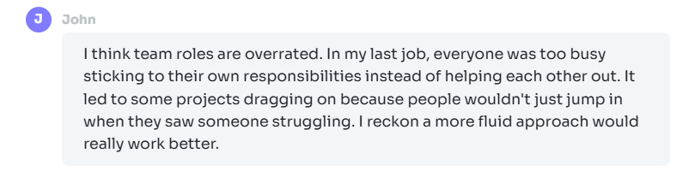
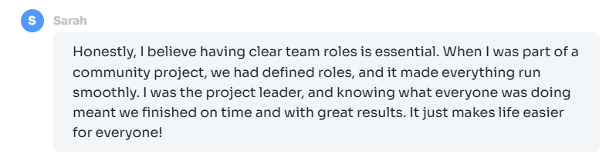
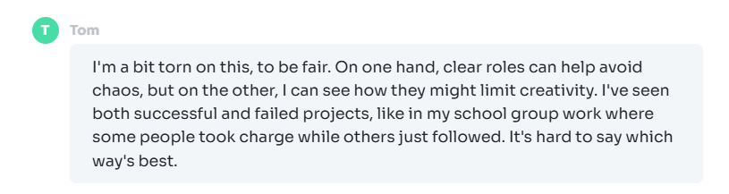
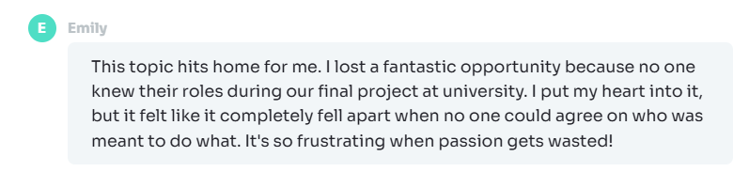
Read these opinions. Which one do you agree with the most and why?

Slide 8
Team Responsibilities in Presentations
Pre-presentation:
Research and gather information
Organize content and create outline
Develop visual aids
Rehearse individually and as a team
During presentation:
Execute assigned roles effectively
Support team members as needed
Adapt to unexpected situations
Post-presentation:
Participate in Q&A session
Gather feedback from audience and team members
Reflect on performance and identify areas for improvement

Slide 9
Continuous Improvement in Presentations
Seek feedback from peers, instructors, and audience members
Record and review your presentations
Attend workshops or seminars on presentation skills
Observe and learn from effective presenters
Join public speaking groups or clubs (e.g., Toastmasters)
Embrace opportunities to present in various settings
Stay updated on presentation technologies and trends

Slide 10
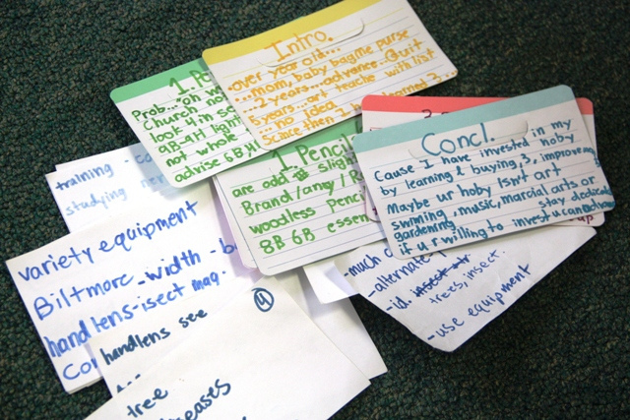
Speaking Cards
https://wordwall.net/resource/82977773/team-role-and-responsibility-in-a-team
Це фото; автор: Невідомий автор; ліцензія: CC BY-SA-NC

