Slide 1
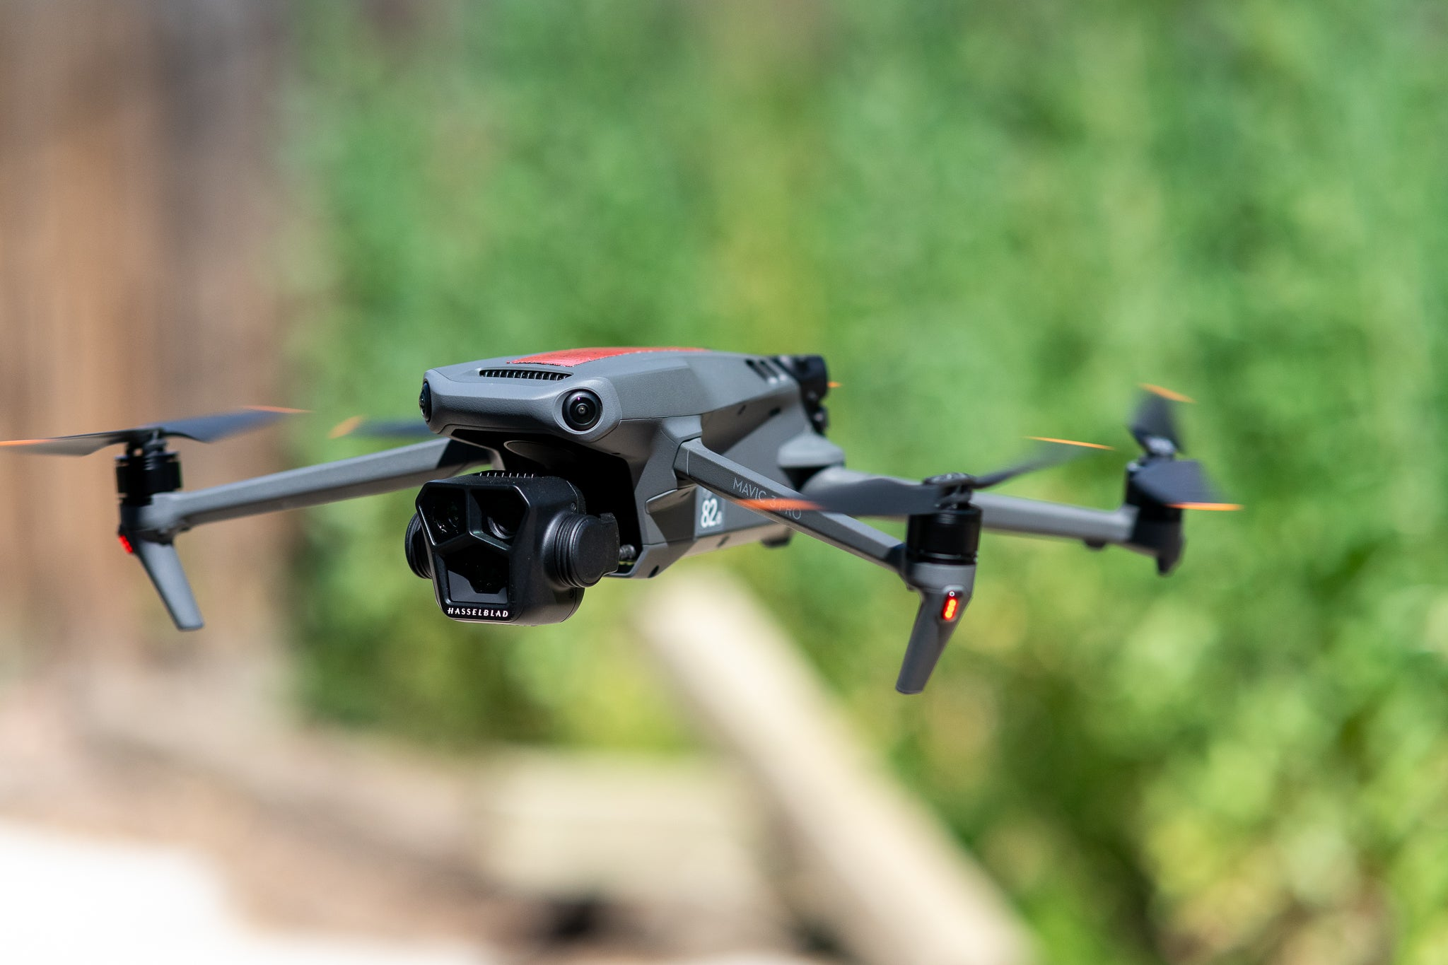
DRONES

Slide 2
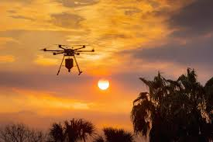
QUESTIONS
Have you ever seen a drone? Where and what was it being used for?
What do you think are some useful tasks drones can help with?
Are there any concerns you think people might have about using drones?

Slide 3
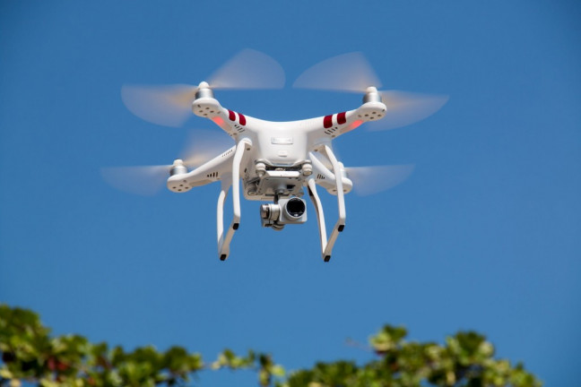
Brief explanation
What is a Drone?
A drone is a type of aircraft that flies without a pilot onboard. It can be controlled from the ground by a person or follow instructions through a program. Drones vary in size and are used for many purposes, including photography, agriculture, delivery, and rescue missions.
Why Are Drones Important?
Drones allow us to see and reach places that are hard for people to access. They make some jobs easier, faster, and safer.

Slide 4
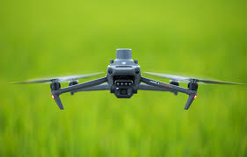
Terms
Drone: A flying machine controlled from the ground or programmed to fly without a pilot.
Remote Control: A device used to control the drone from a distance.
Delivery: Bringing packages or items to people’s homes or businesses.
Rescue Mission: A task to save people in danger, often in hard-to-reach places.
Privacy: The right to keep personal information or actions private.

Slide 5
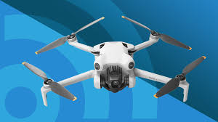
Key points
What Drones Do:
Drones can take photos and videos from the sky, which is helpful in filmmaking and photography.
Farmers use drones to check on their crops and see if they need water or fertilizer.
In some cities, drones are used to deliver small packages quickly.
Drones are also used in rescue missions to reach people in difficult places, such as mountains or disaster areas.
Advantages of Drones:
Efficient: Drones can complete some tasks faster than humans.
Safe: Drones can go to dangerous places, reducing risk to people.
Accessible: Drones can reach areas that are hard for people to access.
Disadvantages of Drones:
Expensive: Drones can be costly to buy and repair.
Privacy Concerns: Drones can take photos and videos, which may invade people’s privacy.
Possible Accidents: Drones need careful handling to avoid accidents.

Slide 6
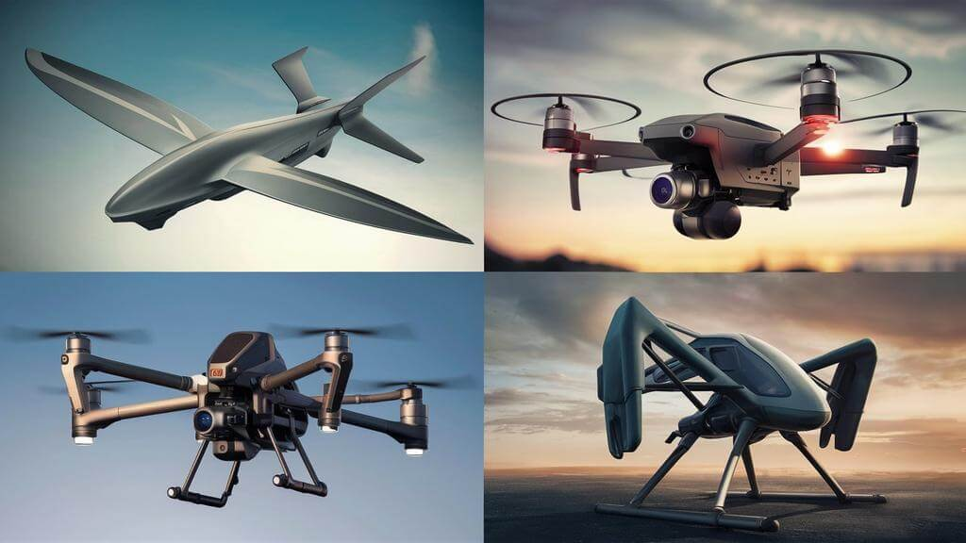
Discussion Questions
How can drones make certain jobs easier or faster?
Why do you think privacy is a concern for people when it comes to drones?
Can you think of other jobs that might benefit from using drones?
How do you feel about using drones for deliveries? Would you like to receive a package by drone?
What are some other ways drones might be used in the future?

Slide 7
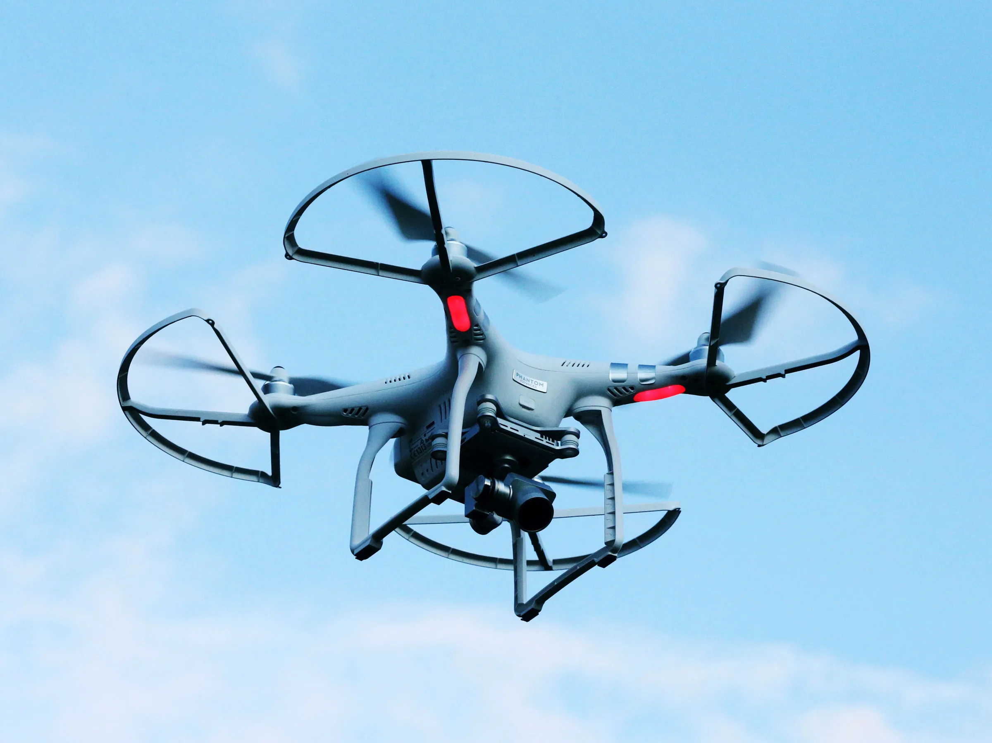
Real-Life Examples of Drones
choose one area where drones are used, such as filmmaking, farming, or rescue operations.
write a short paragraph about how drones help in that field.
present your example to the class.
Example Answer:
“Drones are helpful in farming. Farmers use drones to check on their crops. The drones fly over the field and take pictures, so farmers can see if the plants need water or fertilizer. This saves farmers time and helps them grow healthy crops.”

Slide 8
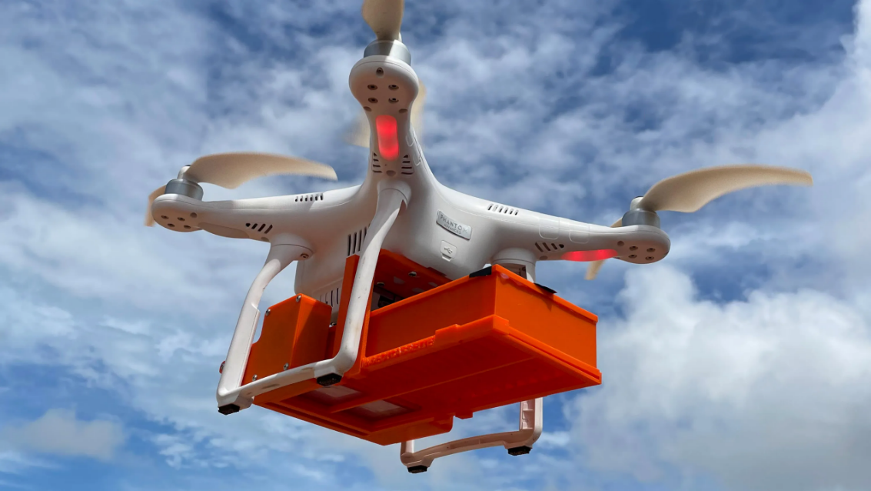
Conclusion and Recap
Drones are unmanned flying machines used for many purposes, such as photography, delivery, farming, and rescue missions.
Drones have both advantages, like efficiency and safety, and disadvantages, like high costs and privacy concerns.
The use of drones is expected to grow in the future as technology advances.

