Slide 1
Infinitive / Gerund
Part 1

Slide 2
Він хоче читати
Він любить читати
Він вміє читати

Slide 3

He wants to read (читати)
He likes reading (читати)
He can read (читати)

Slide 4
1
Bare Infinitive V
Modal verbs
Can, should, must, may, might, will, would
He should learn foreign languages.
Let, make
He let me watch TV.
(Тільки актив)
He made me wash up.
(актив)
I was made to work.
(пасив)
3) You‘d better
I would rather
You had better go.
I would rather go.

Slide 5
1. Sarah lets her dog _______ for a walk in the park every evening.
a) goes
b) to go
c) go
2. You ________ study harder if you want to pass the exam.
a) better
b) had better
c) to better
3. I would rather _______home tonight rather than go out.
a) stay
b) staying
c) to stay
4. He may _______ his phone at home.
a) leave
b) to leave
c) leaving

Slide 6
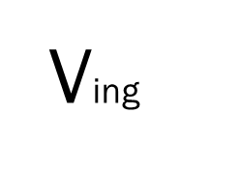
3
Gerund (Ving)
1) As subject (підмет)
Smoking is harmful.
2) Words of feeling
I like
love
hate
prefer
can‘t stand
don‘t mind
I don‘t mind learning Maths.
3) Some words
Admit
Avoid
Continue
Suggest
…
Object to
Look forward to
I look forward to visiting you.
4) After prepositions:
By, with…
On, in, of…
We were extited about visiting them.
5) Phrases:
I am busy
It‘s no use
It‘s worth
I can‘t help
As well as
It‘s worth reading this book.
6) Go skiing
dancing
He goes skiing every winter…

Slide 7
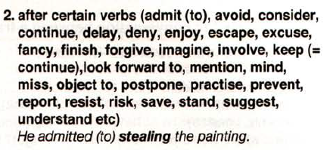
Gerund after these verbs

Slide 8
1. I enjoy _______ novels in my free time. a) reading b) read c) reads d) to read 2. She can't stand _______ in long lines. a) wait b) waits c) waiting d) waited 3.I look forward to ________ you at the party. a) see b) seeing c) saw d) seen 4. He admitted _______ a mistake. a) make b) makes c) making d) made
5. They love ________ in the park. a) walk b) walks c) to walk d) walking 6. It's worth ________ the extra mile for success. a) go b) going c) went d) gone 7. She prefers ________ rather than swimming. a) ski b) skis c) skiing d) to ski 8. It's no use ________ about it now. a) think b) thinks c) thinking d) thought

Slide 9
8
Full Infinitive (to V)
1) Щоб (причина)
I went there to meet him.
2) I‘d like
I‘d love to
I‘d prefer
I’d love to change the world
3) Решта слів
Agree, decide, expect ……
He decided to write a book.
4) Після прикметників
I am glad to see you.
5) Too, enough
He was too stunned to speak
6) It is kind of you to…
It is kind of you to invite us
7) He was the first to
next to
last to
best to…
He was the first to write it.
8) What? Where? How?
I don’t know what to do

Slide 10
1. I’d love ___________ this book for children.
a) writing
b) to write
c) write
2. She is happy enough ___________ for the party.
a) prepare
b) to prepare
c) preparing
3. It was bad of you ___________ these things.
a) to do
b) doing
c) do
4. He was the next ___________ that evening.
a) to call
b) calling
c) call
5. She wants ___________ the trip.
a) planning
b) plan
c) to plan
6. We called them ___________ the future plans.
a) discuss
b) to discuss
c) discussing

Slide 11
