Slide 1

Employment trends. Resolving the conflicts.
Created by Iryna Zhukevych
PhD in Pedagogical Sciences
Associate Professor

Slide 2

How do you understand the word “Conflict”?

Slide 3
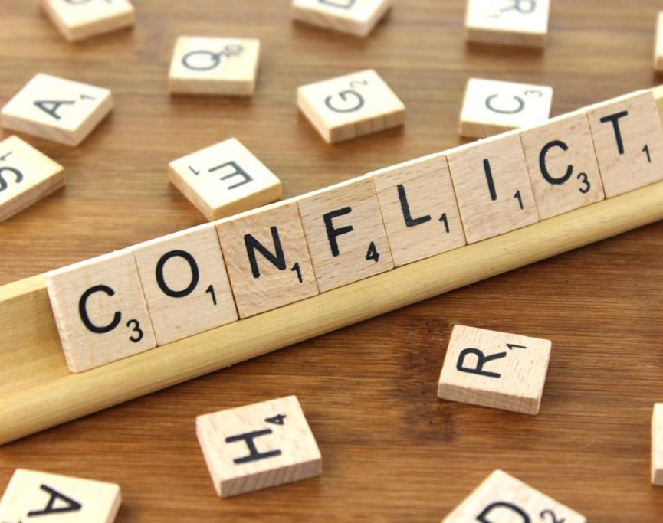
What was your last disagreement that you had with someone in the family, at work or with a stranger in the street? What was the conflict about and how did you resolve it?
Це фото; автор: Невідомий автор; ліцензія: CC BY

Slide 4

Market Leader. Advanced
Course Book
Unit 5. p. 48-49, ex. A-I.
Audio tracks 2.12-2.13

Slide 5
How To Resolve Conflict at Work
A Manager's Role in Resolving Conflict
https://www.youtube.com/watch?v=fshjGv43dR8
Decide if the sentence is True or False.
Workplace conflict is uncommon and rarely occurs between team members.
According to the video, a manager spends a significant amount of time mediating workplace conflicts.
The video suggests that personal bias can lead to workplace conflicts.
All workplace conflicts can be resolved without any intervention.
Differences in work styles and backgrounds can contribute to workplace conflict.
The workplace environment can affect the likelihood of conflicts occurring among employees.
Resolving workplace conflict early is not important according to the video.

Slide 6
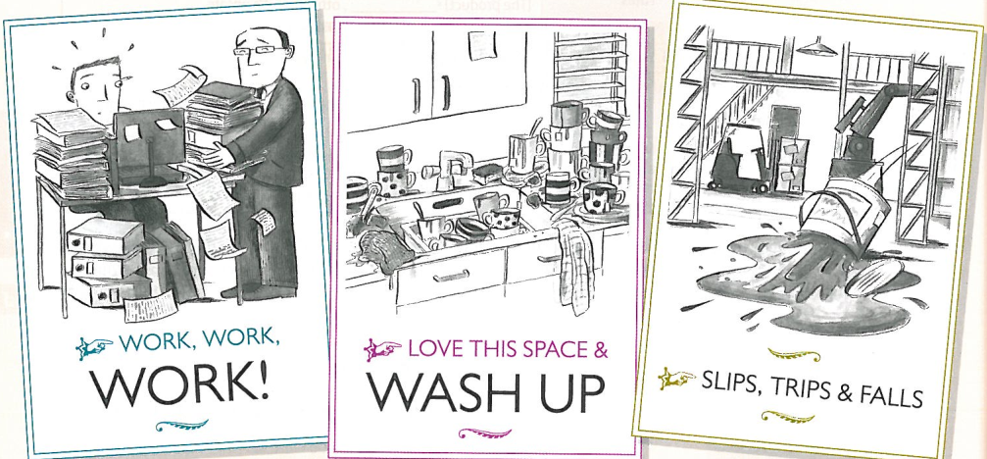
Look at some of the reasons for possible conflict in a team. Have you experienced any of these at your work or place of study?

Slide 7
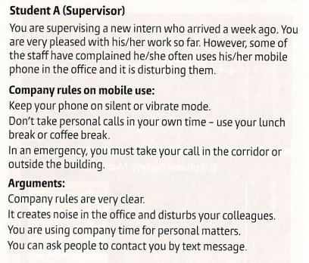
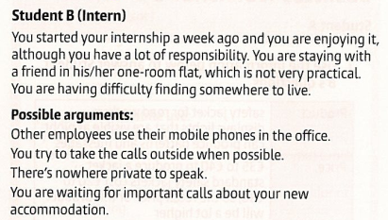
Practice
You are going to practice resolving the conflict.
Scenario.
Several colleagues have complained about a new intern using his/her mobile phone in the office. The intern’s supervisor has agreed to meet the intern and one of the colleagues to resolve the situation.

Slide 8

The Most Effective CONFLICT RESOLUTION Techniques At Work
https://www.youtube.com/watch?v=2vmWAqat86A
1. Describe the importance of having a conflict resolution toolkit in the workplace.
2. What are some specific guidelines that one should include in their personal conflict resolution toolkit? Provide at least three examples.
Explain the concept of active listening and its role in effective conflict resolution. How can it impact communication?
4. Discuss the difference between empathy and sympathy as mentioned in the video. Why is it important to understand this distinction in conflict resolution?
5. What is the significance of mindfulness in managing conflict according to the speaker? How can it help individuals deal with their emotions during disagreements?

