Slide 1

Great Innovators
Created by Iryna Zhukevych
PhD in Pedagogical Sciences
Associate Professor

Slide 2

Discuss the following statement
Many of the most innovative ideas come from people who challenge the status quo and think differently.

Slide 3

Let’s check your knowledge
https://docs.google.com/forms/d/1C75_f-yWGJEppnw0LogZ46l1ubJ_XOlm4cWC1jn8abw/edit

Slide 4

Short information about famous innovators
https://gamma.app/docs/Untitled-0kmyi5bj6qurp23?mode=doc

Slide 5
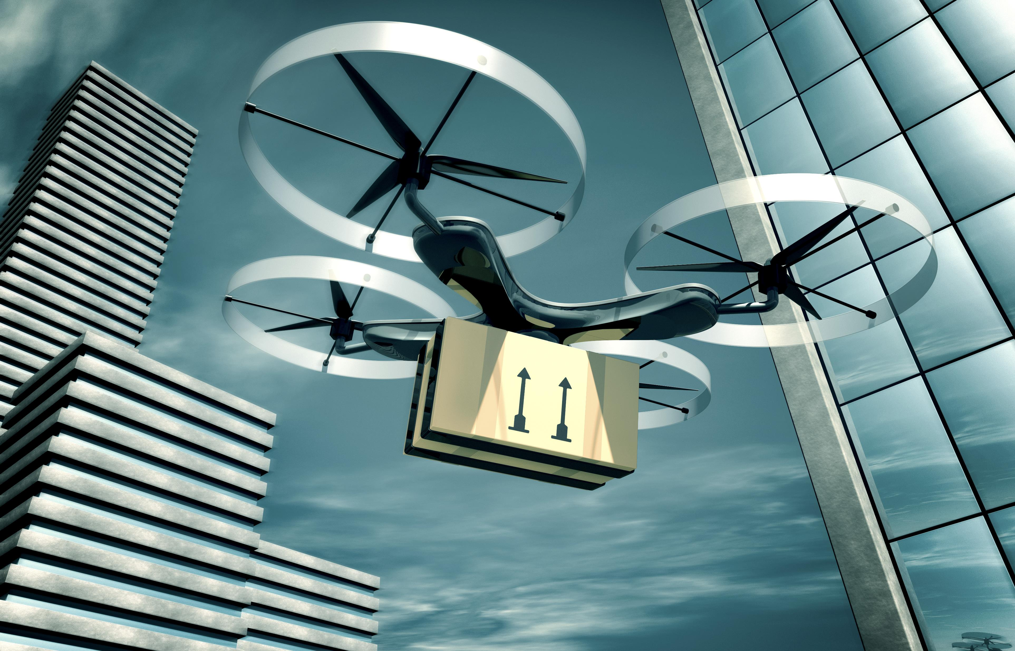
Smart technology
https://app.fluentize.com/lesson/smart-technology-impact/download/interactive
https://www.youtube.com/watch?v=95cTchHTZlA
After watching the video discuss what problems these inventors were trying to solve with their inventions.

Slide 6

Watch the video “The 10 AI Innovations Expected to Revolutionize 2024 – 2025” and discuss the questions below
https://www.youtube.com/watch?v=xouZueHZ6dM

Slide 7

AI and Tech Innovations Impacting the World
Describe how AI-powered self-driving vehicles are expected to transform transportation.
What advancements in augmented reality can we expect between 2024 and 2025?
Explain the significance of GPT-5 and its expected capabilities.
How is cloud computing predicted to change the healthcare industry by 2025?
What potential applications do brain-computer interfaces have in medical and entertainment fields?
Discuss the implications of 3D printing in sectors like the military and space exploration.
What role is SpaceX playing in the development of space-based internet networks?

Slide 8
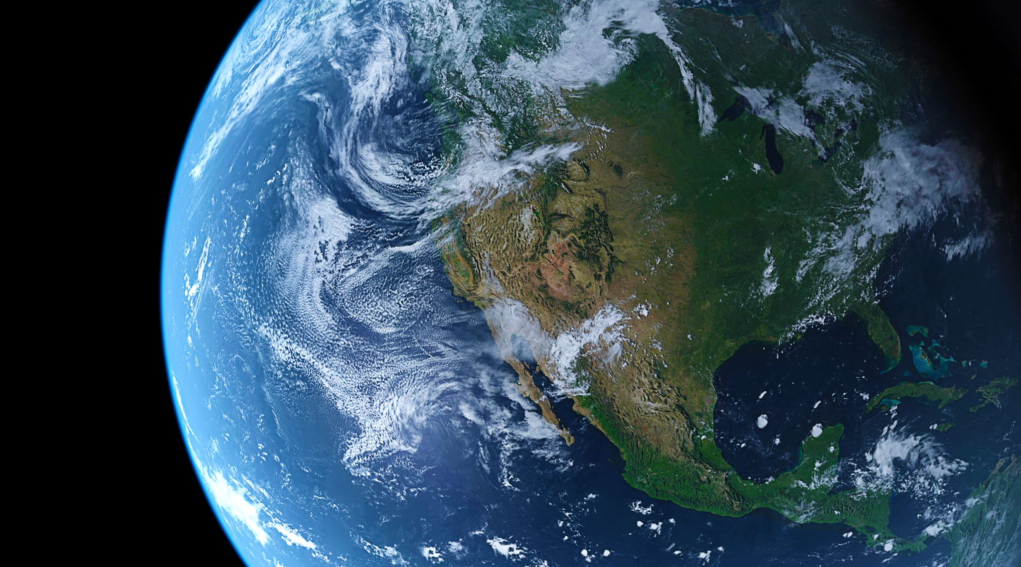
Additional materials
Video about INVENTIONS THAT WILL SOON CHANGE THE WORLD
https://www.youtube.com/watch?v=2Cwtln8SprM

