Slide 1

Created by Iryna Zhukevych
PhD in Pedagogical Sciences
Associate Professor
Це фото; автор: Невідомий автор; ліцензія: CC BY-SA

Slide 2
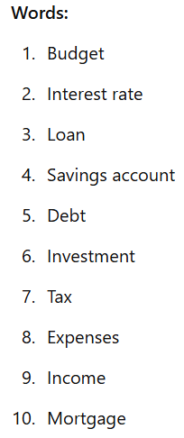
Match the words with their correct definitions.
A. Money you earn from working or investments B. The amount of money a bank lends to you to buy a house or property C. Money you owe, usually due to borrowing D. Money you pay to the government based on your income or purchases E. The amount of money the bank charges for borrowing money F. A type of account where you save money and earn interest G. Money you spend on things like food, rent, or transportation H. A financial product that allows you to borrow money to purchase something I. Putting money into something with the expectation of earning a profit J. A plan for how you will spend and save your money

Slide 3
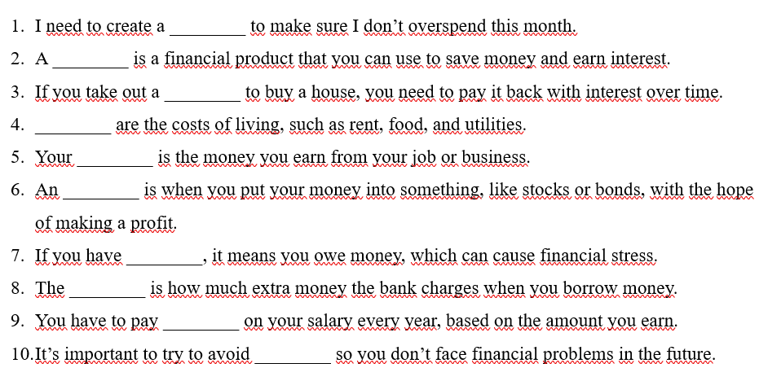
Fill in the blanks with the correct words from the list below.
Words: budget, savings account, debt, expenses, income, investment, loan, mortgage, interest rate, tax

Slide 4
Discuss the following questions.
1. Do you think it’s better to rent or buy a house? Why?
2. How do you usually manage your personal finances? Do you use a budget?
3. What are the advantages and disadvantages of taking out a loan?
4. What do you think is the most important aspect of personal finance?

Slide 5

Read the statements below. Write "True" or "False" next to each one.
A loan is money you receive that you must pay back with interest.
A mortgage is a type of savings account.
A budget helps you plan your monthly expenses.
Interest rates are the fees charged by the bank for borrowing money.
Taxes are usually paid at the end of the year.
An investment is a type of loan you give to the government.
You should avoid taking out a loan if you don’t have a stable income.

Slide 6
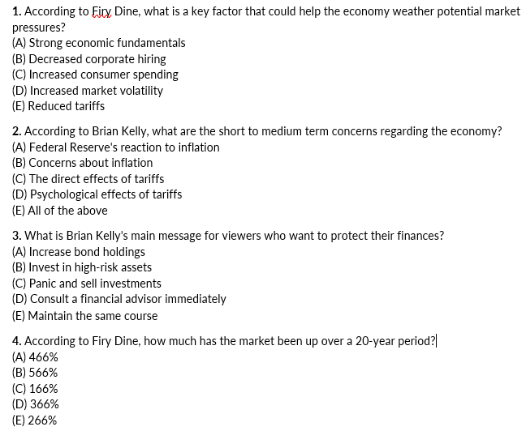
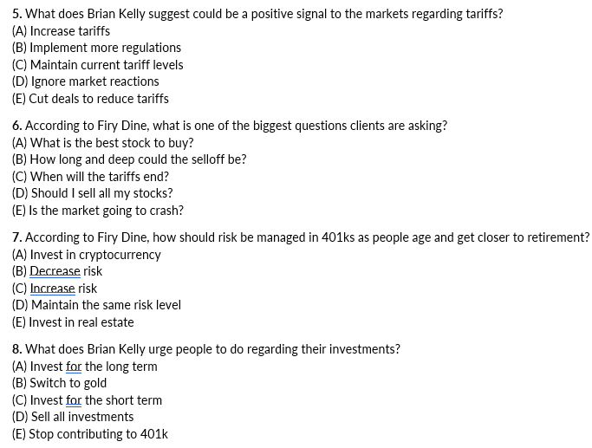
Watch the video and do the quiz. https://www.youtube.com/watch?v=AOF-stK_yOE

Slide 7
Scenario 1: Budgeting for a Student Exchange (Focus: Budgeting, Currency Exchange, Cost of Living)
Olena, a student from Kyiv, has been accepted for a semester-long exchange program in Poland.
Task/Questions:
Olena needs to create a budget for her time abroad. What factors should she consider, such as accommodation, food, transportation, and entertainment?
Discuss the best ways for Olena to exchange Ukrainian hryvnia (UAH) to Polish złoty (PLN). What are the potential risks and benefits of different methods?
Research the cost of living in a major Polish city compared to Kyiv. What are the key differences, and how can Olena adapt her spending habits?
What kind of unexpected cost should Olena plan for?
Language Focus:
Discussing financial planning, comparing costs, using conditionals ("If she does this, then..."), and expressing opinions.

Slide 8
Scenario 2: Managing Part-Time Work and Studies (Focus: Income, Expenses, Time Management)
Dmytro, a university student in Lviv, works part-time in a café to support himself.
Task/Questions:
Dmytro needs to balance his work schedule with his studies. What strategies can he use to manage his time effectively?
Analyze Dmytro's monthly income and expenses. How can he identify areas where he can save money?
What are the legal considerations for student part-time work in Ukraine, such as taxes and labor laws?
Discuss the pros and cons of part-time work for a student.
Language Focus:
Analyzing data, providing advice, discussing legal implications, and debating pros and cons.

Slide 9
Scenario 3: Saving for the Future (Focus: Saving, Investing, Financial Goals)
Yulia, a student in Kharkiv, wants to start saving money for her future, such as for further education or a down payment on an apartment.
Task/Questions:
What are the different saving options available to young adults in Ukraine, such as savings accounts or term deposits?
Discuss the potential benefits and risks of investing in the Ukrainian financial market. What are some basic investment concepts that Yulia should understand?
Help Yulia create a realistic financial plan with short-term and long-term goals. How can she stay motivated and disciplined with her saving habits?
Discuss the importance of financial literacy for young people in Ukraine.
Language Focus:
Explaining financial concepts, creating financial plans, giving presentations, and expressing informed opinions.

Slide 10

Let’s do the test.
https://docs.google.com/forms/d/e/1FAIpQLSe3HncTux-UKrffTBDHEk4qXrbMci2zZGym8Wvya_Wj5QJJkA/viewform?usp=header

