Slide 1

The World Wide Web

Slide 2
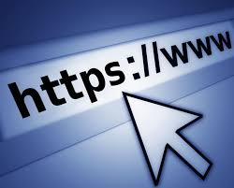
Activity: "Life Before the Web"
Ask students: "Can you imagine life without the World Wide Web?"
Discuss how people accessed information before the internet era (e.g., books, newspapers, TV).
Discussion Prompt: "How has the WWW changed the way we communicate and work?"

Slide 3

Key Terms & Basic Definitions
World Wide Web (WWW): A system of interlinked web pages and multimedia content accessed via the internet.
Hypertext Transfer Protocol (HTTP/HTTPS): The protocol used for transferring data over the web.
Web Browser: A software application (e.g., Chrome, Firefox) used to access web pages.
Web Server: A computer that stores and delivers web content.
Uniform Resource Locator (URL): A unique address for web resources.
HTML (Hypertext Markup Language): The standard language for web page structure.
CSS (Cascading Style Sheets): A styling language used for designing web pages.
JavaScript: A programming language for interactive web applications.
Search Engine: A tool (e.g., Google, Bing) that helps users find information online.
Web 3.0: The next generation of the web, focusing on AI, decentralization, and blockchain.

Slide 4
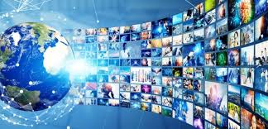
Discussion Questions
How does the World Wide Web differ from the Internet?
Why is HTTP/HTTPS important for web security?
How do search engines rank and display web pages?
What are the challenges of Web 3.0 compared to earlier versions?
How has the WWW impacted privacy and cybersecurity?

Slide 5

Speaking Topics
"The Evolution of the World Wide Web: From Web 1.0 to Web 3.0"
"The Role of Search Engines in the Digital Age"
"Why Cybersecurity is Critical for the World Wide Web"
"The Impact of Social Media and E-Commerce on the WWW"
"How the WWW is Changing with AI and Blockchain Technologies"

Slide 6

Advantages & Disadvantages of the WWW
Advantages | Disadvantages
Instant access to information worldwide | Privacy and security risks
Global communication and collaboration | Spread of misinformation
E-commerce and digital economy opportunities | Cybercrime and hacking threats
Online learning and entertainment | Digital divide (unequal access to the internet)

Slide 7
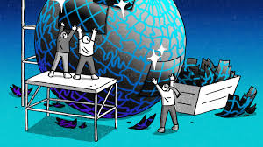
Task: "Build Your Own Web Page"
Design a simple personal or business web page using HTML & CSS.
Steps:
Define the purpose of the web page (e.g., portfolio, news, product showcase).
Create a basic structure using HTML.
Style it using CSS for layout and design.
Present and explain the design choices.

Slide 8
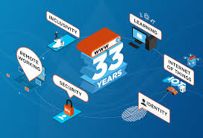
Conclusion & Reflection
Final Thought: "The World Wide Web connects people, businesses, and knowledge, but also presents challenges in privacy, security, and accessibility."

