Slide 1

Energy. Problem Solving
Created by Iryna Zhukevych
PhD in Pedagogical Sciences
Associate Professor

Slide 2
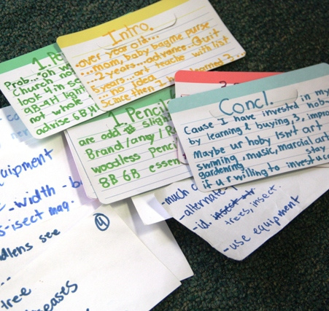
Speaking Cards
https://wordwall.net/resource/80234278/energy
Це фото; автор: Невідомий автор; ліцензія: CC BY-SA-NC

Slide 3
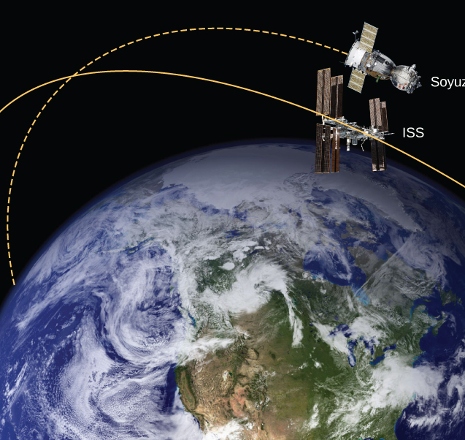
Video: The Energy of Earth
Watch a video by TED Ed called “A guide to the energy of the Earth.” Watch the video here:
https://yourenglishpal.com/blog/esl-conversation-lesson-plan-energy/
Це фото; автор: Невідомий автор; ліцензія: CC BY

Slide 4
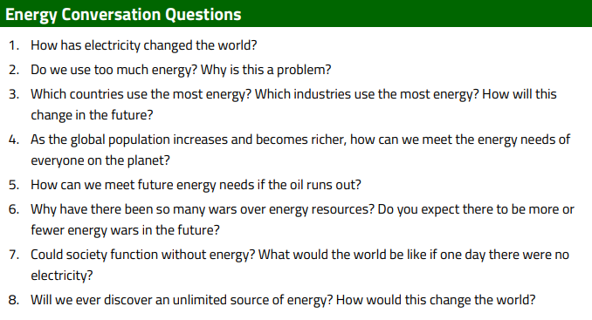

Slide 5
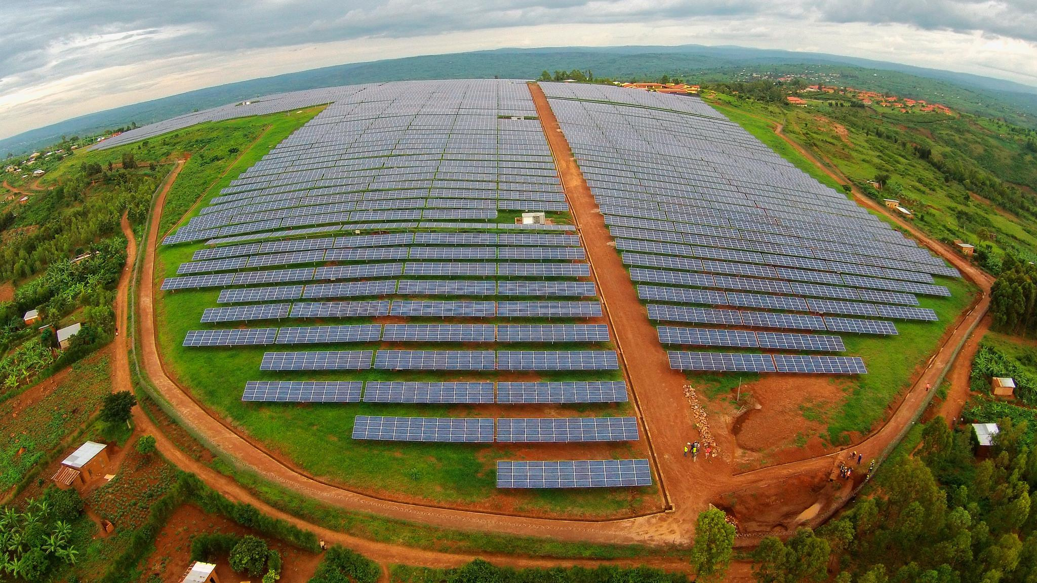
Watch the video
“The Latest Breakthroughs in Renewable Energy Technology”
https://www.youtube.com/watch?v=wk4CVRRes0E
Це фото; автор: Невідомий автор; ліцензія: CC BY-SA-NC

Slide 6
After watching the video decide if the sentence is True or False
1. Recent breakthroughs in solar energy technology have made it less efficient and more expensive.
2. Perovskite solar cells are made from a unique material that can convert sunlight into electricity at a lower cost than traditional silicon cells.
3. Concentrated solar power uses mirrors or lenses to focus sunlight onto a small area to generate heat and electricity.
4. Thin film solar cells are heavier and less flexible than traditional solar cells.
5. Battery systems allow solar energy to be used as a base load power source even when the sun is not shining.
6. Larger wind turbines with longer blades are designed to capture more wind energy and generate less electricity.
7. Offshore wind farms are being developed in shallow waters where winds are less consistent.
8. Tidal energy is a form of hydropower that harnesses the energy of ocean tides to generate electricity.
9. Enhanced geothermal systems can tap into deeper sources of heat and increase the efficiency of geothermal power plants.
10. Geothermal energy cannot provide a reliable source of base load power.

Slide 7
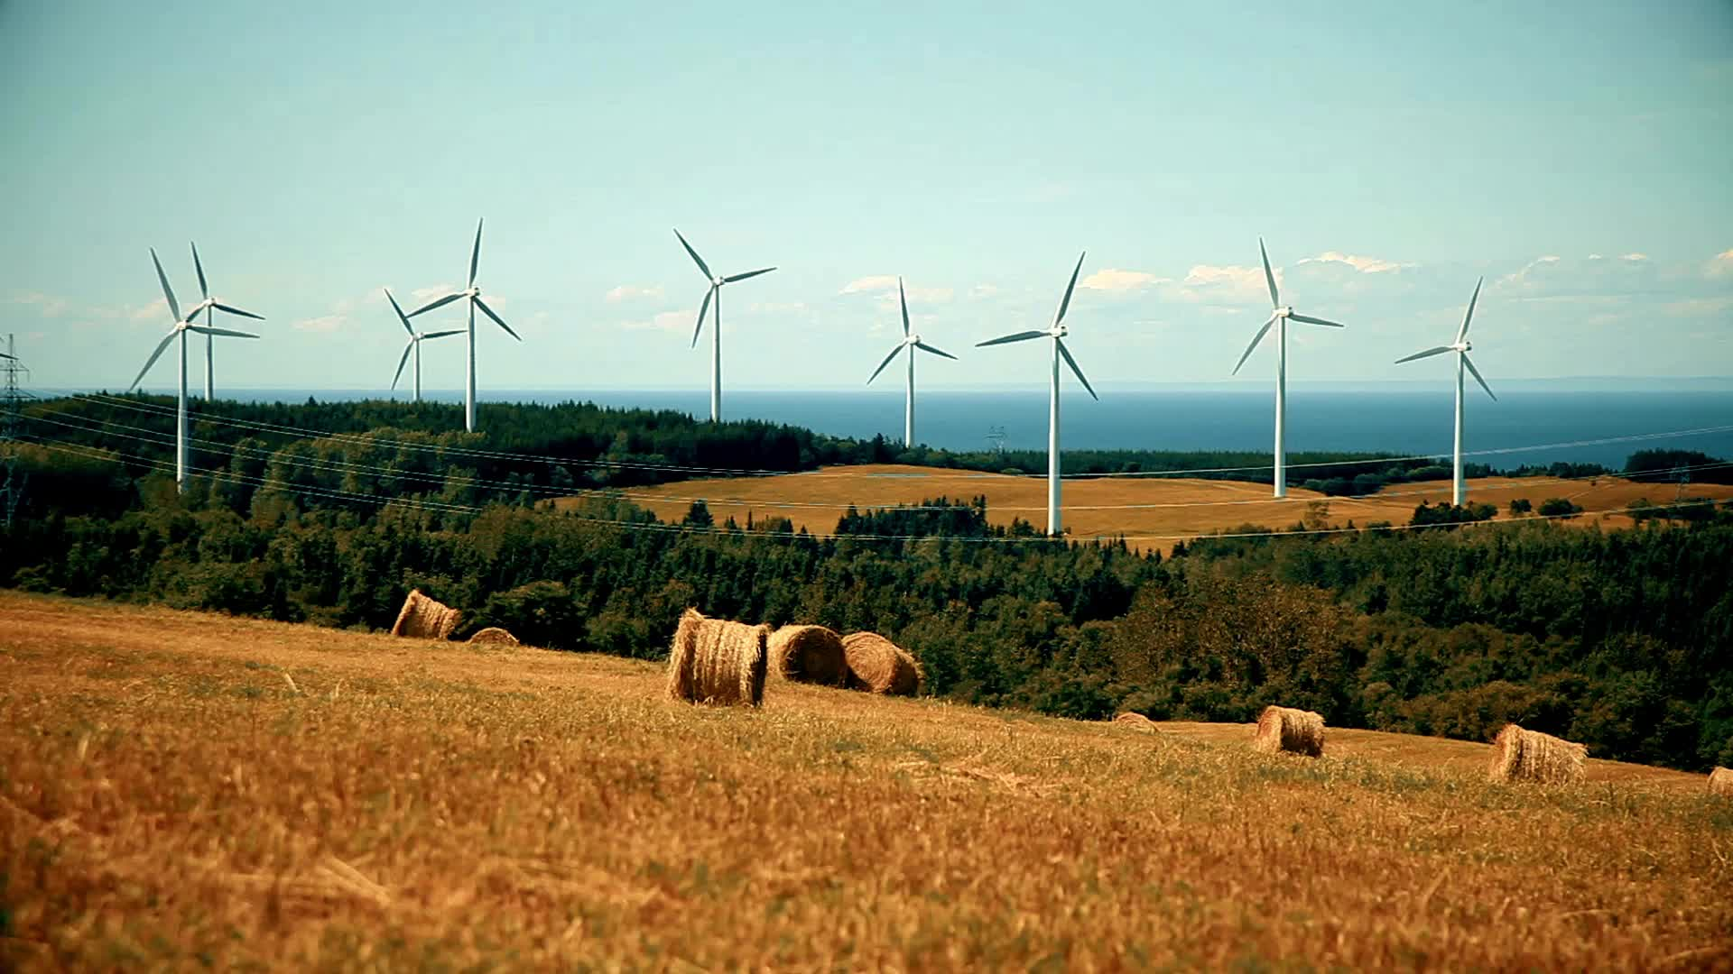
Describe three ways in which energy consumption impacts the environment

Slide 8
List three principles of energy conservation and explain how they can be applied in everyday life

Slide 9
Speaking
Think of one energy-saving action you can commit to for the week.
Introduce the concept of energy conservation and encourage personal responsibility in energy use.

Slide 10
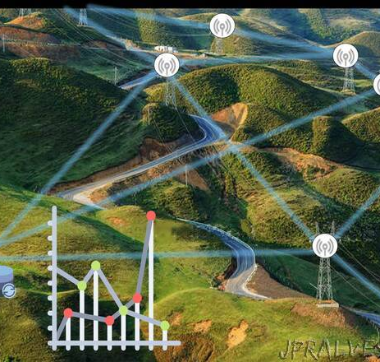
Watch the video.
Discuss your thoughts and reactions to the information presented
https://www.youtube.com/watch?v=9aBNIekp4qY&t=10s
Це фото; автор: Невідомий автор; ліцензія: CC BY-NC-ND

