Slide 1
Understanding Your Field. Revision
Created by Iryna Zhukevych
PhD in Pedagogical Sciences

Slide 2
"The most powerful person in the world is the storyteller. The storyteller sets the vision, values, and agenda of an entire generation that is to come."
Steve Jobs (1955 – 2011), co-founder of Apple

Slide 3
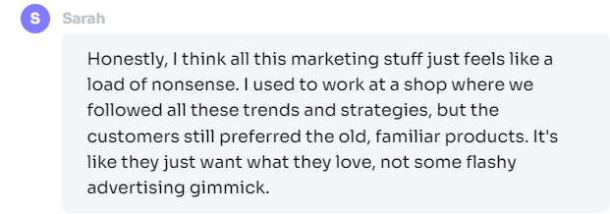
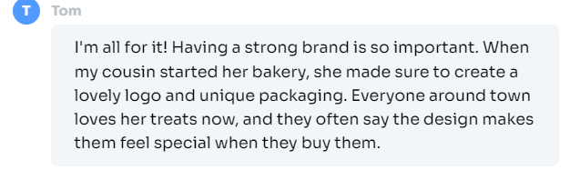
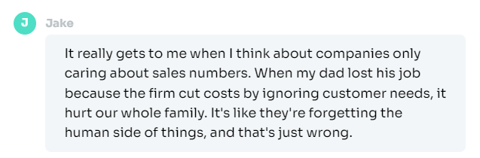
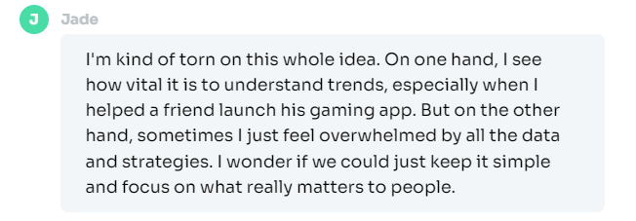
Read these opinions. Which one do you agree with the most and why?

Slide 4

Marketing Discussion
What is marketing?
What comes to your mind when you think of the word 'marketing’?
What's the difference between marketing and advertising?
Can you think of any memorable marketing campaigns? What made them so memorable?
What are the most successful marketing tactics?
Is marketing always necessary for all products and services? Can you think of any exceptions?
What are the greatest challenges in marketing today?

Slide 5
Marketing Vocabulary
market research (noun) – the collection, interpretation and analysis of information on the target market for a particular product or service.
market segmentation / market segment (nouns) – the process (segmentation) by which potential customers can be grouped together (segment) into categories such as demographics or special interests.
the marketing mix / the Four Ps (noun) – the four considerations known as the marketing mix are: product (the item or service sold to satisfy customers' needs); price (the correct price for the target market); promotion (how customers are informed about the product); and place (where the product will be sold to maximize sales).
guerilla marketing (noun) – an unconventional, surprising or creative marketing strategy.
marketing executive (noun) – a professional who works in marketing.
niche market (noun) – a smaller, more specialized subset of a wider market for a product or service.

Slide 6
Using the vocabulary words above, complete the following sentences (remember to use the correct form of the word, e.g. verb conjugation or plural noun)
Many companies make the mistake of trying to target the mass market when they would have much more success targeting a smaller _________.
Sasha Baron Cohen invading the Oscars ceremony and 'spilling' the ashes of Kim Jong-Il to promote his new film was a great example of _______.
The _________ for Apple's iPod was young adults and teenagers.
The ________ should always be taken into account when bringing a new product to market.
The results of JLB’s _________ suggested their products should be aimed at recent retirees or those close to retirement.
The work of a __________ can vary from launching marketing campaigns and analyzing market research data to managing social media accounts.

Slide 7

Discussion Questions Before Watching Video
1. What do you think are the core values of a successful brand?
2. Do you believe that marketing should focus more on values and beliefs rather than product features?
3. How important is it for a company to invest in marketing and branding?
4. Can you think of any other brands that have successfully communicated their core values through marketing?
5. Do you agree with the statement that people with passion can change the world for the better?

Slide 8
Video: Steve Job's Marketing Philosophy https://www.youtube.com/watch?v=keCwRdbwNQY&t=3s
After you've watched the video, discuss the following questions:
Are the values of a company important when you buy a product? What values are you most attracted to in a brand?
What are the values that Apple communicates?
Steve Jobs mentioned Nike as an example of a company that communicates its values well. What are the values of Nike in your opinion?
Can you think of any other companies that market their products in a similar way?
Which companies tend to focus on specifications, rather than on values, when marketing their products?
Is there anything more important than communicating the brand's values when marketing products and services?

Slide 9
True / False Statements
Apple recently fired their advertising agency and started a competition with 23 new agencies.
The speaker believes that Apple is about more than just making boxes for people to get their jobs done.
The new marketing campaign aims to honor people who have changed the world.
The speaker mentions that Apple's core values have changed significantly over the years.
The theme of the new campaign is "Think Different.
The speaker states that the market and Apple's place in it have remained the same over the past decade.
The speaker feels indifferent about the new marketing campaign.

Slide 10
Conversation Questions
How has the internet changed marketing?
If you had created your own product or service, how would you go about marketing it?
How do national cultures affect how products are marketed?
What new consumer trends could marketing take advantage of?
What ethical considerations should you consider when marketing a product for children?
Do you think marketing could be considered an art or a science? Why or why not?
Is the purpose of marketing to convince people to buy things they don't need?
The New York Times described marketing as “the art of telling stories so enthralling that people lose track of their wallets.” Do you agree with this definition of marketing?

