Slide 1

Created by Iryna Zhukevych
PhD in Pedagogical Sciences
Associate Professor
Це фото; автор: Невідомий автор; ліцензія: CC BY-SA

Slide 2
What comes to mind when you think of alliances?

Slide 3
Watch the video and discuss the questions below.
https://www.youtube.com/watch?v=l0O6B7i94aU
1. What are the main differences between formal and informal alliances as described in the video?
2. Discuss why countries prefer to form alliances rather than act independently. What advantages do alliances provide?
3. How did historical events, such as the world wars, influence the perception of alliances, particularly for the United States?
4. What are some potential downsides to forming defense alliances, according to the speaker?
5. Reflect on the statement about critics of U.S. alliances. What are the benefits mentioned that critics might overlook?

Slide 4

The main types of alliances
Defensive alliances (e.g., NATO)
Offensive alliances (e.g., Axis powers in WWII)
Economic alliances (e.g., European Union, NAFTA)
Political/ideological alliances (e.g., Non-Aligned Movement)

Slide 5

Watch the video and discuss the difference between treaties and alliances.
https://www.youtube.com/watch?app=desktop&v=C9m6IQX87G4

Slide 6
Discuss the potential motivations and benefits for countries to form these different types of alliances.

Slide 7
Watch the video and discuss the main idea of the EDUC European University Alliance
https://www.youtube.com/watch?v=auHV9gMgdUQ

Slide 8
Discuss the following statement
"Alliances can both prevent and provoke conflicts in international relations.“

Slide 9
Choose one country and explain how its participation in international alliances has shaped its national identity and foreign policy.

Slide 10
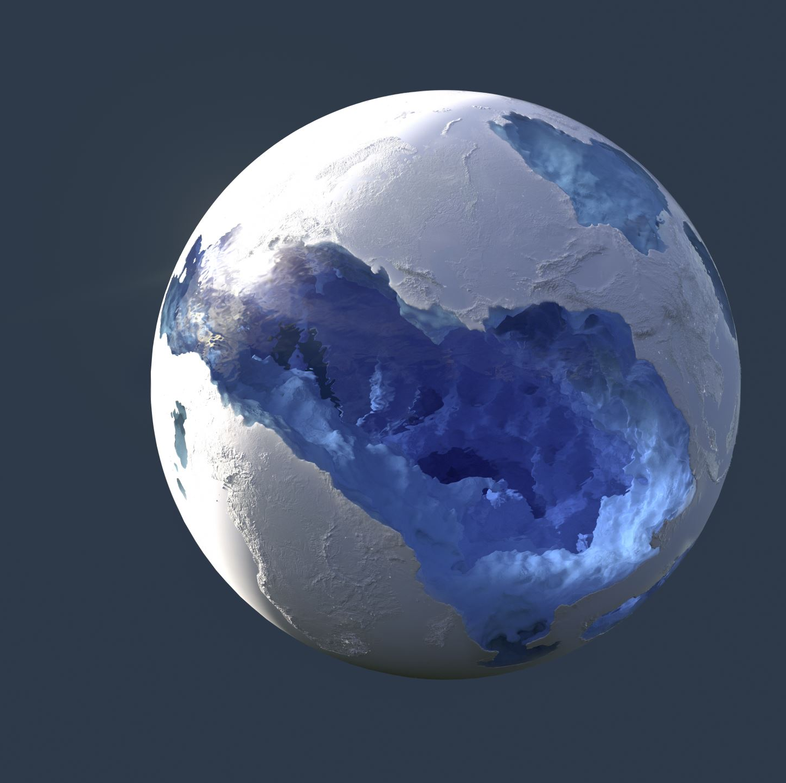
Choose one of the following contemporary alliance issues and discuss its potential implications for global politics
a) The rise of China and its impact on existing alliances in Asia-Pacific
b) The future of NATO in the face of changing security threats
c) The role of alliances in addressing global challenges like climate change

