Slide 1

Employment trends
Created by Iryna Zhukevych
PhD in Pedagogical Sciences
Associate Professor
Це фото; автор: Невідомий автор; ліцензія: CC BY-SA

Slide 2
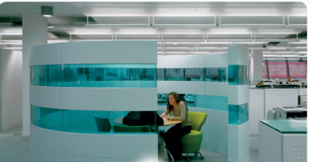

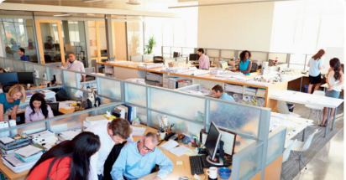
Look at the photos. Which one is closest to the environment that you work in or expect to work in one day? What are the advantages and disadvantages of each place?

Slide 3
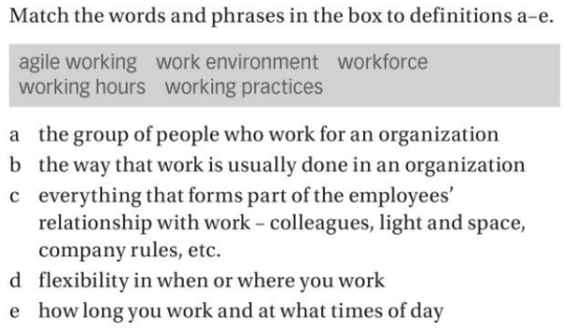

Slide 4
Discuss how you think people’s work environments, working hours and practices have changed in recent years, or may change in the future.

Slide 5
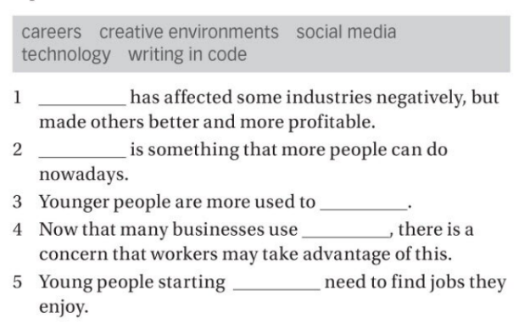
Watch the video and complete statements with the correct topic from the box.
https://en.islcollective.com/english-esl-video-lessons/listening-comprehension/deep-listening-focus-on-meaning/the-future-of-work/584989

Slide 6

Debate about the future of work
https://en.islcollective.com/english-esl-video-lessons/speaking-practice/discussion/jobs-and-work/debate-about-the-future-of-work/737319
Це фото; автор: Невідомий автор; ліцензія: CC BY-ND

Slide 7

What jobs do you think will be most in demand by 2030 and why?
Це фото; автор: Невідомий автор; ліцензія: CC BY-SA-NC

Slide 8
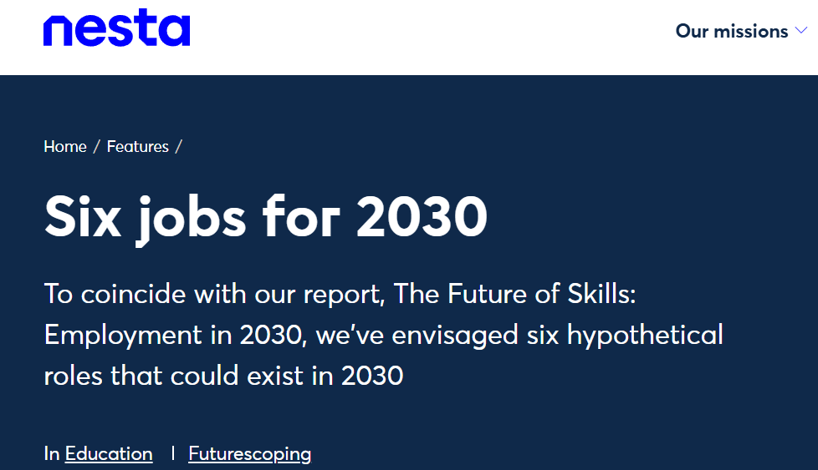
Were you surprised by any of the predictions in the Future of Skills report?
https://www.nesta.org.uk/feature/six-jobs-2030/

Slide 9

Market Leader. Advanced
Course Book
Unit 5. p. 44-45, ex. A-I.
Audio tracks 2.1-2.11

Slide 10

Answer the questions below
Q. How has your chosen career changed over the last century? Have the skills and knowledge required for this career changed over time?
Q. How might this career or job area continue to change in the future?
Q. What are some of the training or study pathways which lead to a career in this area?

