Slide 1

Computer Applications
Created by Iryna Zhukevych
PhD in Pedagogical Sciences
Associate Professor

Slide 2

Watch the video and answer the questions below
https://www.youtube.com/watch?v=3gMOYZoMtEs&t=13s
1. What is an app, and how does it function on a smartphone or tablet?
2. Describe how mobile apps can enhance convenience in daily activities. Provide an example from the video.
3. Explain the difference between mobile apps and computer applications based on the information provided in the video.
4. What types of tasks or activities can apps assist users with, according to the video?
5. Discuss the ways in which apps contribute to communication, productivity, and entertainment.
6. How can users acquire new apps? What are some methods mentioned in the video?

Slide 3

Speaking Cards
https://wordwall.net/resource/79563875/computer-applications

Slide 4

Theoretical Materials. Presentation
https://gamma.app/docs/Untitled-fzd1khygz5mdkf0?mode=doc

Slide 5
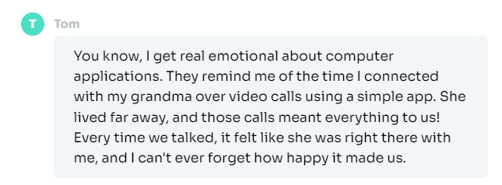


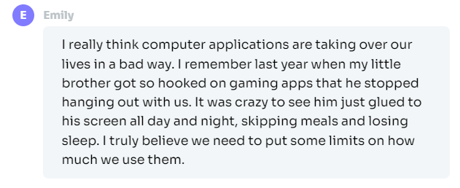
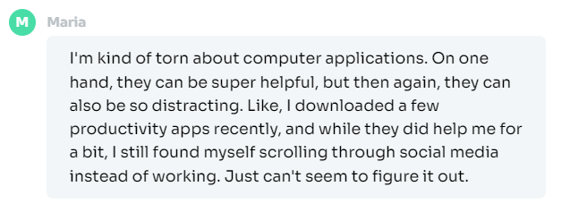
Read these opinions. Which one do you agree with the most and why?

Slide 6

Advantages of using CAs
1. Helps with organization and time management through tools like calendars and to-do lists.
2. Makes it easy to communicate with others using email and messaging apps.
3. Offers many resources for learning new skills, such as online courses and tutorials.
4. Saves time on tasks like budgeting, editing documents, and creating presentations.
5. Provides access to a wide range of information and entertainment options online.

Slide 7

Disadvantages of CAs
1. Can be overwhelming with too many applications and options available.
2. May lead to distractions from work or study due to games and social media.
3. Requires regular updates and maintenance to run smoothly.
4. Can cause eye strain or fatigue from long periods of screen time.
5. Increases dependence on technology, making it hard to complete tasks without a computer.

Slide 8

Discuss the quotes
Computers are like a bicycle for our minds.
- Steve Jobs
The great thing about a computer notebook is that no matter how much you stuff into it, it doesn't get bigger or heavier.
- Bill Gates

Slide 9

Watch the video and answer the questions below
https://www.youtube.com/watch?v=sGgXP4dGJms
1. Describe the primary functions of word processing software as mentioned in the video.
2. Explain how spreadsheets can be beneficial for managing personal finances.
3. What are the three main components of databases highlighted in the video, and what role does each play?
4. Discuss how the integration of different productivity applications can enhance workflow efficiency according to the video.
5. Why is mastering productivity software considered important in today's digital world?

Slide 10

Game.
Computer Instructions
https://wordwall.net/resource/79565188/computer-instruction

