Slide 1
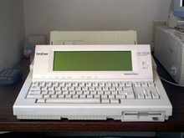
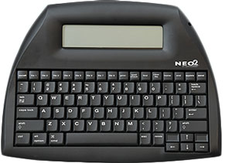
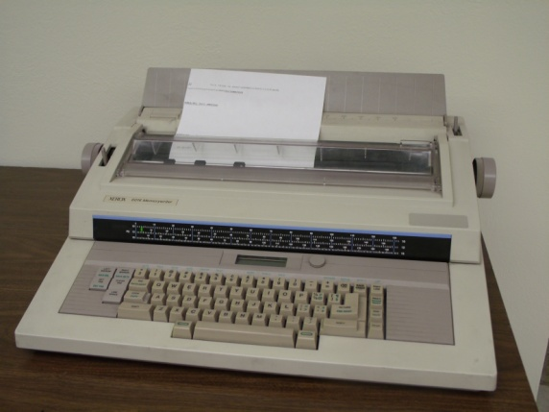
Exploring the Features of Leading Word Processing Software:
Microsoft Word, Google Docs, and Apple Pages

Slide 2
Word processor
A word processor is a device or software program capable of creating, storing, and printing text documents. It allows users to write and modify text, display it on a screen, save it electronically, and print it out.
This presentation compares Microsoft Word, Google Docs, and Apple Pages for word processing.
Their features, opportunities for cooperation and interface design are being considered.

Slide 3
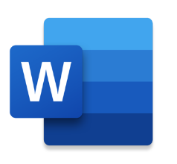
Microsoft Word
Microsoft Word is a powerful word processor with advanced formatting options, extensive template library, and seamless integration with other Microsoft Office applications. Its robust features make it a top choice for professional document creation and editing.

Slide 4

Google Docs
Google Docs offers real-time collaboration, cloud-based storage, and easy sharing options. Its simplicity and accessibility make it ideal for collaborative projects and remote teamwork, allowing multiple users to edit documents simultaneously.

Slide 5
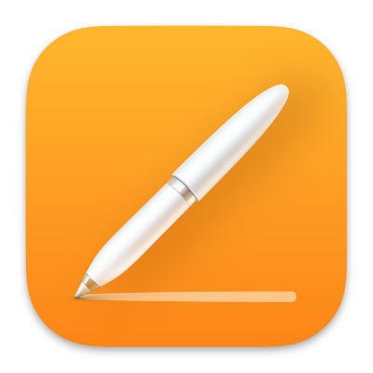
Apple Pages
Apple Pages provides a user-friendly interface, elegant templates, and seamless integration with other Apple devices. Its focus on design and creativity makes it a preferred choice for creating visually appealing documents and publications.

Slide 6
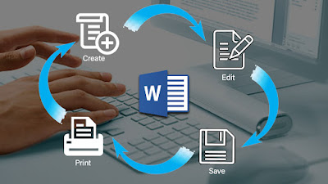
Comparison
In conclusion, each word processing software has its unique strengths. Microsoft Word excels in professional document creation, Google Docs offers seamless collaboration, and Apple Pages focuses on design and creativity. Consider your specific needs and preferences when choosing the best option for your projects.

Slide 7
Thanks for attention!

