Slide 1

Автор: Гаєва Поліна Олександрівна
Рік: 2023

Slide 2
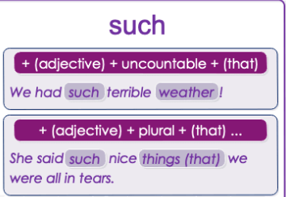
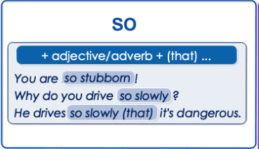
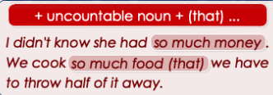
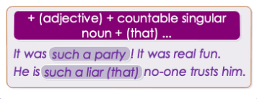
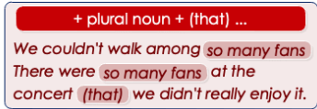

Slide 3
1. We stayed on the top floor suite. There was ______ lovely view from the terrace.
a. such
b. such a
c. so
2. It was ______ late ______ we decided to leave.
a. so / that
b. such / than
c. so much / that
3. We had ______ fun we stayed for an extra night. Choose TWO correct options
a. so many
b. such
c. so much
4. The music was ______ we called the police
a. so loud
b. such loud that
c. so much loud that
5. John! I'm ______ happy to see you!
a. such
b. so much
c. so

Slide 4
6. If you drive ______ we'll never get there.
a. so much slowly
b. so slowly
c. such a slowly
7. In California we don't usually have so ______.
a. good weather
b. rain
c. much rain
8. In California we don't normally have such ______.
a. horrible weather
b. much weather
c. a horrible weather
9. I love Angela. She is ______. Choose TWO correct options
a. so nice
b. so nice person
c. such a nice person
10. You should be proud to have ______ clever daughters.
a. so
b. such a
c. such

Slide 5
1. You speak English ______________ fluently! It's incredible.
2. I've never seen _______________ amazing views before.
3. Why did you buy ________________expensive car? You don't even like driving.
4. I'd be happier if I didn't have ____________problems. I really have a lot of problems.
5. You are _____________ idiot! You should treat people better.
6. He has ______________money that he could buy any house in the city.
7. Why did she say _______________terrible things?
8. She entered the room ____________quietly that we didn't hear her.
9. You are _______________liar! You never tell the truth.
10. We really liked the music at the concert. It was _____________ great music!

Slide 6
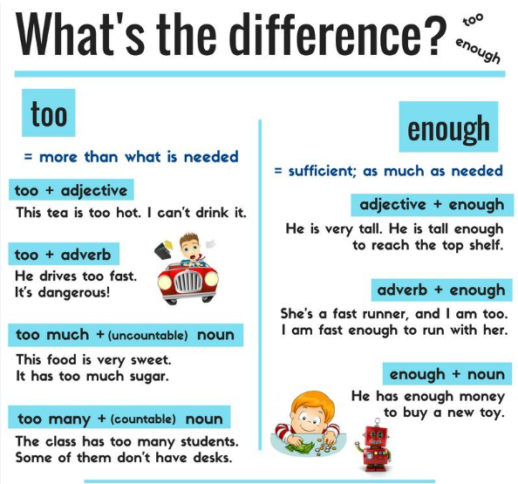

Slide 7
1. I can't carry this suitcase. It's _____________ heavy.
2. This bag isn't big _____________. I can't put all my possessions in it.
3. Is your meal warm _____________? If not, I'll put it in the microwave.
4. Mom was _____________ worried to go to sleep, so she stayed up all night.
5. I don't like this fizzy drink. It's much _____________ sweet.
6. I'll ring you up later. I haven't got _____________ time at the moment.
7. She's _____________ young to drink alcohol. She's not even 15 yet.
8. We weren't able to buy tickets for both games because we didn't have _____________money.
9. I couldn't see her anywhere because it was getting _____________ foggy.
10.You can't play in our first team. You're not good _____________.

