Slide 1

Emotions. Feeling stressed
Created by Iryna Zhukevych
PhD in Pedagogical Science
Associate Professor

Slide 2

Discuss the questions
Do you show your emotions much? Do you talk about them? Is that a good or bad thing?
Can you think of any situations where it’s good or bad to show your feelings?
What kind of things (if any) upset you, cheer you up or embarrass you?

Slide 3
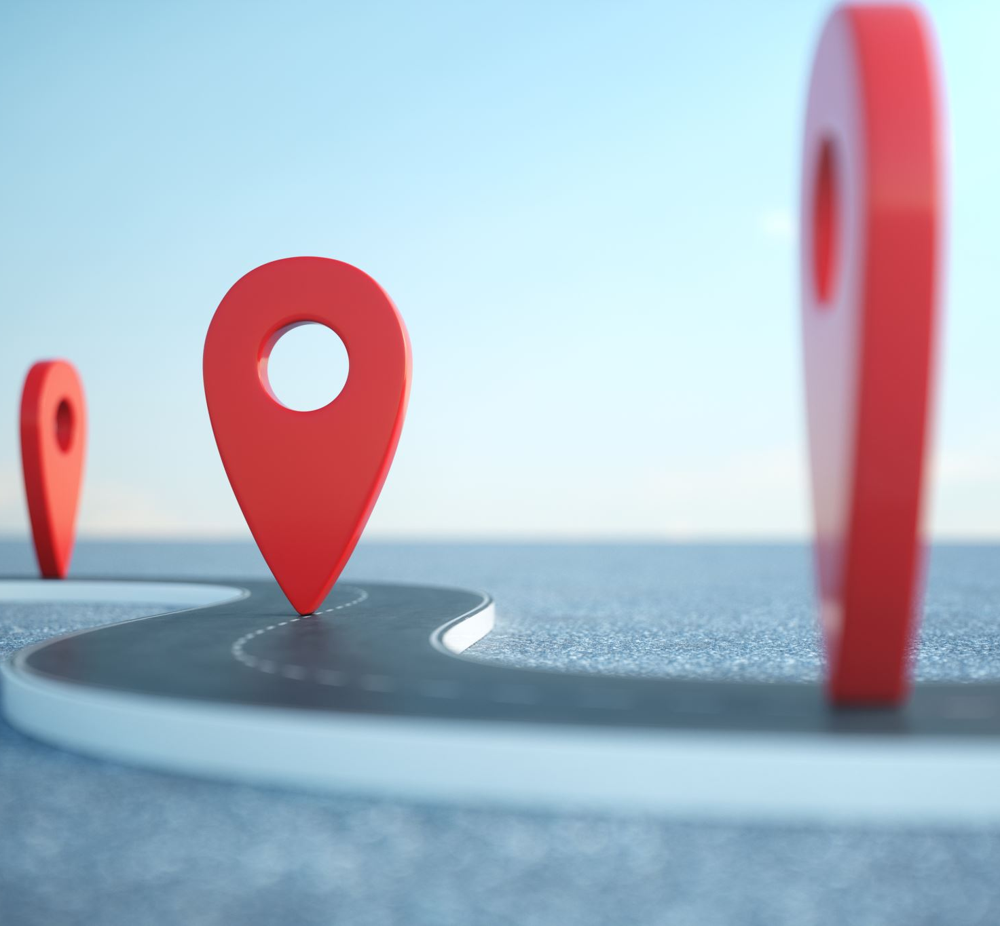
Watch the video and do exercises
https://en.islcollective.com/english-esl-video-lessons/vocabulary-practice/general-vocabulary-practice/adjectives/the-emoji-movie-emotions-galore-positive-negative/18275

Slide 4
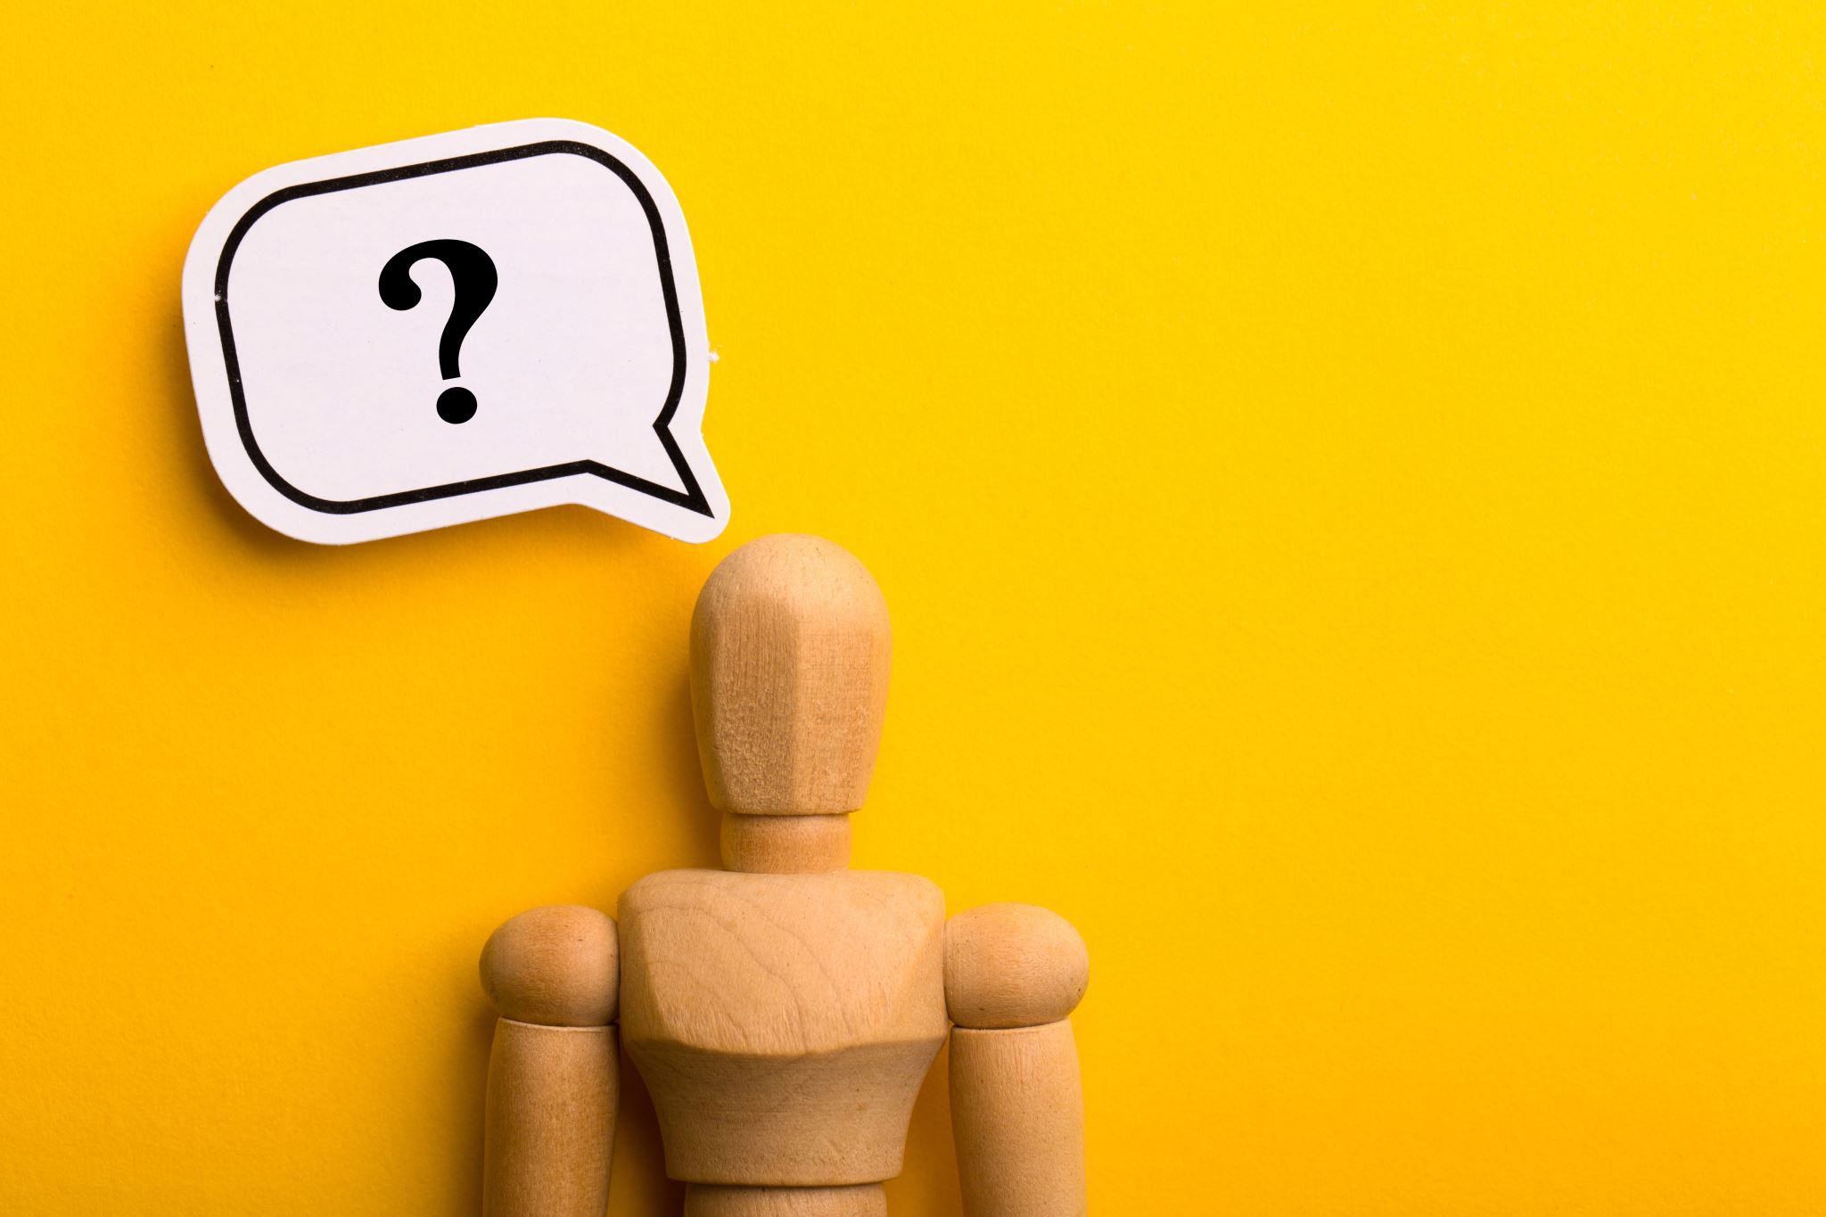
What are some of the physical signs of stress?

Slide 5
• Racing heart
• Shaking hands
• Shaky legs
• Clenching fists
• Reddening of the skin
• Headaches
• Tenseness
• Muscle spasms

Slide 6
What are some of the emotional signs of stress?

Slide 7
• General feelings of anxiety
• Feeling overwhelmed
• Inability to focus
• Avoidance behaviors
• Inability to make decisions
• Fight or flight response
• Acting out

Slide 8
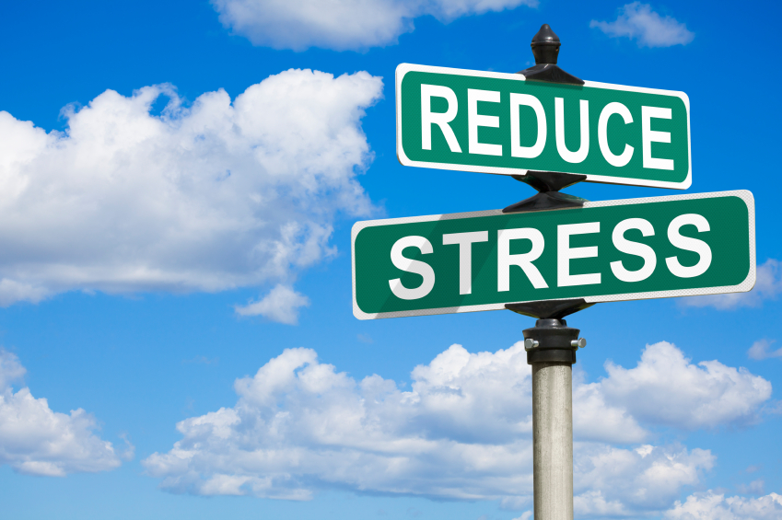
• Listening to music
• Playing with a pet
• Laughing or crying
• Writing, painting, or doing other creative activities
• Exercising or getting outdoors to enjoy nature
• Discussing situations with a parent or close friend
• Practicing deep breathing, meditation, or muscle relaxation
Це фото; автор: Невідомий автор; ліцензія: CC BY-SA

