Slide 1
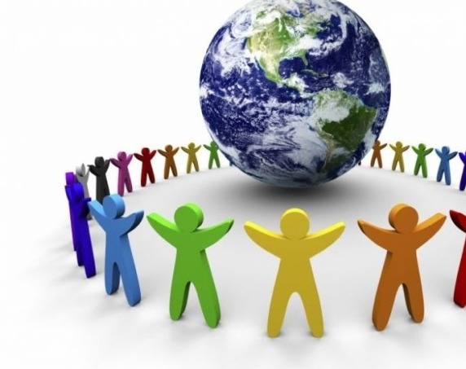
Science and Society
Created by Iryna Zhukevych
PhD in Pedagogical Sciences
Associate Professor
Це фото; автор: Невідомий автор; ліцензія: CC BY-SA

Slide 2
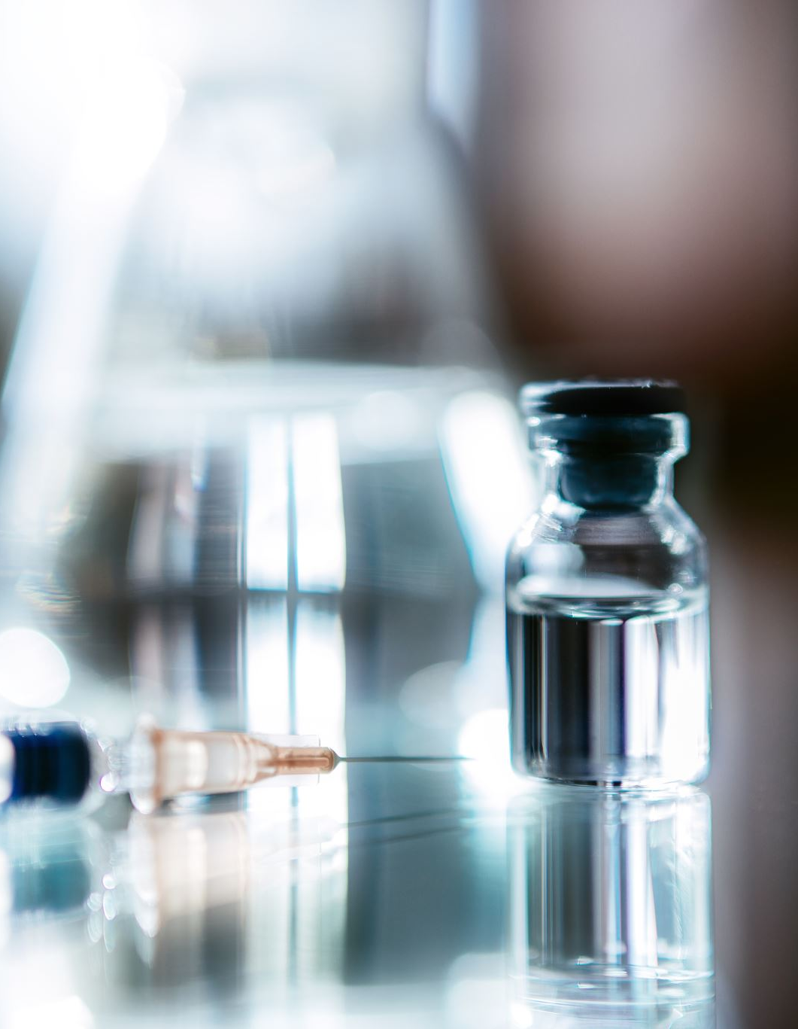
Speaking cards
https://wordwall.net/resource/84028270/science-and-society

Slide 3

The 2024 Science Breakthrough Radar
https://www.youtube.com/watch?v=tvG6zWhGBvQ
1. What advancements in technology are expected to emerge within the next five years?
2. How do scientists envision the relationship between humans and nature evolving in the future?
3. Discuss the potential implications of AI on peace and war. What are your thoughts on this?
4. Describe what is meant by "Eco augmentation" and how it could impact ecological systems.
5. In what ways might living on the moon and space manufacturing change human society over the next 25 years?

Slide 4
Reading.
Science shapes society, influencing daily life from the wheel to the internet. Today, science and society are intertwined, with new technologies changing how people live and work. In healthcare, scientific progress has led to vaccines and treatments, improving life expectancy. The recent pandemic highlighted the importance of scientific research in public health, showcasing the role of vaccines. Science also impacts the environment, with climate change requiring scientific solutions and international cooperation. Scientists collaborate with policymakers and society to create sustainable practices. Moreover, science influences education and technology, transforming learning through technology integration. Online resources and digital tools, rooted in scientific development, enhance students' skills for a tech-driven future. In conclusion, the relationship between science and society is reciprocal. Scientific advancements drive societal changes while societal needs guide research. Embracing scientific knowledge responsibly ensures a prosperous future for all.

Slide 5

Decide if the statement is true or false.
Scientific advancements have no effect on public health.
The relationship between science and society is one of mutual influence.
Climate change does not require scientific solutions.
Online learning tools are based on scientific developments.
The recent pandemic showed that scientific research is unimportant.
Scientists work with society to develop sustainable practices.
Science has changed how people live and work in modern times.

Slide 6
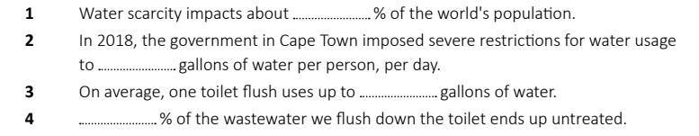
The Solution to Water Scarcity Is in the Bathroom
https://www.youtube.com/watch?v=xnGF--597iE&t=3s
Write the correct numbers according to the information in the video.

Slide 7

Discuss the questions according to the information in the video.
1. What is a potential solution to water scarcity? What is the problem with this solution?
2. For wastewater treatment to work, what process would water have to go through?
3. Which places around the world have implemented wastewater treatment solutions?
4. What is "desalination" and what does Alice (the reporter) say about it?
5. What does Alice mention is the real hurdle to wastewater treatment?

Slide 8
Discuss the questions below
1. What are your thoughts on recycled wastewater treatment? What adjectives would you use to describe this solution? (interesting, peculiar, revolutionary, etc.)
2. How would you feel about drinking properly-treated, recycled wastewater? Do you agree that it's irrational to be disgusted by it? Why or why not?
3. In the video, Alice says that most people take water for granted. What does this mean? Do you agree with her idea? Why or why not?

Slide 9
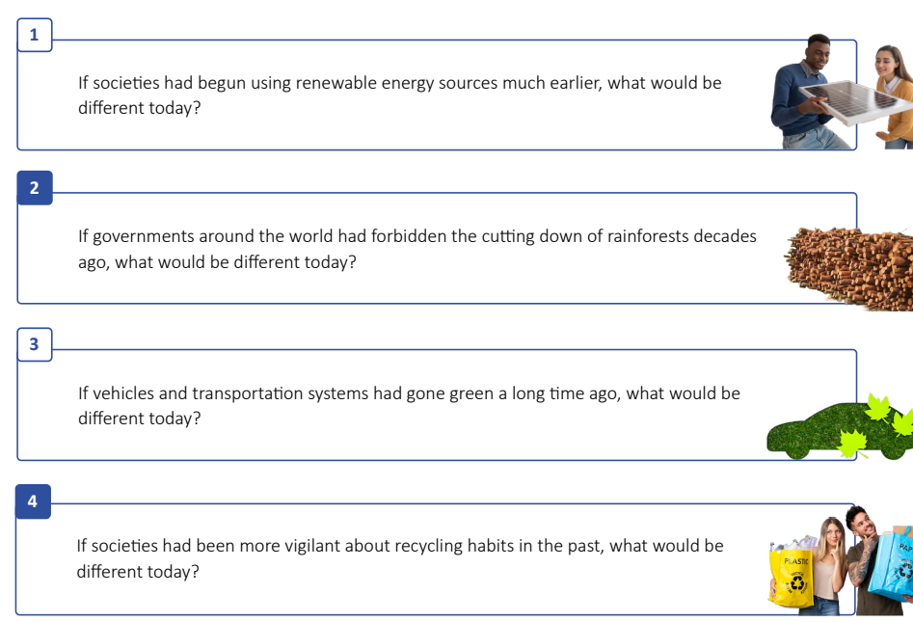

Slide 10

Thanks for your attention and collaboration!

