Slide 1
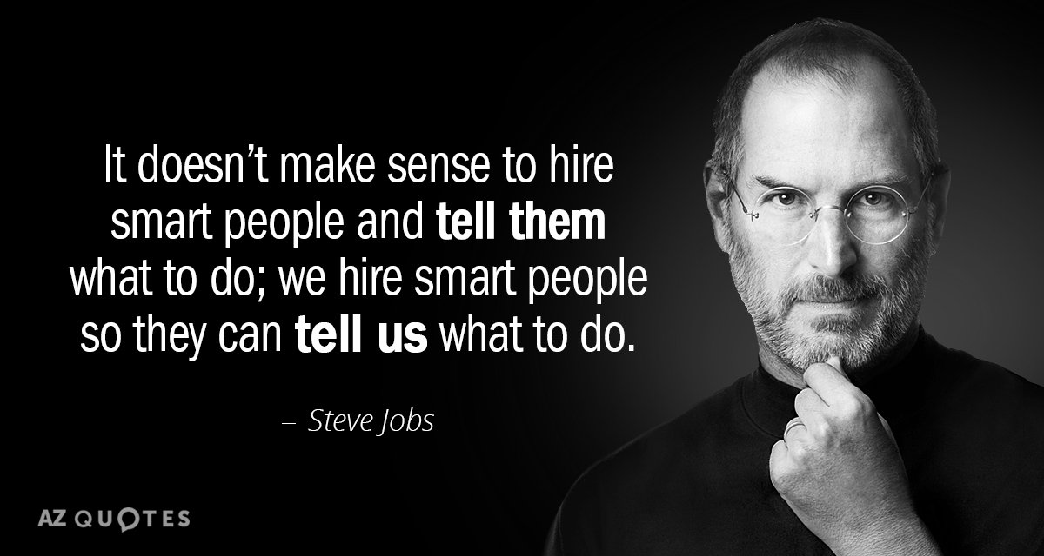
Success: are you qualified enough?
Created by Iryna Zhukevych
PhD in Pedagogical Sciences
Associate Professor
Це фото; автор: Невідомий автор; ліцензія: CC BY

Slide 2

Why you’re more successful than you realize
https://www.youtube.com/watch?v=XG7Mi3__gj8

Slide 3

After-watching activity. Answer the questions below.
1. What is the dictionary definition of success mentioned in the video?
2. How does the speaker suggest we redefine success beyond wealth, position, and fame?
3. Can you provide an example from the video where someone achieved success but faced personal challenges?
4. What does the speaker mean by saying "happiness is success"?
5. Discuss the significance of embracing failure according to the speaker. How does it contribute to one's success?
6. How does the speaker relate personal health to the concept of success?
7. What does the quote from Robin Williams imply about personal value and happiness?
Це фото; автор: Невідомий автор; ліцензія: CC BY-NC-ND

Slide 4

Setting Achievable Goals
Setting SMART goals (Specific, Measurable, Achievable, Relevant, Time-bound) is vital for success. These goals provide a clear roadmap and help you track your progress. Remember to regularly review and adjust your goals as needed to stay aligned with your vision.

Slide 5
Types of Qualifications
Educational Qualifications:
Degrees (Bachelor's, Master's, Ph.D.)
Diplomas and certificates
Specialized training programs
Professional Qualifications:
Industry-specific certifications
Licenses
Professional memberships
Experiential Qualifications:
Work experience
Internships
Volunteer work
Personal Qualities:
Soft skills (communication, leadership, teamwork)
Character traits (reliability, adaptability, creativity)

Slide 6
Professional Development and Continuous Learning
Staying current in a rapidly evolving job market
Methods for ongoing professional development:
Online courses and MOOCs
Workshops and seminars
Professional conferences
Industry publications and journals
Importance of adaptability and lifelong learning mindset

Slide 7
Gaining Relevant Experience
Importance of practical experience in becoming qualified
Ways to gain experience:
Internships and co-op programs
Part-time jobs in related fields
Volunteer work and community involvement
Personal projects and portfolios
Leveraging university resources for experience opportunities

Slide 8

Put the verbs in bold into the correct category below
After years of hard work and patience, Joe finally made it. He’s a millionaire now.
We’d been organizing the trip for months, but in the end our plans fell through.
Kate’s phone was off all day, but I managed to call her in the evening.
Do you think his plan will come off in the end?
If you don’t have a little luck on your side, all your work may come to nothing.
Despite the financial crisis, some banks are continuing to prosper.
Dave had a wonderful opportunity to impress his new boss, but in the end he failed.
Be successful: Be unsuccessful:
Це фото; автор: Невідомий автор; ліцензія: CC BY-SA

Slide 9

Speakout Intermediate. Student’s Book.
p.86-87 , ex. 1-7.
Workbook p.50, ex.1-2.

Slide 10

Successful Students DO NOT STOP! -
Powerful Study Motivation
https://www.youtube.com/watch?v=uKr_Cc_Ytfo
Це фото; автор: Невідомий автор; ліцензія: CC BY

