Slide 1
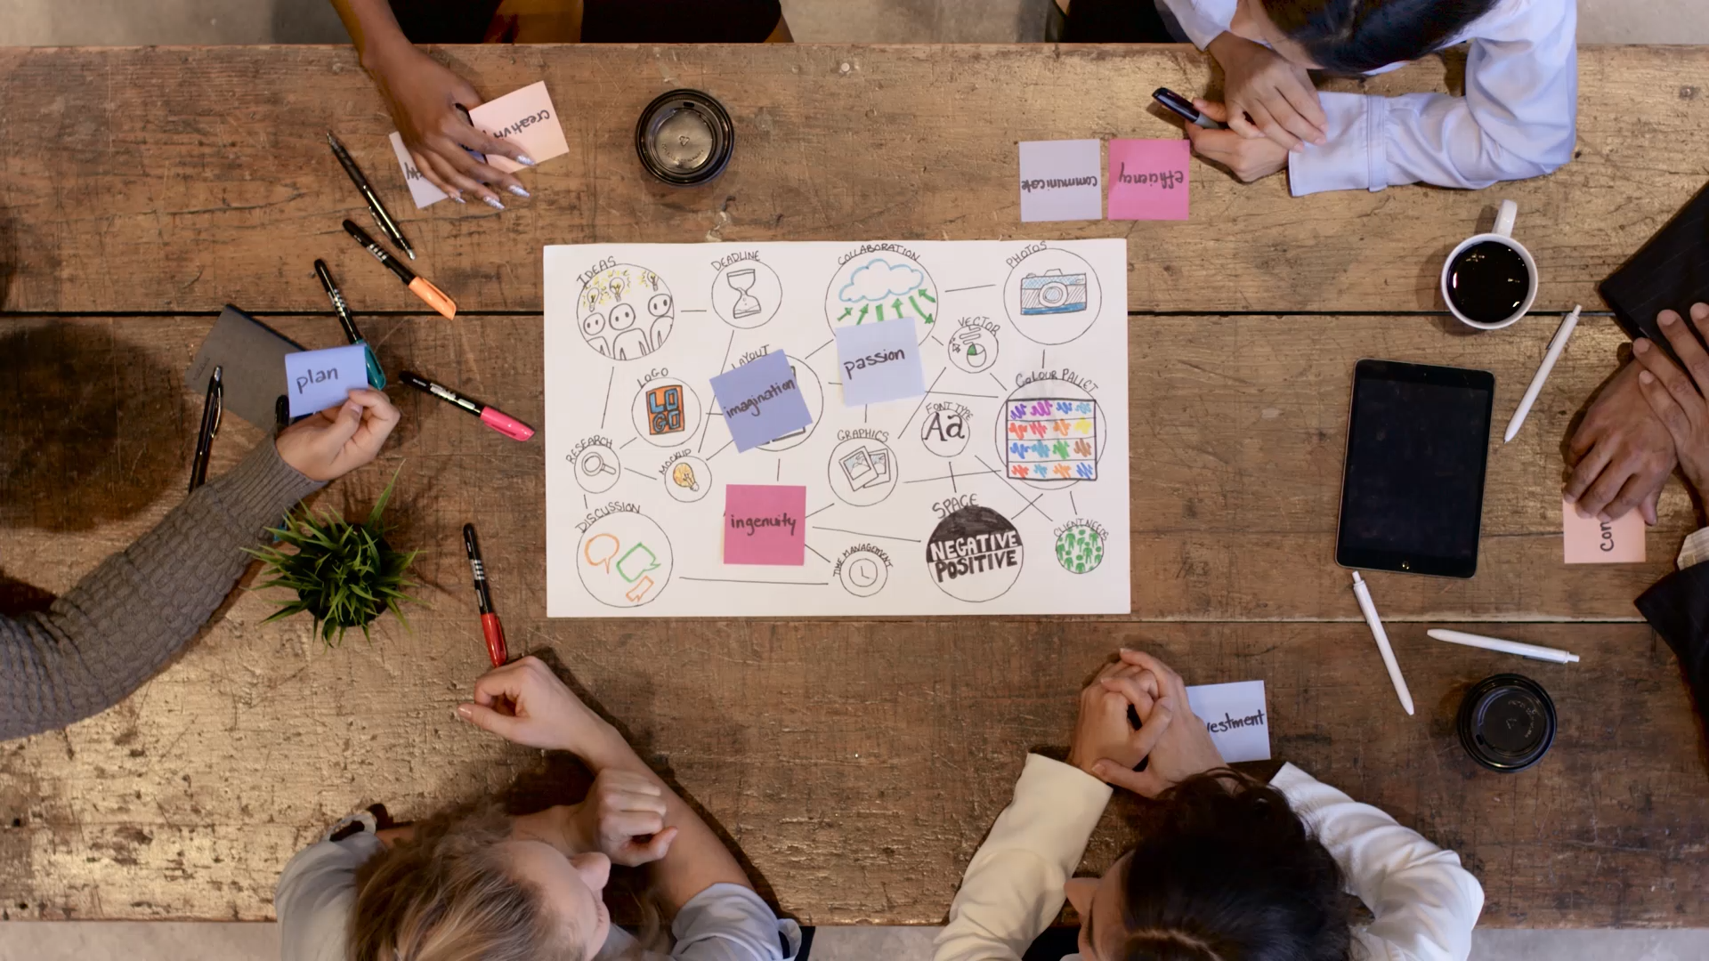
Introduction to Design Fields.
Design processes and methodologies
Created by Iryna Zhukevych
PhD in Pedagogical Sciences
Associate Professor

Slide 2

Vocabulary
https://quizlet.com/ua/1039773706/design-processes-and-methodologies-flash-cards/?i=35daow&x=1jqt

Slide 3

Drag and drop words to rearrange each sentence into its correct order
https://wordwall.net/resource/91526027

Slide 4
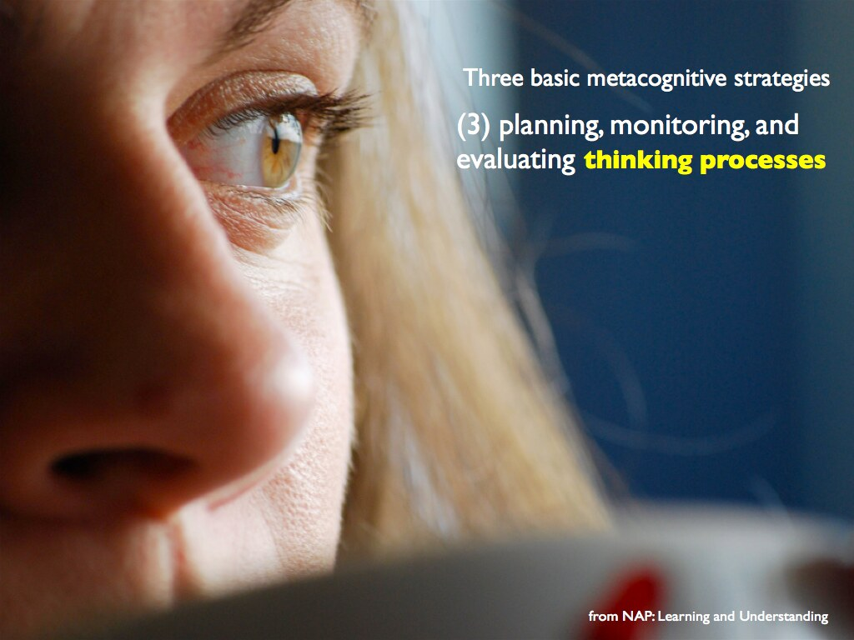
The 5 Stages in the Design Thinking Process
https://www.interaction-design.org/literature/article/5-stages-in-the-design-thinking-process?srsltid=AfmBOopBKqTGN7Be5ixTYp4ojm2-pL95gYrujNvmZQKfYahnnmEdFaSQ
Це фото; автор: Невідомий автор; ліцензія: CC BY-SA-NC

Slide 5
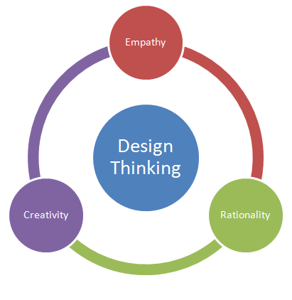
Discuss how the five stages of the design thinking process can be utilized to measure the impact of design thinking on a specific project.
Reflect on the interconnections between empathy, ideation, and prototyping in this measurement process.
Analyze potential challenges that might arise in assessing this impact and propose strategies to overcome them.
Це фото; автор: Невідомий автор; ліцензія: CC BY-SA-NC

Slide 6

Think of a website or app you use regularly. Can you identify examples of how some of these design processes or methodologies might have been applied in its creation?

Slide 7
Scenario 1: The Confused Startup
A new tech startup is building an innovative mobile application. The team consists of passionate engineers and a brilliant product owner, but they lack a dedicated UX designer. They've jumped straight into development, driven by the urgency to launch.
The Problem: Features are being built in a siloed manner, leading to an inconsistent user experience. User feedback from early testers is confusing and contradictory. The team realizes they need a more structured approach to design but isn't sure where to start.
Questions:
Should they hire a UX designer now? What would be their initial priorities?
Which design methodology would be most suitable for a fast-paced startup environment with limited resources (e.g., Lean UX, Design Thinking)?
How can they quickly incorporate user feedback into the existing product?
What are some lightweight design processes they could implement immediately (e.g., sketching, wireframing, usability testing)?

Slide 8
Scenario 2: The Stagnant Enterprise
A large, established corporation is redesigning its flagship web application, which hasn't been updated in years. They have a large design team, but the process feels slow and bureaucratic. Multiple stakeholders have conflicting opinions, and decisions take a long time to be made.
The Problem: The redesign project is facing significant delays and budget overruns. The design team is frustrated by the lack of clear direction and the constant revisions based on stakeholder feedback. The final design risks being a compromise that satisfies no one.
Questions:
How can they streamline their design process to improve efficiency and reduce bottlenecks?
What strategies can they use to effectively manage stakeholder expectations and facilitate decision-making?
Could a more agile design methodology (e.g., Design Sprints) help them iterate faster and gather feedback more quickly?
How can they foster better collaboration between designers, developers, and other stakeholders?

Slide 9
Scenario 3: Designing for Accessibility
A government agency is tasked with redesigning its website to be accessible to all citizens, including those with disabilities. The current website has numerous accessibility barriers, making it difficult for many people to access essential information and services.
The Problem: The design team lacks sufficient expertise in accessibility guidelines (WCAG) and best practices. They need to ensure the redesigned website meets accessibility standards without compromising usability for all users.
Questions:
What steps should they take to educate the design and development teams about accessibility requirements?
How can they integrate accessibility testing and evaluation throughout the design process?
What design methodologies or frameworks can help them prioritize accessibility from the outset (e.g., Universal Design principles)?
How can they involve users with disabilities in the design and testing process to ensure the website meets their needs?

Slide 10
Scenario 4: The Remote Collaboration Challenge
A distributed design team, spread across different time zones, is working on a complex e-commerce platform redesign. Communication and collaboration are proving to be challenging due to the geographical distance.
The Problem: Lack of face-to-face interaction is hindering effective brainstorming, feedback sharing, and decision-making. Misunderstandings and delays are becoming frequent.
Questions:
What tools and technologies can facilitate seamless remote collaboration within the design process (e.g., collaborative whiteboarding tools, video conferencing, project management software)?
How can they establish clear communication protocols and workflows for a remote team? What remote design methodologies or adaptations of existing methodologies can they adopt to improve efficiency and team cohesion? How can they foster a sense of shared understanding and team culture despite the physical distance?

