Slide 1
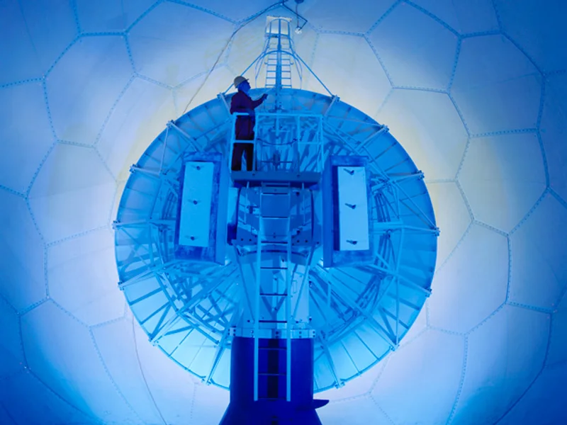
RADIOLOCATION

Slide 2

DISCUSSION
Questions:
Have you ever heard of radiolocation? What do you think it means?
Can you think of any real-world applications of radiolocation (e.g., radar in weather stations, air traffic control)?
Why might knowing the position and speed of objects be important in different fields (e.g., aviation, military, maritime)?

Slide 3
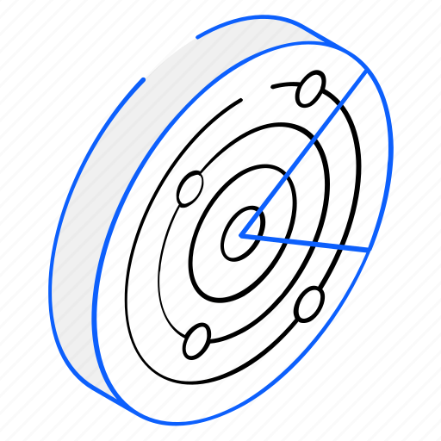
Brief Explanation:
Radiolocation is a technique that uses radio waves to detect the position, distance, and speed of objects. It’s used in various areas like navigation, surveillance, and tracking.
Examples: Air traffic control uses radiolocation to monitor airplanes, while weather stations use it to detect storms.

Slide 4

Terms to Explain:
Radiolocation: Using radio waves to locate and track objects.
Radar: A system that uses radiolocation technology to detect objects.
Transmitter: A device that sends out radio waves.
Receiver: A device that picks up the reflected radio waves.
Antenna: The component that sends and receives signals in a radar system.
Doppler Effect: A change in frequency of waves relative to an observer, used to measure the speed of moving objects.

Slide 5
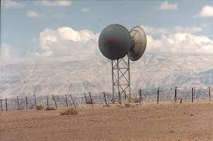
Detailed Explanation of Radiolocation
How Radiolocation Works:
Radiolocation systems send out radio waves that reflect off objects.
By measuring the time it takes for these waves to return and analyzing any changes in their frequency, the system can calculate the distance, position, and speed of the object.
Components:
Transmitter: Sends out radio signals.
Receiver: Captures reflected signals.
Antenna: Facilitates the transmission and reception of radio waves.
Processor: Analyzes the data to determine object details.

Slide 6
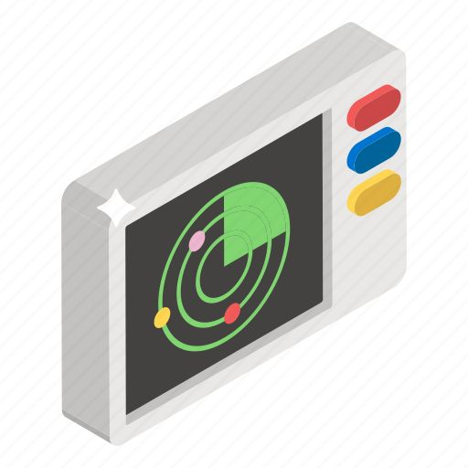
Types of Radiolocation:
Active Radiolocation: Uses both transmitters and receivers to detect objects actively.
Passive Radiolocation: Detects signals emitted by the object itself, useful for stealth detection.

Slide 7
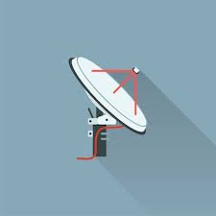
Discussion Questions
How do you think radiolocation might be different from satellite GPS?
What are some benefits and limitations of using radiolocation in different environments (e.g., mountains, oceans)?
How might advances in radiolocation technology impact transportation or safety in the future?

Slide 8
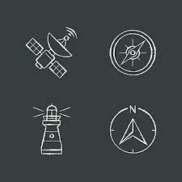
Practice and Application
Air Traffic Control: Explain how radiolocation keeps planes at a safe distance from each other.
Weather Forecasting: Demonstrate how Doppler radar detects weather changes.
Maritime Navigation: Discuss the use of radiolocation for tracking ships and preventing collisions.

