Slide 1
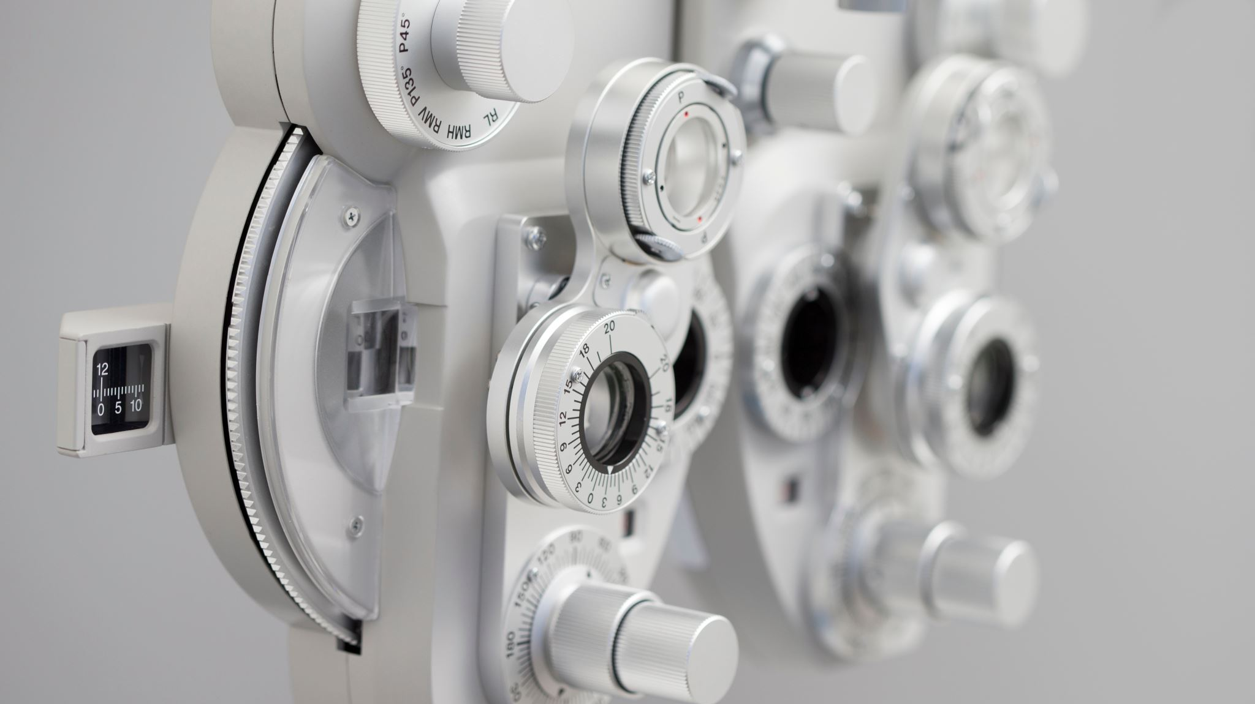
Instructions and Procedures
Created by Iryna Zhukevych
PhD in Pedagogical Sciences
Associate Professor

Slide 2

Speaking Cards
https://wordwall.net/resource/79625162/instructions-and-procedures

Slide 3
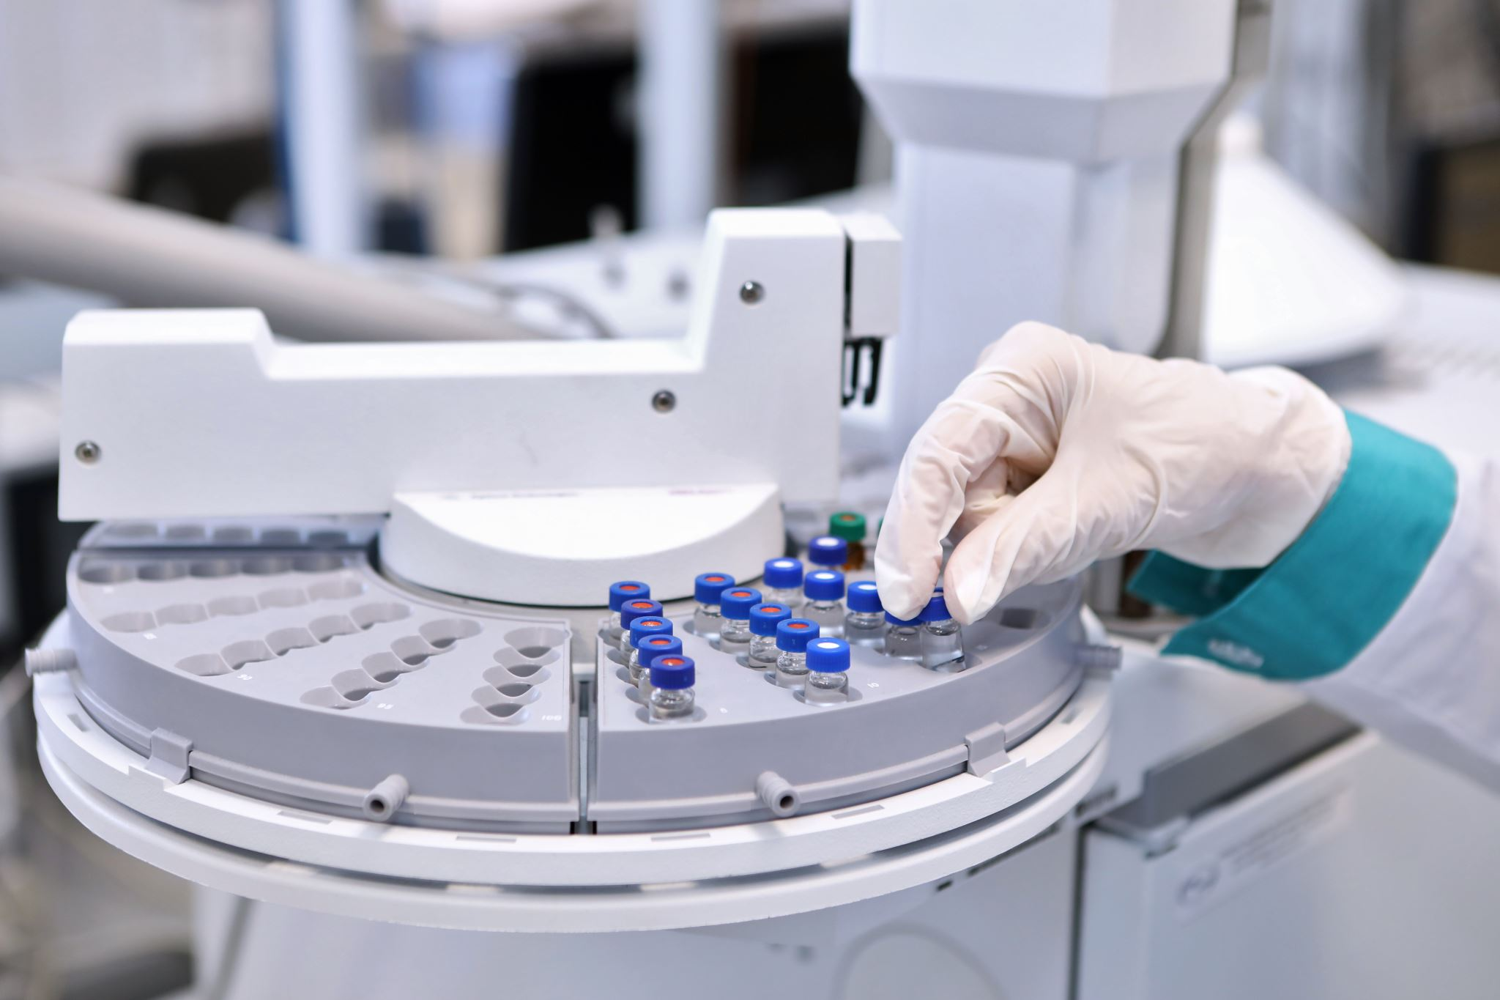
Read the text and tell which sentences are True and which are False. https://classroom.google.com/c/NzIyODI0MjIwNTc2/m/NzIyODIzMjU4MjY5/details
1. It is necessary to inspect biomedical devices for damage before use.
2. Calibration of biomedical equipment should be done only once a year.
3. Standard operating procedures help prevent mistakes when using medical devices.
4. Cleaning biomedical equipment is not important for its longevity.
5. Regular training for personnel is recommended to keep up with technological changes.
6. Calibration records should be kept in a logbook.
7. New technology developments do not affect operation protocols.

Slide 4

Create sentences using the words below in the context of a medical setting
calibration
maintenance
equipment
procedures

Slide 5

Short scenario
Inspect a fictional biomedical device, such as a heart monitor or other.
Role-play the inspection process, discussing what steps you would take and what you would look for to ensure the device's safety and effectiveness.
After 8 minutes demonstrate your role-play to the group.

Slide 6

Safety First
Brainstorm and write down as many procedures or practices you believe are crucial for ensuring safety in the use of medical devices.

Slide 7

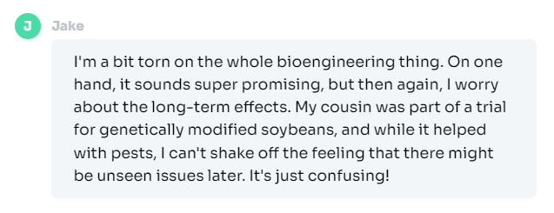
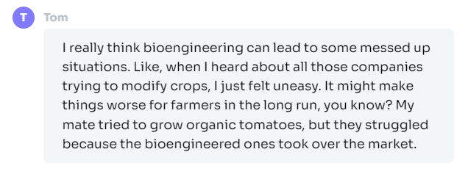
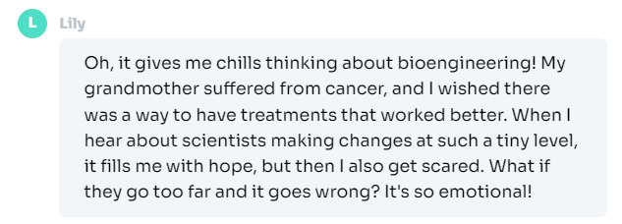
Read these opinions. Which one do you agree with the most and why?

Slide 8
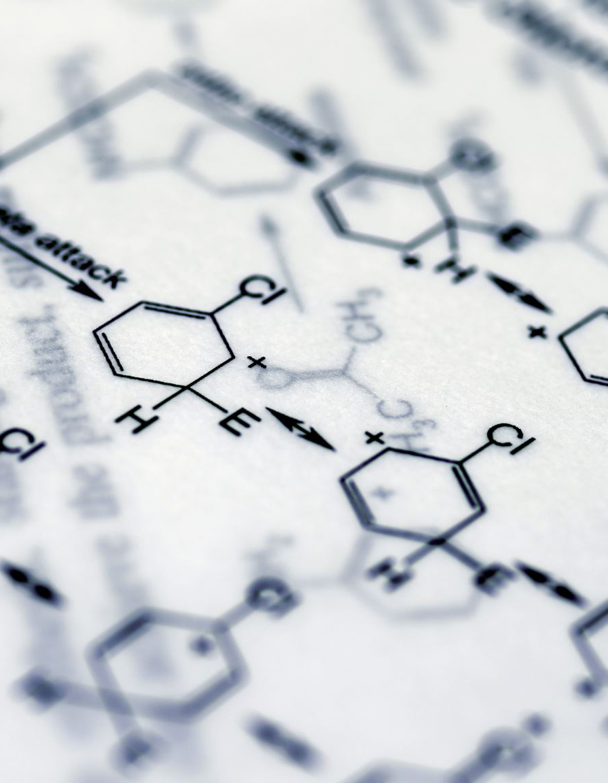
Discuss the following quotes
"Biotechnology is the tool of the future, and it is the key to solving many of the world's problems." - Craig Venter
"Bioengineering is the application of the principles of engineering and biological sciences to create products and processes that improve the quality of life." - George Church
"Science knows no country, because knowledge belongs to humanity, and is the torch which illuminates the world." - Louis Pasteur
"Engineering is not only study of 45 subjects but it is moral studies of intellectual life." - Prakhar Srivastav
"Biotechnology is a powerful tool for improving the quality of life and the environment." - Paul Berg

Slide 9

Watch the video and answer the questions below
https://www.youtube.com/watch?v=VmHBADXeCy8
1. What does bioengineering mean to you based on the speaker's description?
2. Describe the characteristics of a person suited for a career in bioengineering as mentioned in the video.
3. How does the speaker compare bioengineering to a form of art? Provide specific examples from the transcript.
4. What unique perspectives did the founding faculty bring to the bioengineering department at Stanford?
5. In what ways does the speaker believe bioengineering can contribute to sustainability and addressing societal needs?

Slide 10
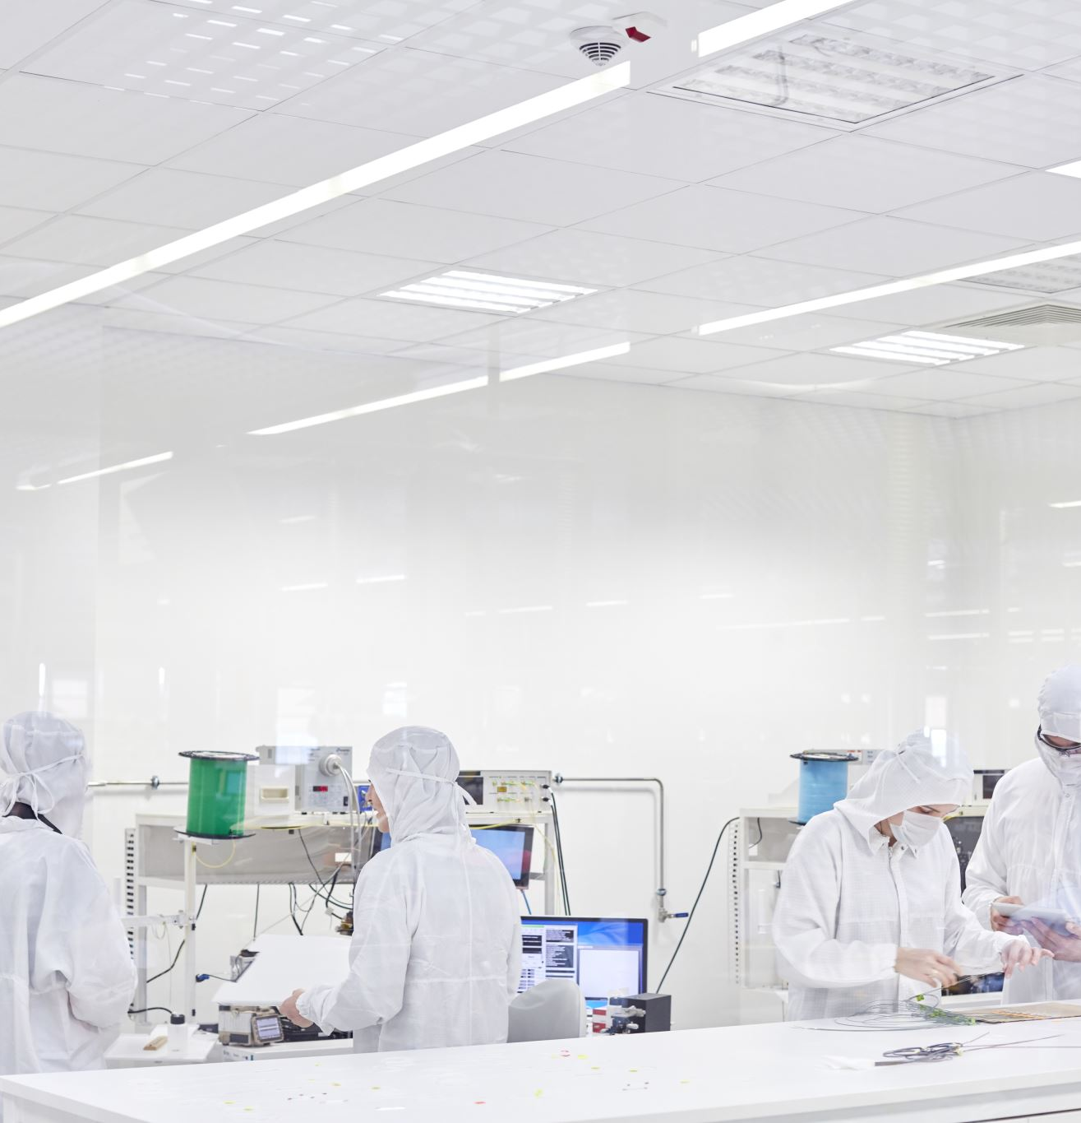
Watch the video and answer the questions below
https://www.youtube.com/watch?v=sBvHrsogVUk
What are the key questions that a prospective biomedical engineer should ask themselves before entering the field?
Describe the main difference between biomedical engineering and biomedical science.
How does biomedical engineering apply engineering principles to solve medical problems?
Identify and explain at least three different career paths available to biomedical engineers.
What roles do biomedical engineers play in a hospital setting?
Discuss the importance of research and development within biomedical engineering.
In what ways did the video highlight the contributions of biomedical engineers during the pandemic?

