Slide 1

Partnerships
Created by Iryna Zhukevych
PhD in Pedagogical Sciences
Associate Professor

Slide 2
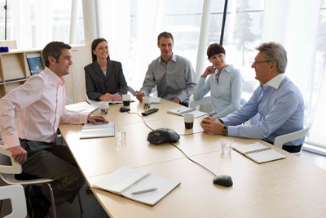
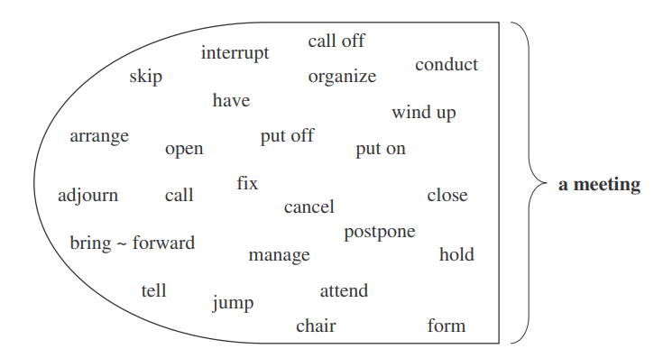
Find five words that do not form a strong word partnership with the word meeting.
Це фото; автор: Невідомий автор; ліцензія: CC BY-SA

Slide 3
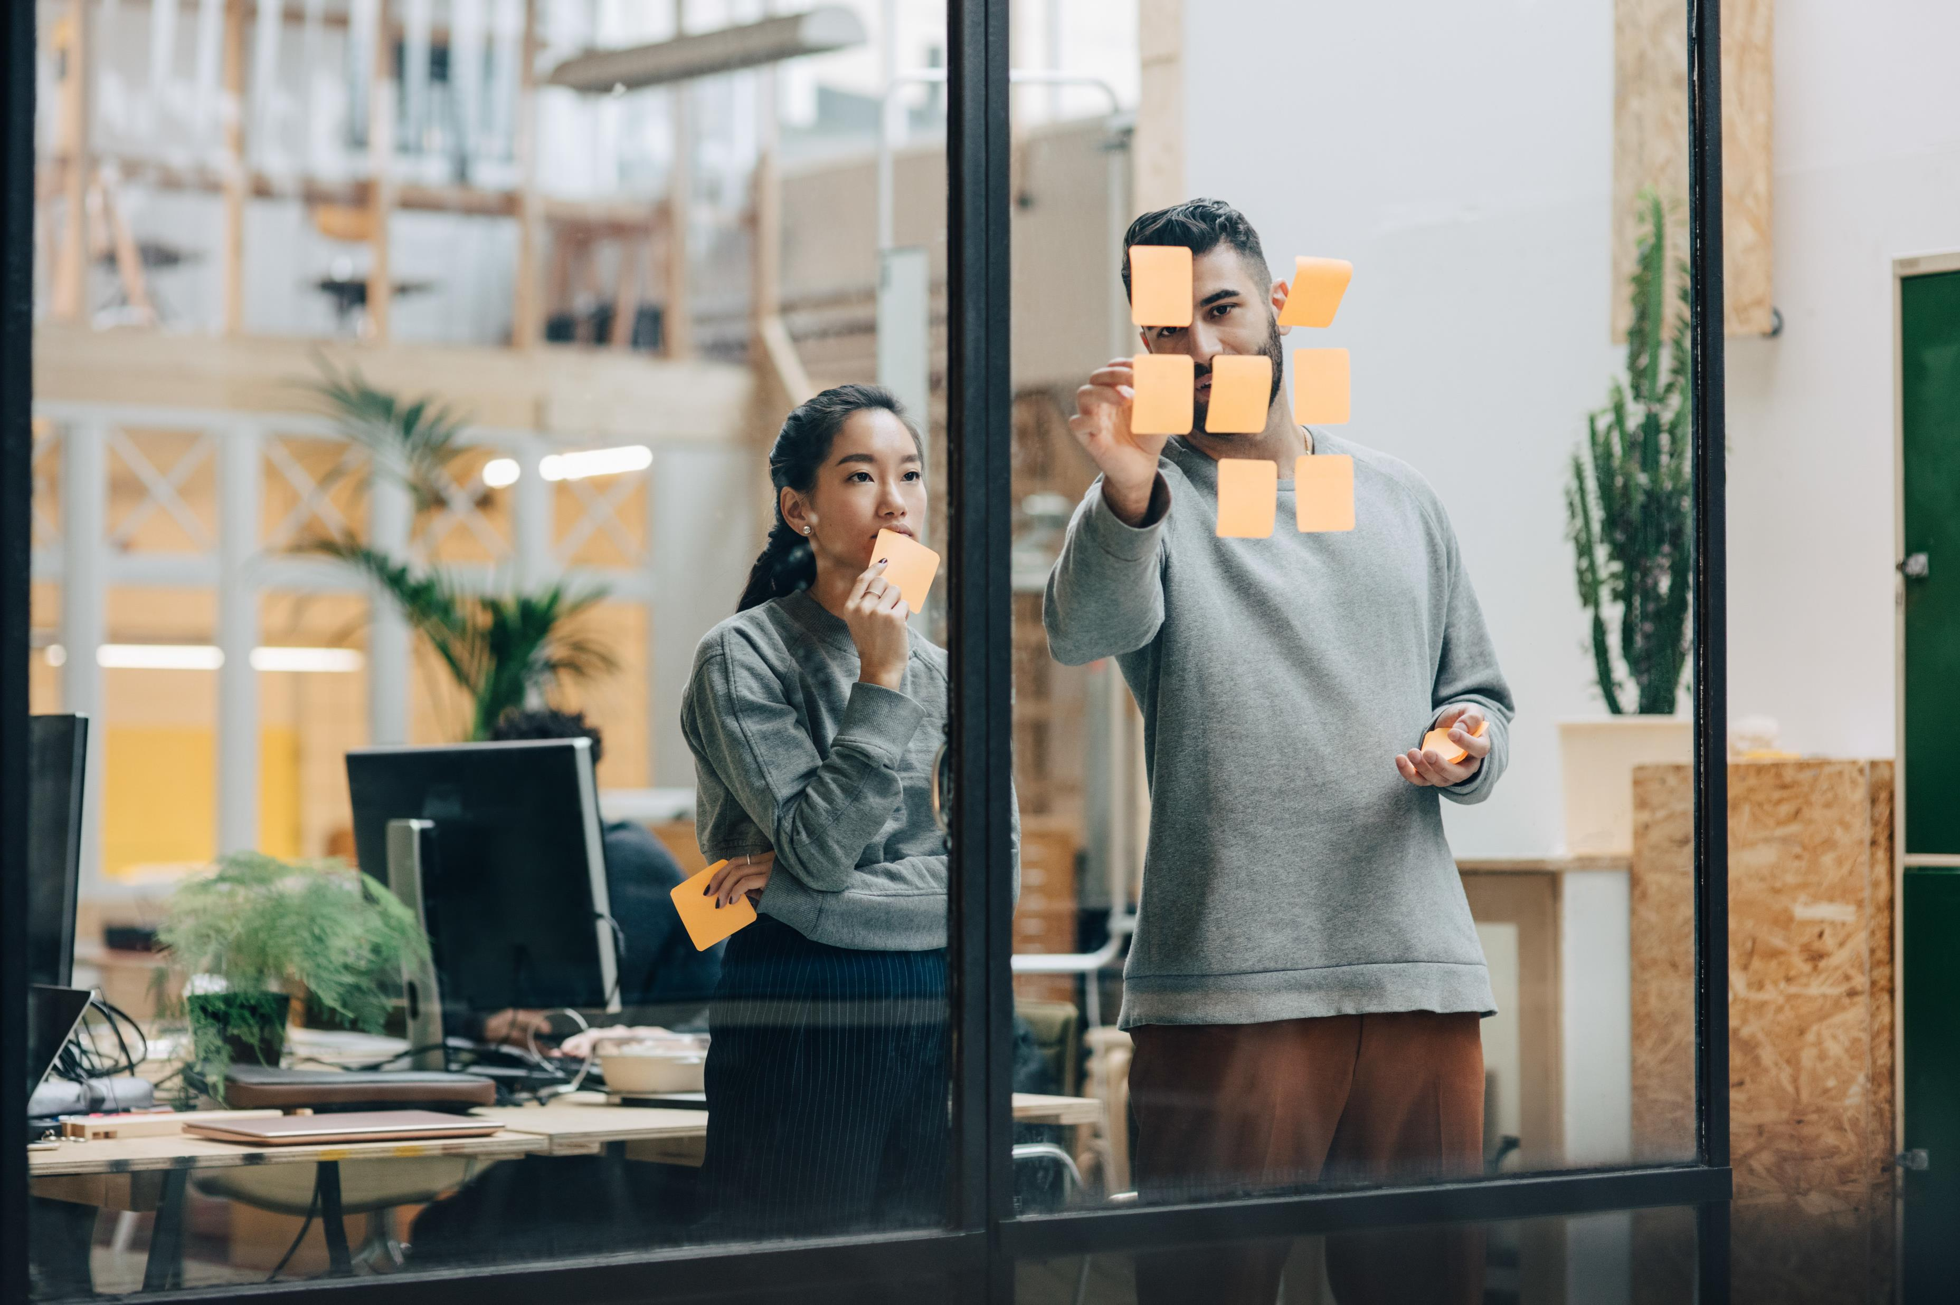
The Power of Partnership
https://gamma.app/docs/The-Power-of-Partnerships-0dxxzwbypfifxi5

Slide 4
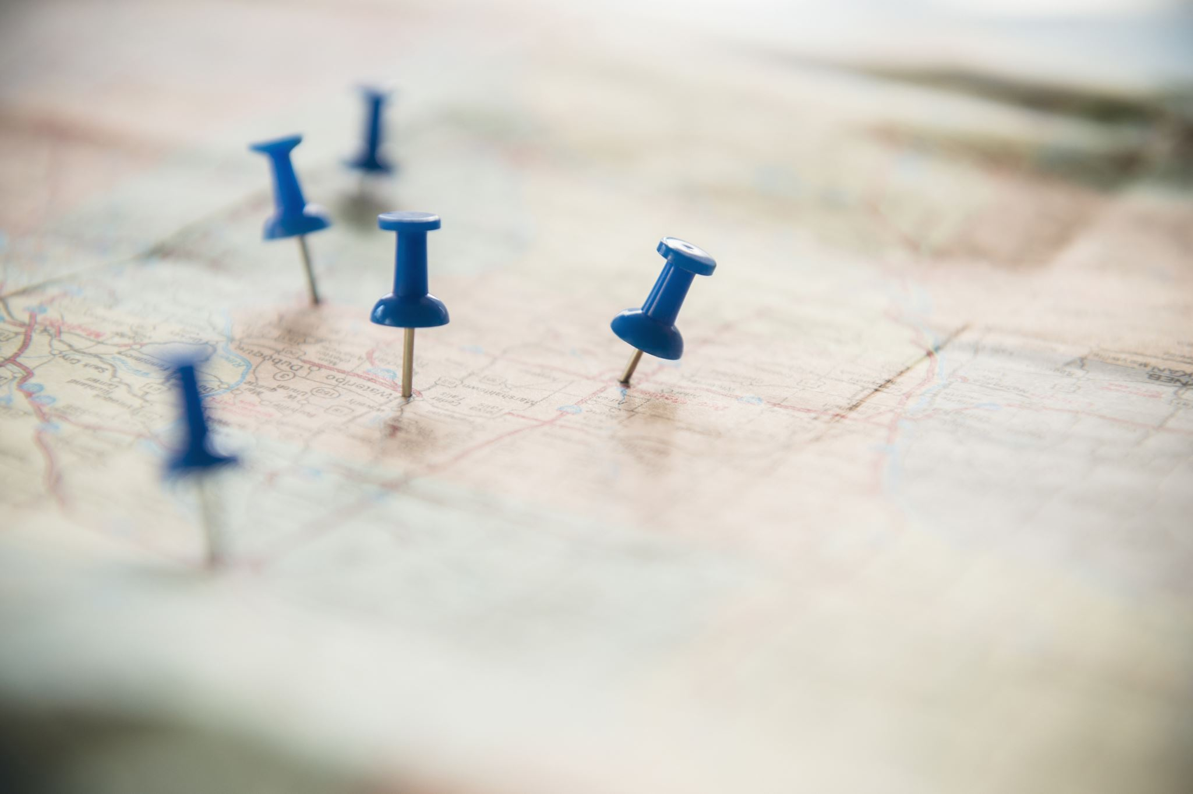
READING. TURNING NEW CONTACTS INTO PARTNERS
https://www.teachingenglish.org.uk/sites/teacheng/files/Socialising%205_From%20contact%20to%20partner_worksheets.pdf

Slide 5

Watch the video about Business Partner and do online exercises
https://en.islcollective.com/english-esl-video-lessons/vocabulary-practice/memory-game/jobs-and-work/business-partner-b1-unit-111/882407

Slide 6
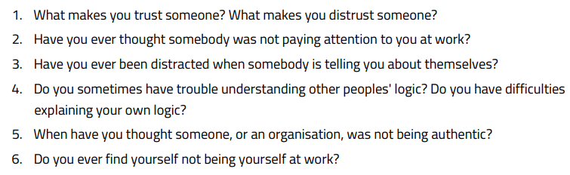
Watch the video and after, discuss the following questions:
https://www.youtube.com/watch?v=pVeq-0dIqpk

Slide 7
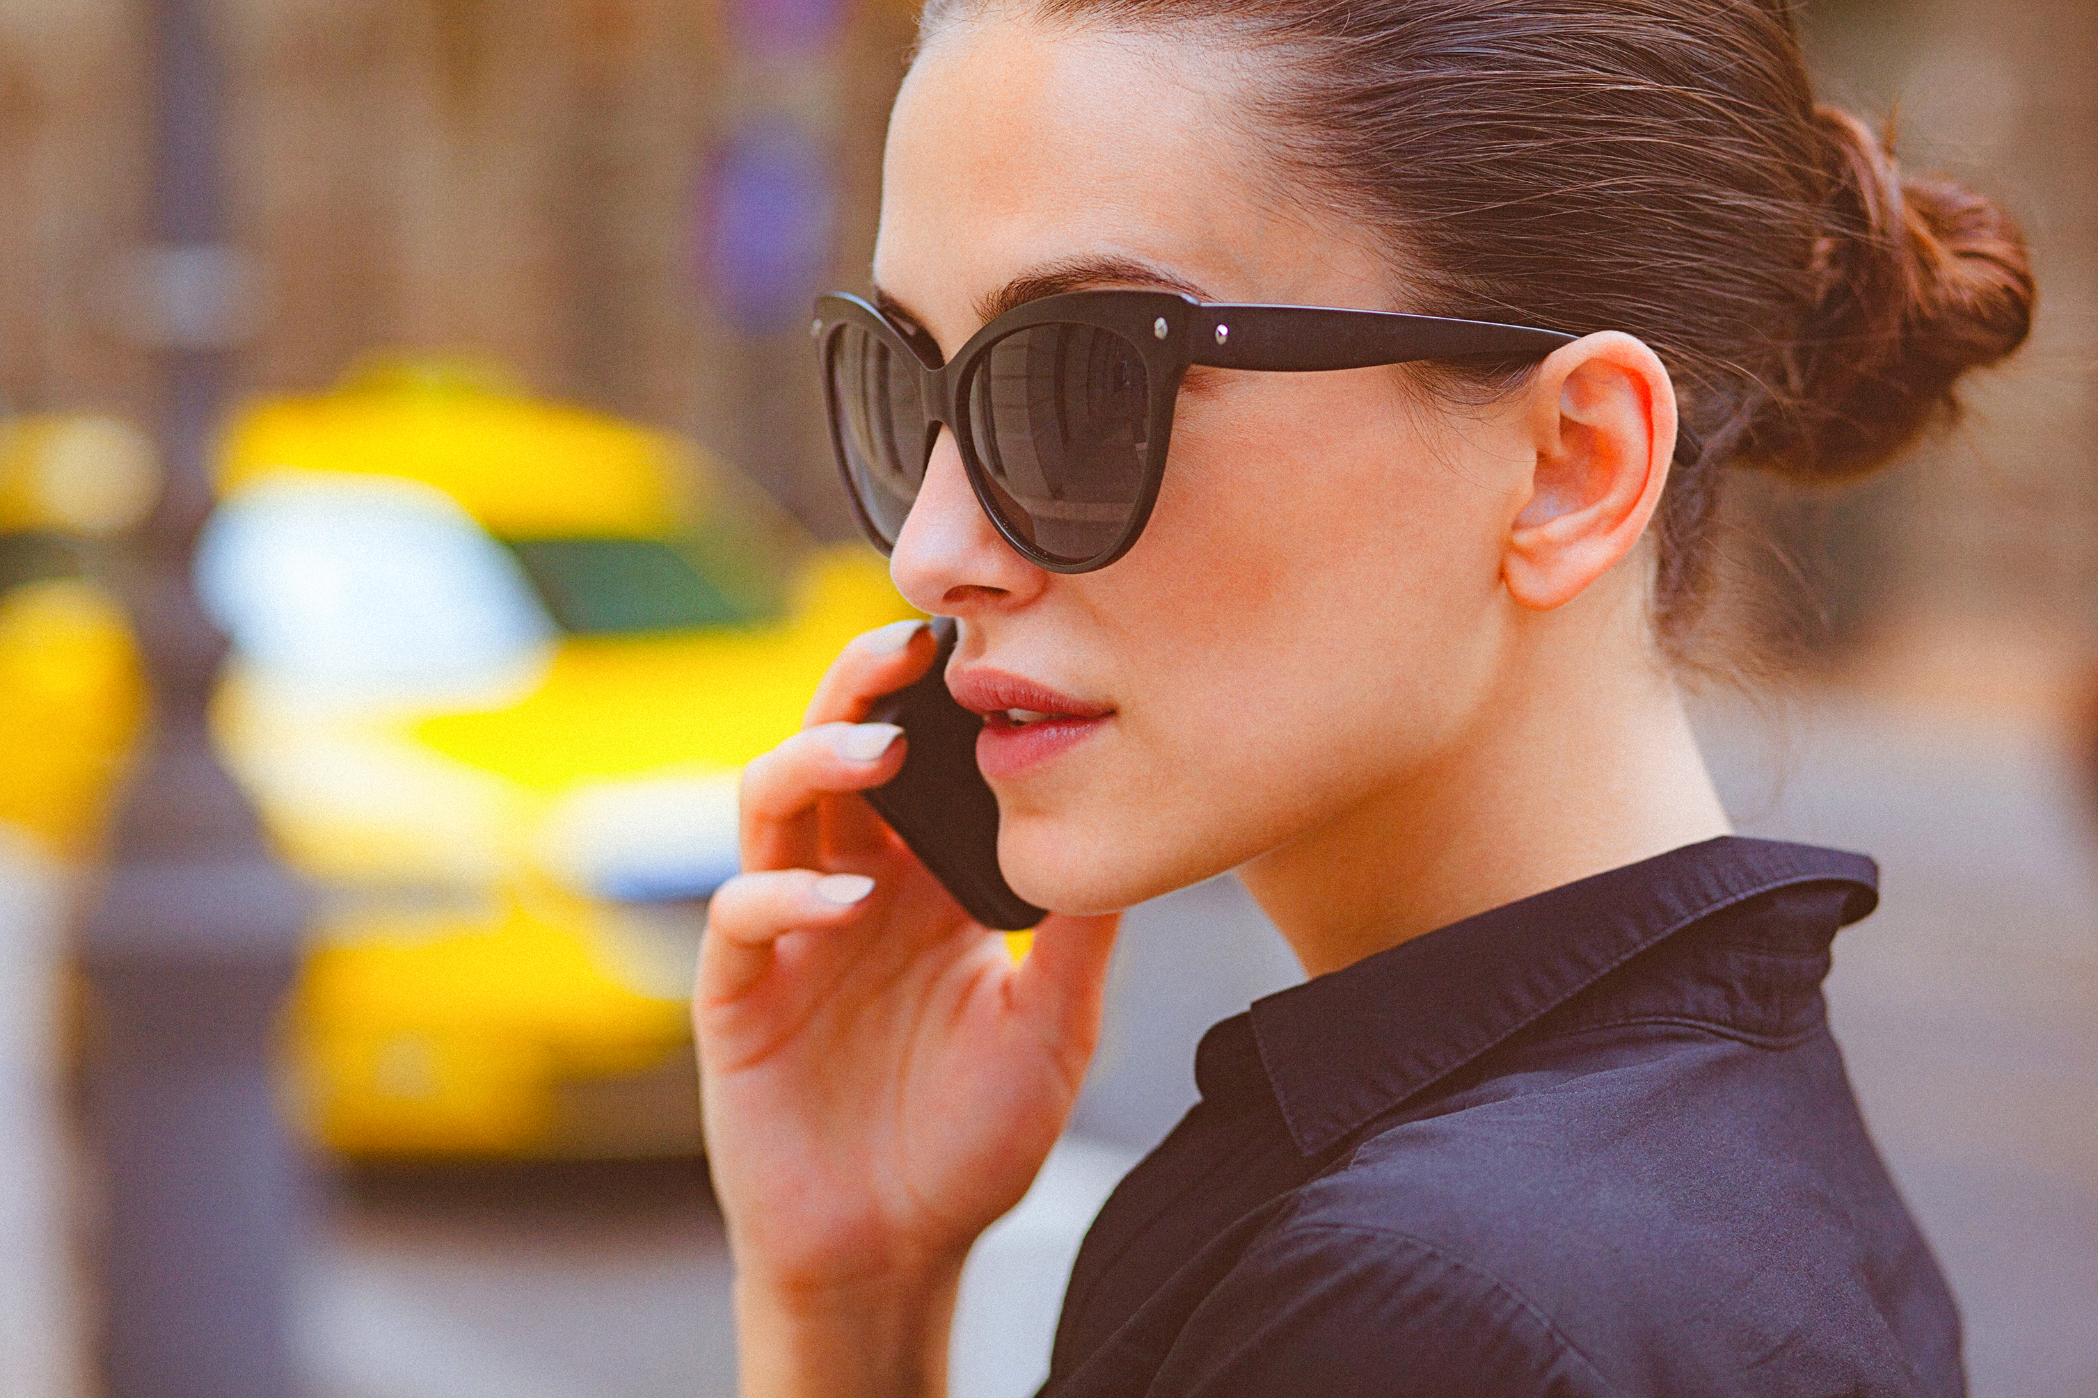
True/False Statements
1. The author initially joined Uber because they believed the company was thriving and successful.
2. The author wore an Uber t-shirt for a significant period as a personal commitment to the company.
3. Trust is composed of authenticity, logical rigor, and empathy, according to the author.
4. The author claims that empathy is the least common reason for trust to wobble.
5. The author suggests that understanding where trust wobbles can help improve it.
6. The author believes that empathy requires minimal time and effort to be effective.
7. The author is currently still working at Uber and continues to wear the t-shirt daily.

Slide 8

Fill in the gaps
Be _______________(1) in all situations
_______________(2) and trust in the workplace
Do not ___________(3) to fit in or please others
Leaders should create a safe and welcoming environment for _______________(4)
Focus on what your authentic self needs to say, not what others want to hear
____________(5) are essential components for success in any organization
Technology can sometimes hinder empathy and collaboration, so it's important to find solutions to promote ___________(6) and understanding.

Slide 9
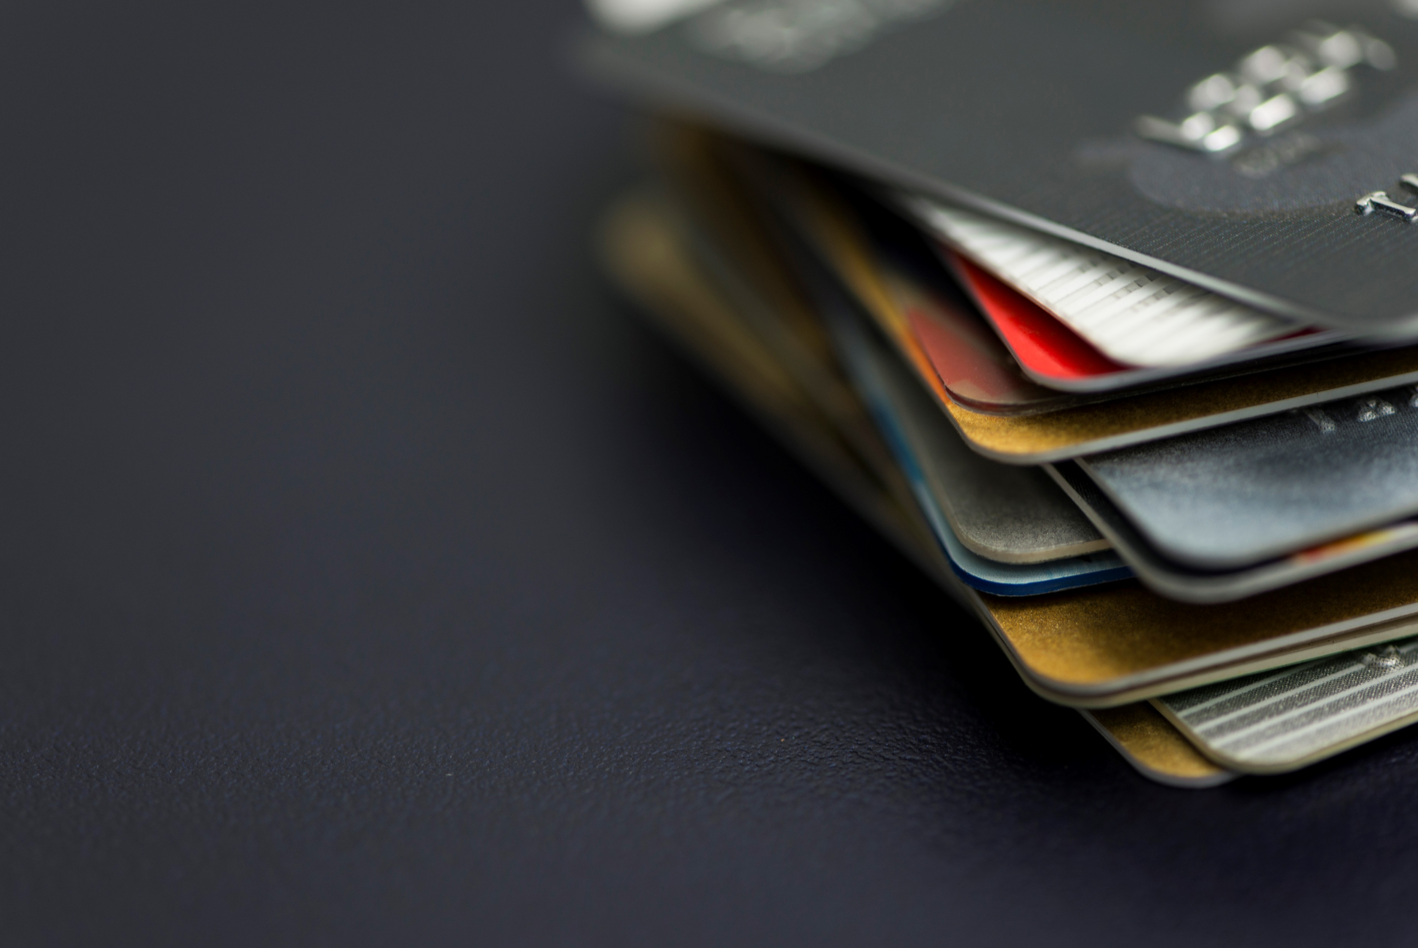
Speaking Cards
https://wordwall.net/resource/79249774

