Slide 1
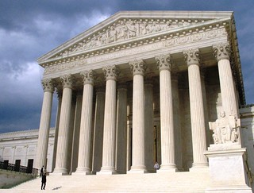
Introduction to Legal Systems: Structure and functions of legal institutions
Created by Iryna Zhukevych
PhD in Pedagogical Sciences
Associate Professor
Це фото; автор: Невідомий автор; ліцензія: CC BY-NC-ND

Slide 2

Introduction to Legal Institutions
Legal institutions: Organized systems and bodies that create, interpret, and enforce laws
• Key components: Courts, legislatures, law enforcement agencies, and regulatory bodies
• Purpose: Maintain social order, resolve disputes, protect rights, and ensure justice
• Importance: Fundamental to the rule of law and democratic governance

Slide 3
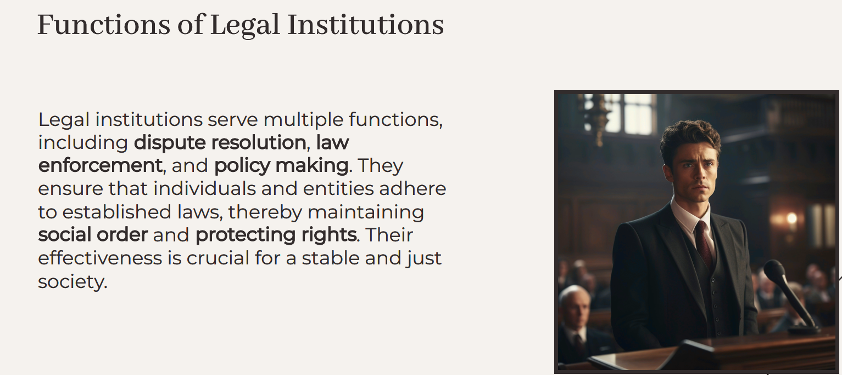

Slide 4

Types of Legal Institutions
Interpret
Courts
• Function: Interpret laws, resolve disputes, and administer justice
• Hierarchy: Supreme Court, appellate courts, trial courts
Create and modify
Legislatures
• Function: Create and modify laws
• Examples: Congress (federal level), state legislatures
Law
Law Enforcement Agencies
• Function: Enforce laws and maintain public order
• Examples: Police departments, FBI, DEA
Oversee
Regulatory Bodies
• Function: Oversee specific sectors and ensure compliance
• Examples: SEC, EPA, FDA

Slide 5
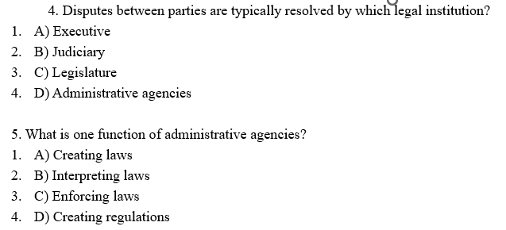
Choose the correct answer from the choices for each question.
Which institution is primarily responsible for interpreting the law?
  A) Legislature
  B) Executive
  C) Judiciary
  D) Administrative agencies
What is the main role of the legislature?
  A) Enforce the law
  B) Interpret the law
  C) Create laws
  D) Adjudicate disputes
Which branch of government is tasked with enforcing laws?
  A) Legislative
  B) Executive
  C) Judicial
  D) Administrative

Slide 6
Answer the following questions
Explain the role of the judiciary in maintaining the rule of law.
Discuss how legislatures contribute to the legal system.
Describe how administrative agencies influence public policy through regulations.

Slide 7
Fill in the blanks with the correct words from the word bank. courts secure justice responsibilities obligation enforcement endeavors legislative
What is the Legal System?
The legal system includes rules, procedures, and institutions by which public initiatives and private (1) … can be carried out through legitimate means. In other words, it is a system for interpreting and enforcing the laws. It elaborates the rights and (2) … in a variety of ways. Jurisdiction’s basis of applying law consists of a constitution, written or oral; primary legislation, statutes, and laws; authorized by constitutionally authorized (3) …. body; primary legislation approved body enacts subsidiary laws or bylaws; traditional practices upheld by the (4) …; Civil, common, Roman, or other code of law as source of such principles or practices. Most of us acknowledge the importance of the legal system in our society. As members of a community, we have a social (5) … to the people around us to create a safe environment for everyone and make us feel (6) … walking the streets and dealing fairly with one another. However, though we abide by these laws and rules each day, we are not the ones responsible for their (7) …, whether we choose to break or follow the law, is up to each person and enforcement falls into the hands of the criminal (8) … system.

Slide 8
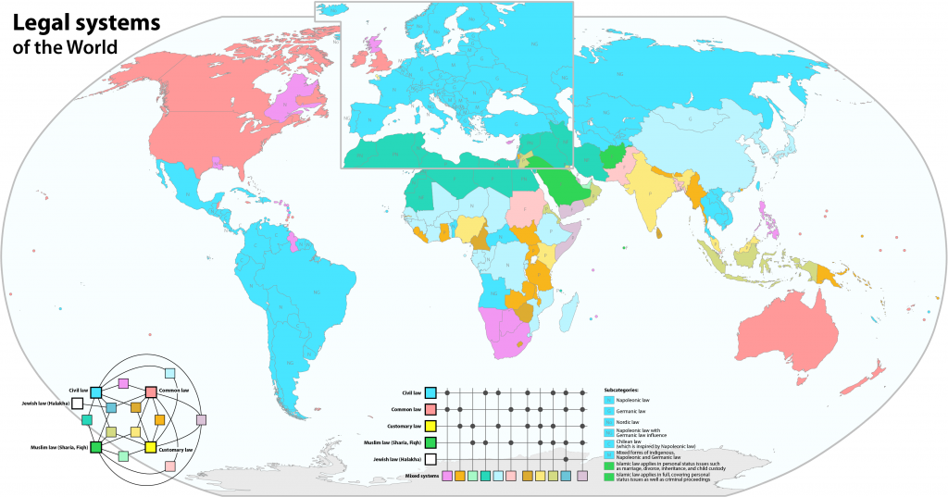
Watch the video “The Legal Systems we live in today”
https://www.youtube.com/watch?v=xaJuFbtuK7E
Це фото; автор: Невідомий автор; ліцензія: CC BY-SA

Slide 9
Decide if the sentence is true or false.
The department store owner expressed a great deal of concern for the person who was hit by the roof tile.
In Civil Law systems, judges look for comparable past cases to decide current cases.
The German Civil Code holds building users responsible for maintaining the structure.
The judge in the Anglo-American legal system evaluates cases based on written codes rather than precedents.
The principle of "stare decisis" in Common Law requires judges to follow past decisions.
In the US, a judge cannot rule in favor of a plaintiff unless negligence is proven.
The judge in a Civil Law system uses a method known as subsumption to apply general rules to specific cases.
The video suggests that both legal systems have equal effectiveness and there is no preference for one over the other.
The video encourages viewers to share their thoughts on which legal system they believe is superior.
The department store operator would be liable if all legal elements were fulfilled under Civil Law.

Slide 10

Speaking Cards
https://wordwall.net/resource/80939956/structure-and-functions-of-legal-institutions
Це фото; автор: Невідомий автор; ліцензія: CC BY-SA-NC

