Slide 1

BUSINESS WRITING
Гаєва Поліна Олександрівна
Рік: 2025

Slide 2
PURPOSE
READER
CONTENT

Slide 3
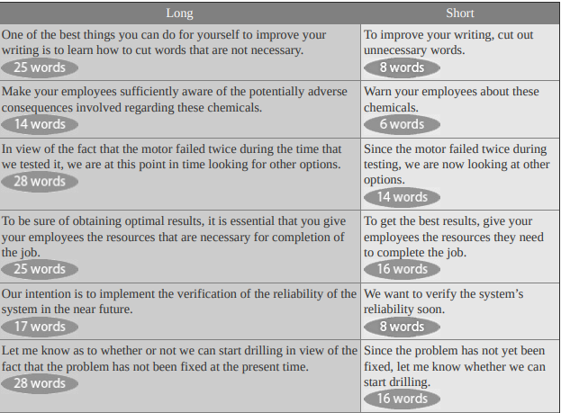
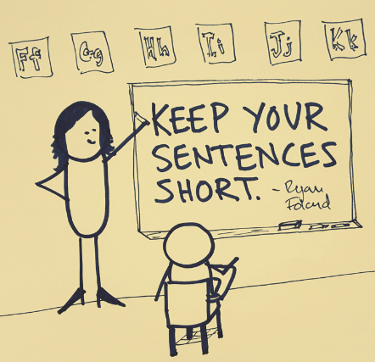
Keep your sentences short

Slide 4
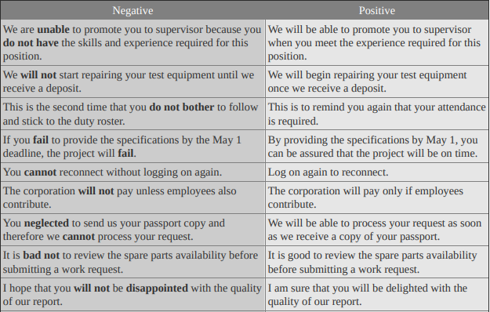
Use Positive Language

Slide 5

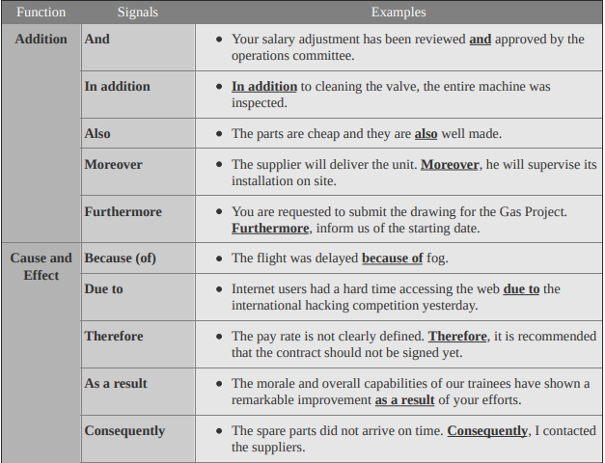
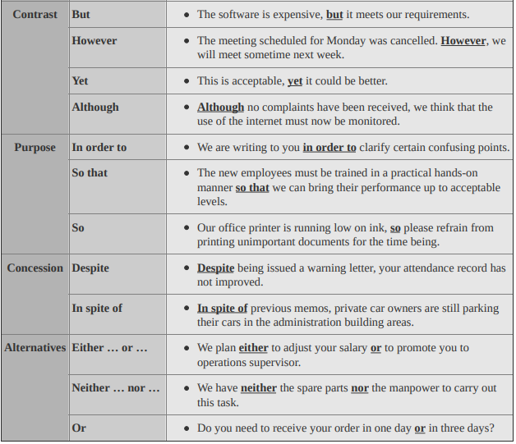
use

Slide 6
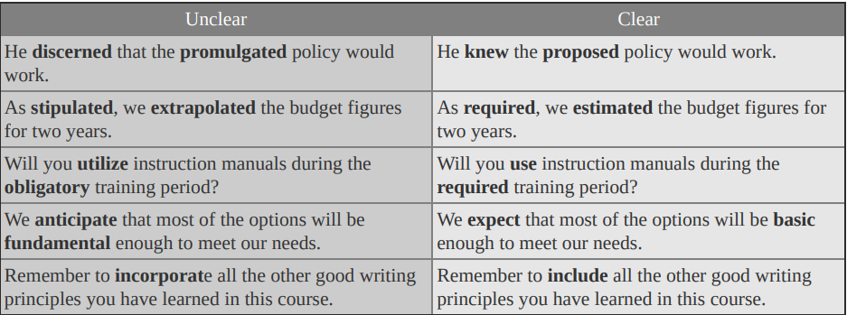

Use simple, familiar words

Slide 7
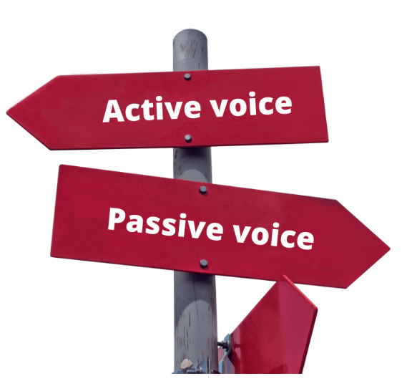
Use the Passive Voice for Specific Reasons
1. Use the passive voice when you do not want to identify who performed the action.
Smoking is prohibited.
A new safety policy was introduced after the accident.
The new offices were decorated last week
2. Use the passive voice to describe a mistake to avoid blaming anyone in particular.
Profits are down by 2%. The incident rate in ABC Field is increasing dramatically this year compared to last year
3. Use the passive voice when you don’t know who carried out the action.
Three computers were stolen from the training center.
The training room was left unlocked.
The briefcase was stolen at the airport terminal.

Slide 8
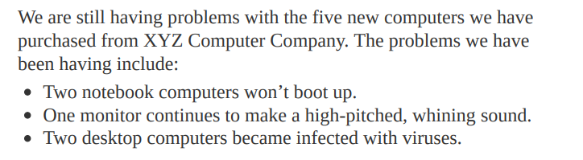
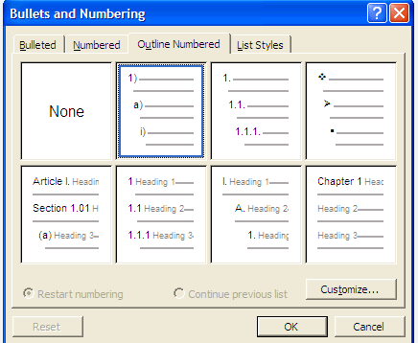
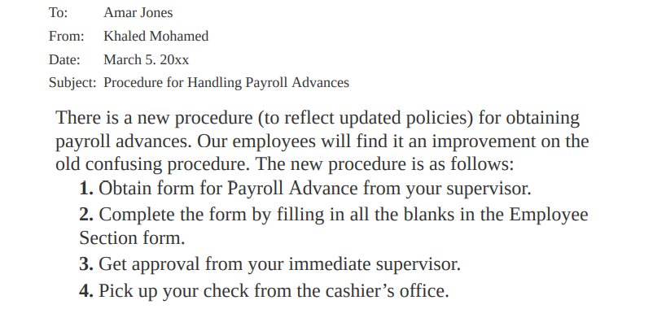
Use Bullet Points and Numbered Lists Correctly

Slide 9
Put lists of items in parallel form
Weak List | Improved List
I left my job for several reasons: Long hours Poor pay I found the work tedious Equipment was dangerous | I left my job for several reasons: Long hours Poor pay Tedious work Dangerous equipment

Slide 10
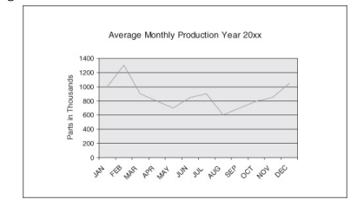
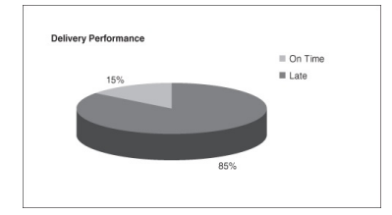
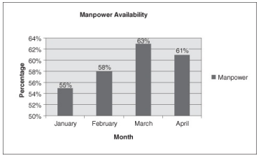
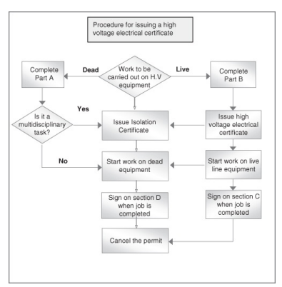
Use Tables and Charts Effectively
line chart
pie chart
bar chart
flow chart

Slide 11
Use impersonal style when expressing opinions
PERSONAL STYLE | IMPERSONAL STYLE
I believe a bonus for our employees should be based on employees’ performance. | The bonus for our employees should be based on employees’ performance.
I expect that the use of computers will make it easier to compile our monthly production report. | The use of computers will make it easier to compile our monthly production report
I feel certain that the new plan is better than the old method. | The new plan is better than the old method for the following reasons:
I think that by taking this course, it will help improve my writing skills. I know that I will learn how to use skills that are good to know in any job. | This course should improve my writing skills, teaching me skills that are good to know in any job.

Slide 12
Avoid Outdated Expressions
Instead of this … | Try this …
Please send your comments not later than (date). | Please send your comments by (date).
Please find attached herewith … | Attached is …
As per your request … | As requested …
We are hereby acknowledging receipt of your order … | We received your order …
Please be good enough to advise me … | Please let me know …

Slide 13
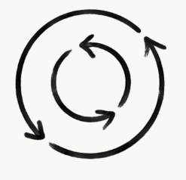
Avoid Repetition
Repetition | Without Repetition
I think the reason why Lucas has been promoted to operations manager is because of his performance. | Lucas has been promoted to operations manager because of his performance.
I ask the question whether trainees can attend the gas turbine course | I ask whether trainees can attend the gas turbine course.
Each individual operator will receive a bonus for completing the task on time | Each operator will receive a bonus for completing the task on time.
Our Human Resources department is planning in advance a meeting to review the effectiveness of the new appraisal system | Our Human Resources department is planning a meeting to review the effectiveness of the new appraisal system.

Slide 14
Avoid Turning Verbs Into Nouns
NOUN FORM | VERB FORM
give instructions to | instruct
make a classification | classify
carry out an investigation of | investigate
perform an assessment | assess
make an observation | observe
conduct a review of | review
The police conducted an investigation into the matter. = The police investigated the matter.
Our intention is to perform an audit of the records of the program. = We intend to audit the program.
Take into consideration the cost of maintaining the data. = Consider the cost of maintaining the data

Slide 15
SUMMARY
1. Keep your purpose, readers and content in mind
2. Keep your sentences short
3. Use positive language
4. Use linking words
5. Use simple, familiar words
6. Use the passive voice for specific reasons
7. Use bullet points and numbered lists correctly
8. Use tables and charts effectively
9. Use impersonal style when expressing opinions
10. Avoid outdated expressions
11. Avoid repetition
12. Avoid turning verbs into nouns

Slide 16
Original
MEMORANDUM
To: All Employees
From: Security Manager
Date: June 4, 20xx
Subject: Company visitors’ procedures
It has recently come to my attention that there are visitors to the Company who present themselves anywhere or to anyone they choose.
It is very important that all visitors check with the receptionist on the 1st Floor. The receptionist will contact the employee that the visitor has come to see, and the employee will go to the reception area to escort their visitor. There should be no unescorted visitors walking through the Company.
If you have questions, please do not hesitate to contact me.
Regards,
Hajar Jassim
Security Manager

Slide 17
Revised
MEMORANDUM
To: All Employees
From: Security Manager
Date: June 4, 20xx
Subject: Company visitors’ procedures
In order to protect the company’s security as well as the safety of all staff, please follow these procedures for handling visits to the main office:
Advise visitors to report to the receptionist on the 1st Floor.
Accompany the visitor to and from the reception and meeting area.
Your co-operation in maintaining the high level of professionalism in our office is greatly appreciated.
Regards
Hajar Jassim
Security Manager

Slide 18
Original
MEMORANDUM
To: All Employees
From: Plant Manager
Date: May 15, 20xx
Subject: New Bus Schedule
For all employees who must travel back and forth between the airport and the production plant, we have developed a new bus schedule.
Two buses will operate beginning June 16. One bus will leave the main gate of the airport and another will leave the main gate of the production plant at 8:30 each morning. They will leave each plant every 20 minutes thereafter.
The afternoon schedule will begin at 1:20 p.m., and the last bus will leave at 4:20 p.m. Note that no buses will leave between noon and 1 p.m.
Regards,
Hajar Jassim
Plant Manager

Slide 19
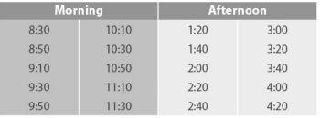
Revised
To: All Employees
From: Plant Manager
Date: May 15, 20xx
Subject: New Bus Schedule
Whom Does It Concern
The new bus schedule affects all employees who must travel back and forth between the airport plant and the production plant.
Effective Date
Two buses will operate beginning June 16.
Bus Timings
The following table shows the bus-timing schedule for both buses
leaving the main gates of each plant as follows:
Note: No buses will leave between noon and 1 p.m. and the last bus will leave at 4:20 p.m.
Regards,
Hajar Jassim
Plant Manager

Slide 20
Original
MEMORANDUM
To: Project Manager
From: Electrical Engineer
Date: June 4, 20xx
Subject: Appreciation letter for Gas Project Team
Some of my colleagues have received a letter of appreciation for the above project. I was very surprised to see my name not included in the lists, as I have been contributing not only to enhance company objectives, but also to pay close attention to work being safely performed during this project.
I therefore feel very upset as my input in the above mentioned project was not considered.
This type of unfairness leads to demoralization of employees and goes against companies benchmarking in creating a healthy environment and boosting employee moral.
I am looking forward to your decision.
Regards,
Yassin Ali
Electrical Engineer

Slide 21
Revised
MEMORANDUM
To: Project Manager
From: Electrical Engineer
Date: June 4, 20xx
Subject: Appreciation letter for Gas Project Team
It has been noted that some employees involved in the Gas project have not been acknowledged.
Obviously, such practice is contrary to company guidelines as they relate to the employees’ motivation scheme. Unfortunately, any perceived unfairness may well create an unhealthy environment among the employees.
Your reply in this matter would be much appreciated.
Regards,
Yassin Ali
Electrical Engineer

Slide 22
Original
MEMORANDUM
To: Mike Hansen
From: Mohamed Afeef
Date: June 4, 20xx
Subject: Attendance Notice
Your work has been excellent. However, your absence record is now overruling your work record. We have difficulty scheduling when we cannot depend on your attendance. We have discussed this subject with you several times before. Now your attendance must meet our requirements or we will have to issue a warning letter if we do not see immediate improvement.
Your adherence to the above is appreciated.
Mohamed Afeef
Senior Project Engineer

Slide 23
Revised
MEMORANDUM
To: Mike Hansen
From: Mohamed Afeef
Date: June 4, 20xx
Subject: Attendance Notice
This is to remind you that your absence record has affected the manpower availability and as a result your colleagues are unable to schedule their duty roster.
Therefore, you are requested to meet the operations requirements. A warning letter will be issued to you if we do not see immediate improvement.
Your adherence to the above is appreciated.
Mohamed Afeef
Senior Project Engineer

Slide 24
Original
MEMORANDUM
To: Plant Manager
From: Mechanical Engineer
Date: June 4, 20xx
Subject: Salary Adjustment Request
I am writing to you to request an increase in my monthly salary. I feel this letter is necessary because I have not been offered an increase over the last five years.
I feel that I am an asset to the company. I believe I have performed all my required duties and others to the best of my ability. The skills I provide are valuable, and I’m sure you’ll agree, they are an essential part of the running of this business.
I am looking forward for your approval and appreciate your comments.
Regards,
Khalid Afeef
Mechanical Engineer

Slide 25
Revised
MEMORANDUM
TO: Plant Manager
From: Electrical Engineer
Date: June 4, 20xx
Subject: Salary Adjustment Request
This is to request an adjustment to my monthly salary since I have not been offered an increase for the past five years.
My personal contribution toward enhancing the productivity of this
department is attached for your information.
Your approval in this matter would be much appreciated.
Khalid Afeed
Electrical Engineer

Slide 26
Original
To All Employees
CC Leadership team
Subject Misuse of E-mail Privilege
We all like to send and receive e-mails, but personal mailings use up too much time and are a distraction from our work.
Therefore, all employees are requested to refrain from using their company e-mail account for personal mail. Those employees who continue to abuse their e-mail privilege will have their accounts revoked.
Remember that the account was given to you to make your job easier by facilitating quick contact with business associates, not to make it possible to communicate with family and friends.
Please respect your e-mail privilege and don’t abuse it, otherwise you risk having your access to e-mail suspended.
Regards,
Ali Salem
IT Manager

Slide 27
Revised
To All Employees
CC Leadership team
Subject Misuse of E-mail Privilege
It has been observed that some employees have taken advantage of their company e-mail by sending non-business messages to a large group of users.
This practice is unacceptable in our environment and disciplinary action will be taken against anyone found misusing his or her e-mail.
Your co-operation would be greatly appreciated.
Regards,
Ali Salem
IT Manager

Slide 28
Original
MEMORANDUM
To: Transport Manager
From: Transport Officer
Date: October 10, 20xx
Subject: Short-term hire of buses
I’d like to tell you that we are having a bit of engine trouble with our buses at the moment and I’m afraid they’ll almost definitely be off the road for a week or so. What I want to say is quite a problem for us because I’ll need the buses next Wednesday.
So, I think the best way to get round this problem is for us to hire the same sort of bus for the time being just until our mechanics can get our buses back on the road.
Can you tell me if you think this idea is OK?
Ivan Naser
Transport Officer

Slide 29
Revised
MEMORANDUM
To: Transport Manager
From: Transport Officer
Date: October 10, 20xx
Subject: Short-term hire of buses
Both buses used to transport passengers between the company head office and the fields are currently under repair due to engine problems. They are likely to be out of service for at least a week.
Therefore, it is recommended that two similar buses be hired temporarily until our vehicles are roadworthy again.
Your approval would be appreciated.
Ivan Naser
Transport Officer

Slide 30
Original
To requests@abc.com
Subject: Car Loan Request
Attachment Car Loan Application Form
Please find attached herewith the car loan application form pursuant to your request.
Please complete the attached form and forward to the undersigned latest by July 10, 20xx in order to complete the processing formalities.
Regards,
Mohamed Hamdi
Human Resources Coordinator

Slide 31
Revised
To requests@abc.com
Subject: Car loan request
Attachment Car loan application form
Attached is the car loan application form as requested.
Please complete the attached form and send it to me before July 10, 20xx.
Regards,
Mohamed Hamdi
Human Resources Coordinator

Slide 32
Original
To: mhamad@abc.com
Subject: English Language Training Proposal
Dear Hamad,
As requested, I have attached a proposal 4 your employees 2 come & study business communication @ Zayed University.
I will get in touch with you shortly 2 discuss about your requirements for a custom programme.
Regards,
Hajar Khaled
Training Coordinator

Slide 33
Revised
To: mhamad@abc.com
Subject: English Language Training Proposal
Dear Hamad,
As requested, I have attached a proposal for your employees to come and study business communication at Zayed University.
I will get in touch with you shortly to discuss about your requirements for a custom programme.
Regards,
Hajar Khaled
Training Coordinator

