Slide 1

Introduction to Governance: Policy-making processes
Created by Iryna Zhukevych
PhD in Pedagogical Sciences
Associate Professor

Slide 2

Definition: Policy-making is the process by which governments, organizations, or institutions develop strategies, plans, or courses of action to address specific issues or achieve certain goals.
Importance: Shapes societal outcomes, allocates resources, and addresses public concerns
Key players: Elected officials, bureaucrats, interest groups, experts, and citizens

Slide 3

The Policy Making Process
https://www.youtube.com/watch?v=aLUbviQoef8
1. What is the policy-making process and why is it important for public policies?
2. Define the term "political agenda" and provide examples of issues that may be included in it.
3. Explain the difference between costs and benefits in the context of public policy. Provide examples for each.
4. Describe the five types of public policy mentioned in the video and give a brief explanation of each.
5. What are the steps involved in the policy-making process, and how does agenda-setting initiate this process?

Slide 4
Arrange the following stages of the policy-making process in the correct order
a) Policy formulation
b) Agenda setting
c) Policy evaluation
d) Policy implementation
e) Policy adoption

Slide 5

List three main actors involved in policy-making and briefly describe their roles.
Це фото; автор: Невідомий автор; ліцензія: CC BY-NC-ND

Slide 6

The Policy-Making Process
https://www.youtube.com/watch?v=2YIwuAzu1yM
1. What characterizes the policymaking process according to the video?
a. A centralized approach
b. A focus on interactions among various levels of government
c. A strictly linear sequence of phases
d. Solely the actions of the President
2. Which stage of the policymaking process involves Congress and the President?
a. Administrative stage
b. Legislative stage
c. Evaluation stage
d. Implementation stage
3. What is rulemaking described as in the video?
a. A purely judicial function
b. A quasi-legislative power delegated to agencies
c. A stage that focuses on public opinion
d. An administrative review process
4. What does adjudication involve according to the video?
a. The creation of new laws
b. The application of current laws to specific cases
c. The evaluation of overall policy effectiveness
d. The enforcement of international treaties
5. How are policies put into effect according to the video?
a. Through public opinion polls
b. By meeting program objectives related to them
c. By legislative mandates only
d. Through executive orders alone

Slide 7
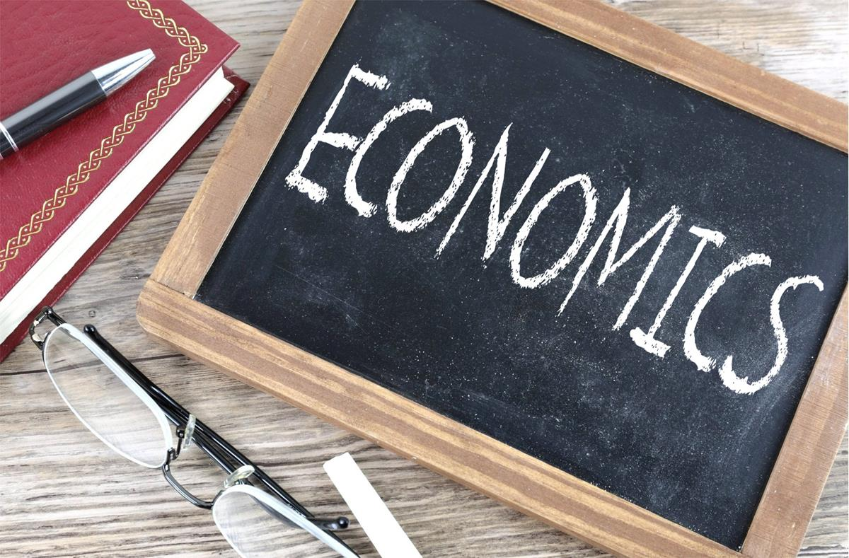
Explain how external factors, such as economic conditions or public opinion, can influence the policy-making process.
Це фото; автор: Невідомий автор; ліцензія: CC BY-SA

Slide 8
Real-world Example Analysis
Choose a recent policy decision in your country and analyze it using the following questions:
a) What was the policy issue?
b) Who were the key actors involved?
c) What factors influenced the decision-making process?
d) How was the policy implemented?
e) What have been the outcomes or impacts of this policy?

Slide 9
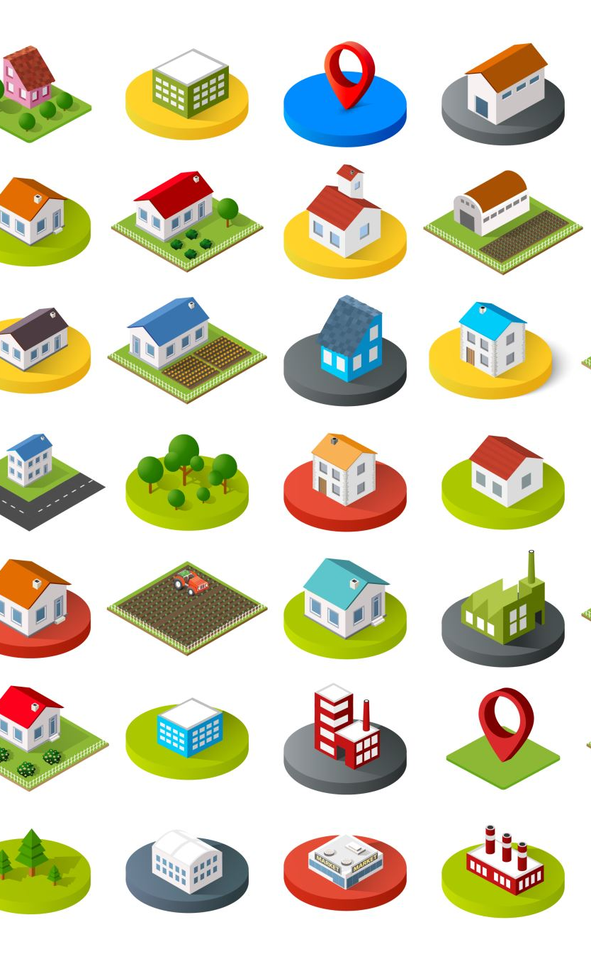
Local Government Policy-Making Process
How Local Government Shapes Public Policy and Affect You
https://www.youtube.com/watch?v=_kUZXTx1oJg
Describe the key functions of local governments.
How do local governments balance local needs with national priorities?
What are the main differences between national and local governments?
Explain the significance of local governments in implementing national public policies. Why are they considered crucial in this context?
Discuss the advantages local governments have that can aid in the successful implementation of national policies.
In what ways can local governments influence national policy-making as described in the video?
Reflect on the relationship between national and local governments. How do they complement each other in the context of public policy development?

Slide 10

Test yourself
https://app.almanack.ai/resources/670fcdaf2f4b217c8b189db4

